Slide 1
Renewable energy

Slide 2
Why should we use renewable energy?
pop quiz…
It can be replenished quickly.
It creates less pollution than nonrenewable energy.
It is easier to use.
A and B.

Slide 3
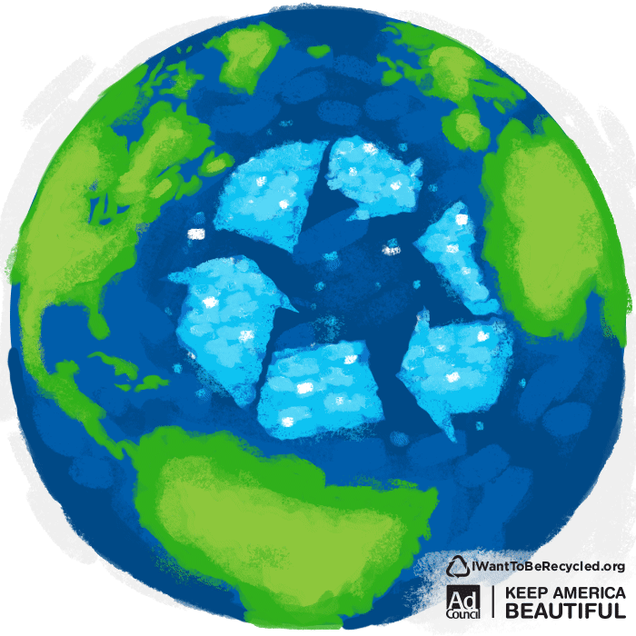
Notes:
Put this slide up while you explain answer to previous question.

Slide 4
What is another terms for renewable energy?
pop quiz…
Better energy.
Dirty energy.
Quick energy.
Clean energy.

Slide 5
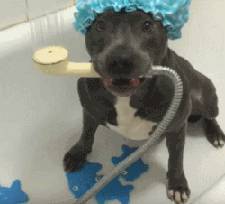
Notes:
Put this slide up while you explain answer to previous question.

Slide 6
A solar panel can produce electricity…
pop quiz…
Anytime the sun is shining, even if it’s cloudy.
Only when it’s a clear, sunny day.
At night.
All the time.

Slide 7
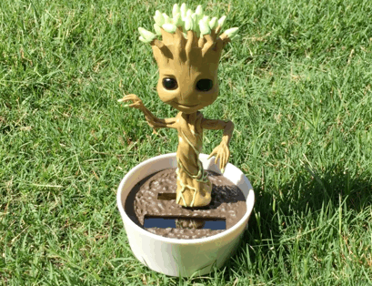
Notes:
Put this slide up while you explain answer to previous question.

Slide 8
True or false? Technology is helping us get better at capturing renewable energy.
pop quiz…
True
False

Slide 9
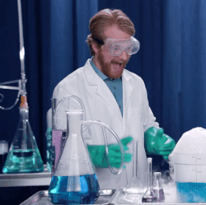
Notes:
Put this slide up while you explain answer to previous question.

Slide 10
Which of the following is not a renewable resource?
pop quiz…
The sun.
Water.
Wind.
Oil.

Slide 11
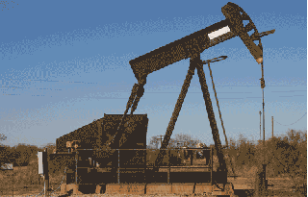
Notes:
Put this slide up while you explain answer to previous question.

Slide 12
what is renewable energy?
Renewable energy is energy derived from a source that can be replenished by nature. Some examples of renewable energy include:

Slide 13
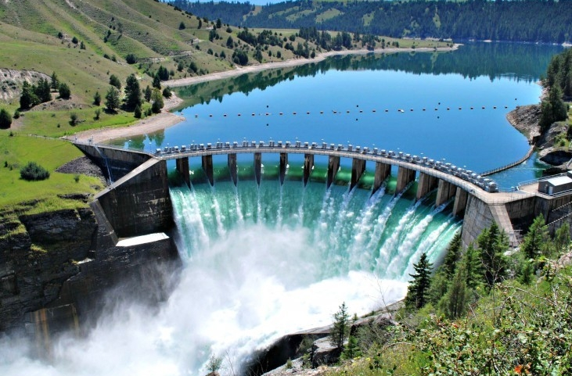
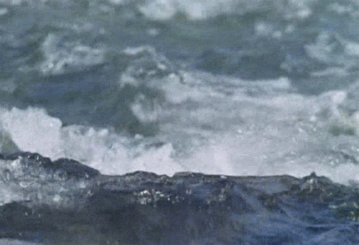
hydropower
Example: A dam (like the Hoover dam).
As water runs through the dam, energy is captured from the water’s movement.

Slide 14
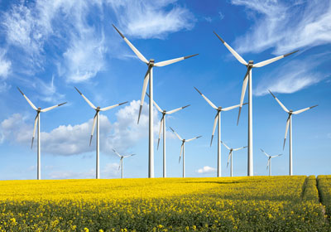
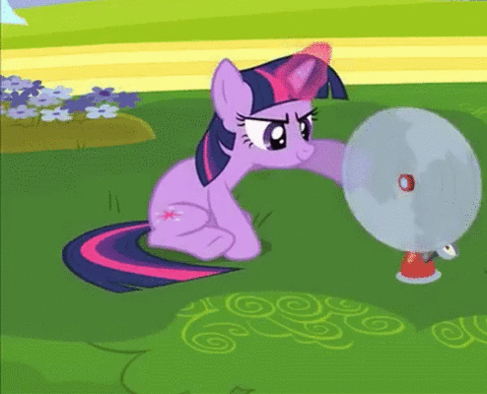
wind
Example: Wind turbines.
It looks like a giant fan but it does the opposite! Instead of using electricity to make wind, wind turns the fan blades to make electricity.

Slide 15
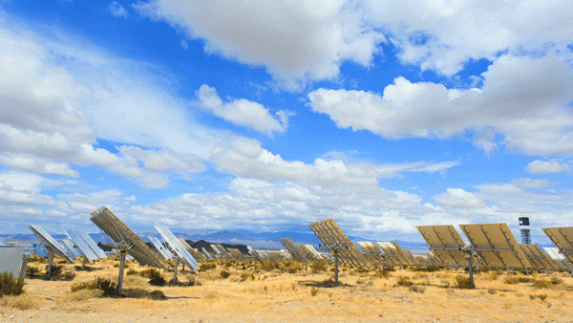
solar
Example: Solar panels
Solar panels capture energy from the sun when the sun shines on them.

Slide 16
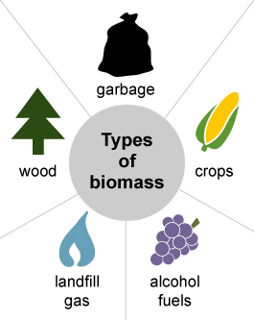
biomass
Organic (natural) material that comes from plants and animals.
Example: Wood, scraps from crops, and even garbage!
Burning biomass can be used to power specialized equipment like tractors and trucks.

Slide 17
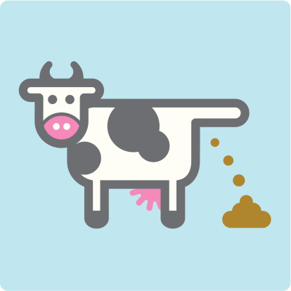
biomass
Manure from cows and other farm animals can also be used as biomass!
yes, really!
Notes:
Ask them if they know what manure is. Then let them all go “ewwwwww” when you tell them it’s poop.

Slide 18
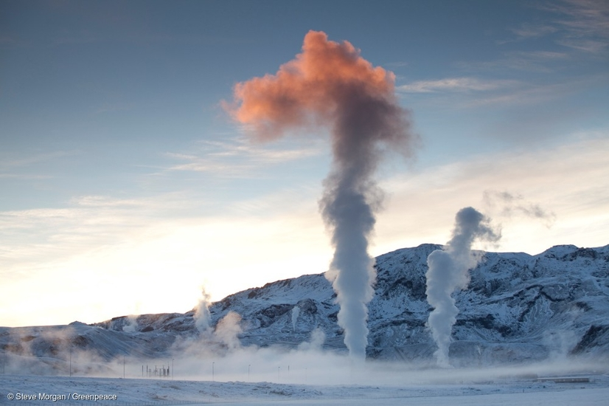
geothermal
Heat from the Earth.
Like the sun, the earth actually makes heat. We can capture this heat and use it to heat homes and buildings.

Slide 19
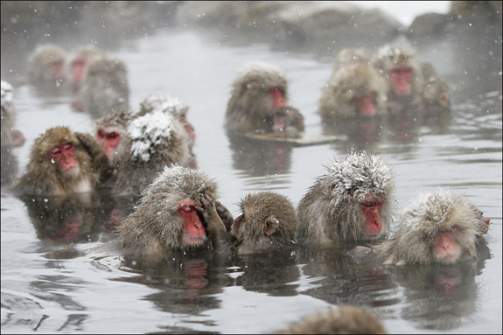
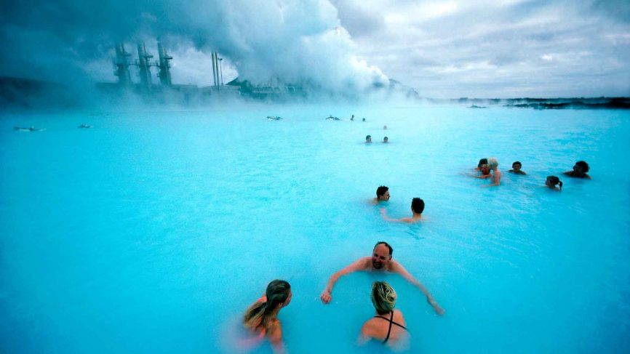
geothermal
Hot springs, like the ones all over Montana are heated by geothermal energy.
Iceland is very famous for its hot springs.
In cold parts of Japan, snow monkeys love to soak in hot springs to warm up!

Slide 20
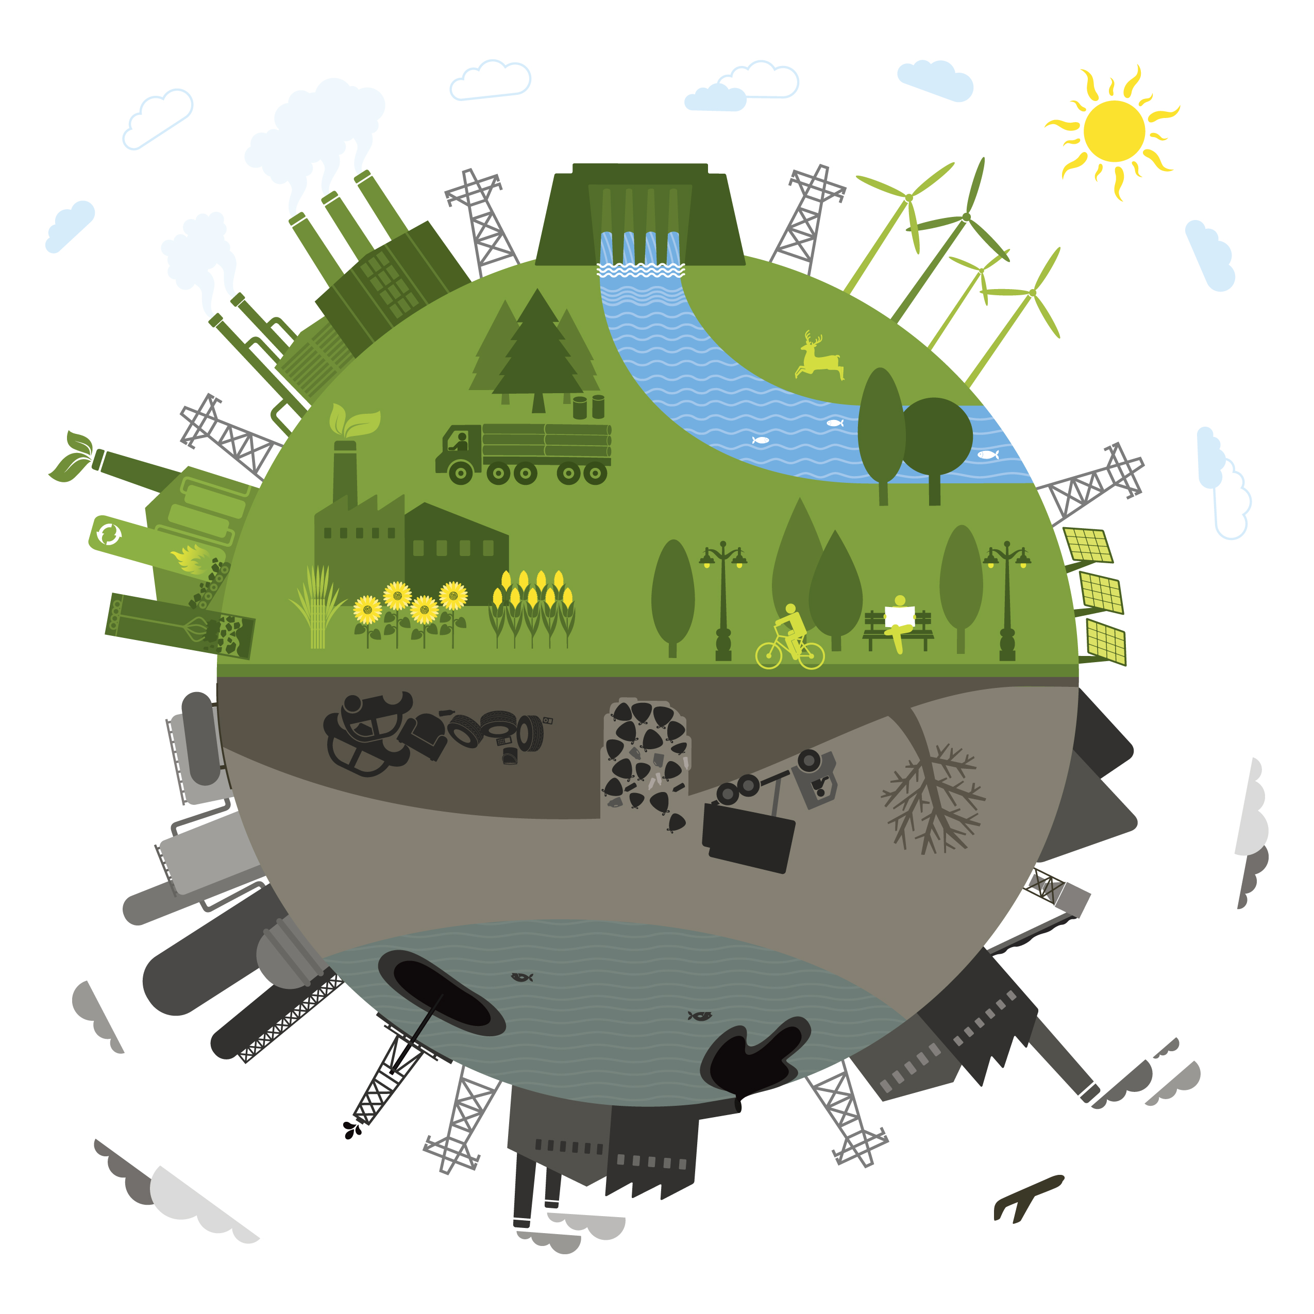
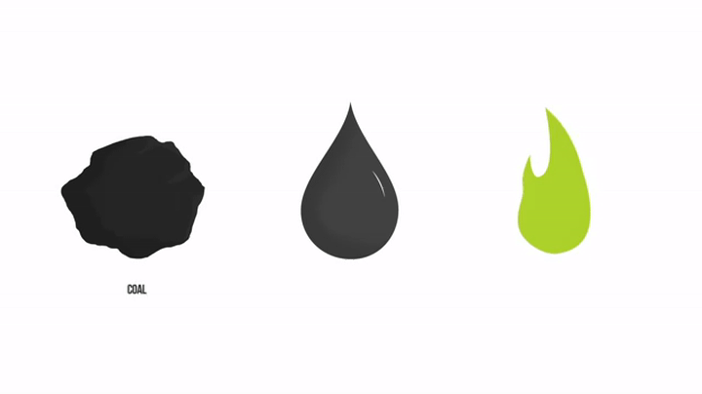
what is renewable energy?
Renewable energy is also called clean energy as creating it doesn’t pollute the environment.
Fossil fuels, like coal, oil, and natural gas are different. There is only so much oil and coal buried in the earth, meaning someday it will run out and we can’t make more.

Slide 21
what is renewable energy?
Fossil fuels also give off pollution, like CO2 and other greenhouse gases, when they are burned.

Slide 22
speaking of fossil fuels….
Did you know some fossil fuels are made from dinosaur bones?

Slide 23
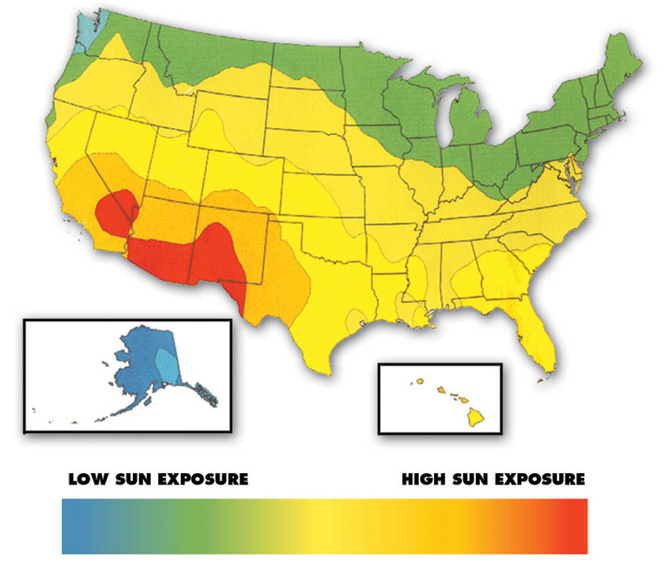
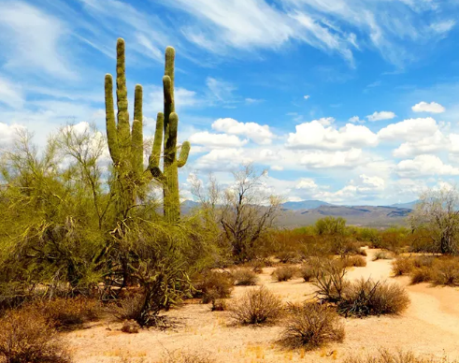
where can we use renewable energy?
Renewable energy can be used in many places around the world in some form or another
For example, if it’s usually pretty sunny where you live, solar power would be a great option.
Notes:
Red=more sun “does anyone know what kind of environment is in the red area?” The desert!

Slide 24
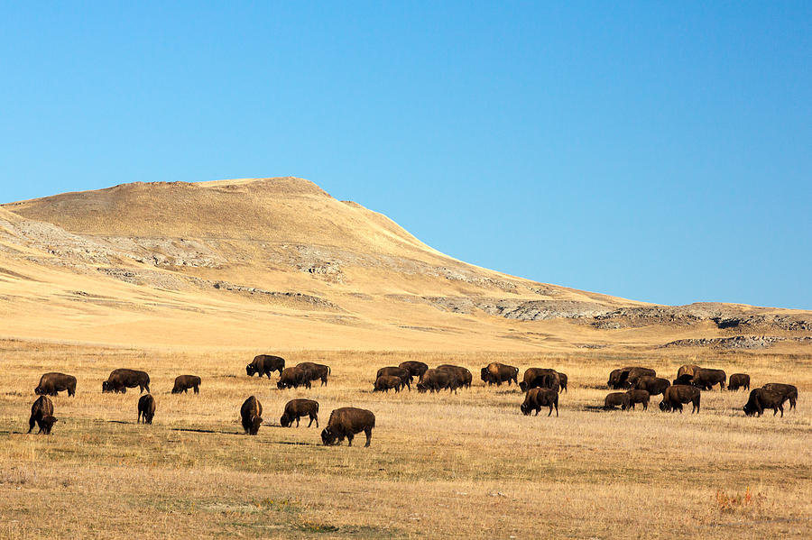
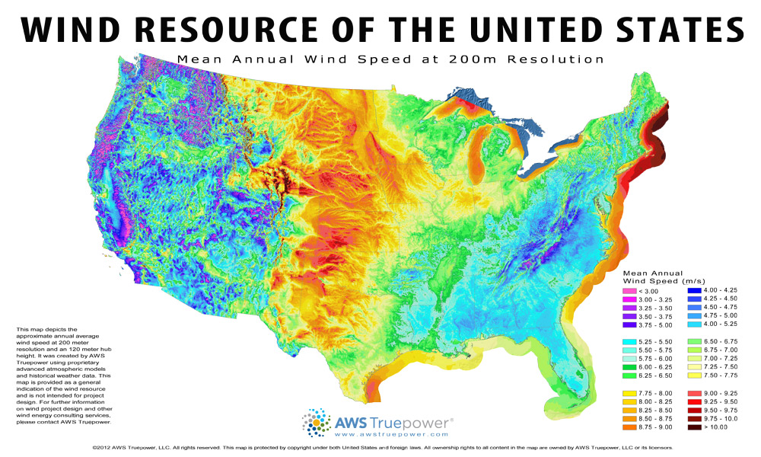
where can we use renewable energy?
Wind is a great option if you live in open, flat regions.
Notes:
Red=more wind. What kind of environment is in the middle of the country? The Great Plains!

Slide 25
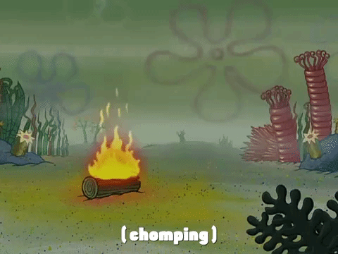
when was renewable energy created?
Some kinds of renewable energy have been around for years!
Did you know burning wood is a renewable energy? That’s been around for a LONG time.

Slide 26
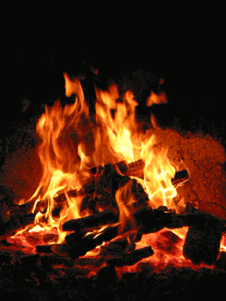
when was renewable energy created?
Today, we have many more options than just burning wood.
We’ve created technology in the form of wind turbines, solar panels, and dams that have made it much easier to capture earth’s energy.
We’ve only really started using renewable energy in the last 20 years or so.

Slide 27
why should we use renewable energy?
Unlike fossil fuels, such as coal and oil, renewable energy won’t run out. It will always be there for us to use.
Doesn’t pollute the environment as much as fossil fuels.

Slide 28
why don’t we always use renewable energy?
We haven’t figured out how to capture and use renewable energy as well as we have with oil and coal. This makes it more expensive for everyone to use.
However renewable energy is becoming cheaper everyday as technology gets better.

Slide 29
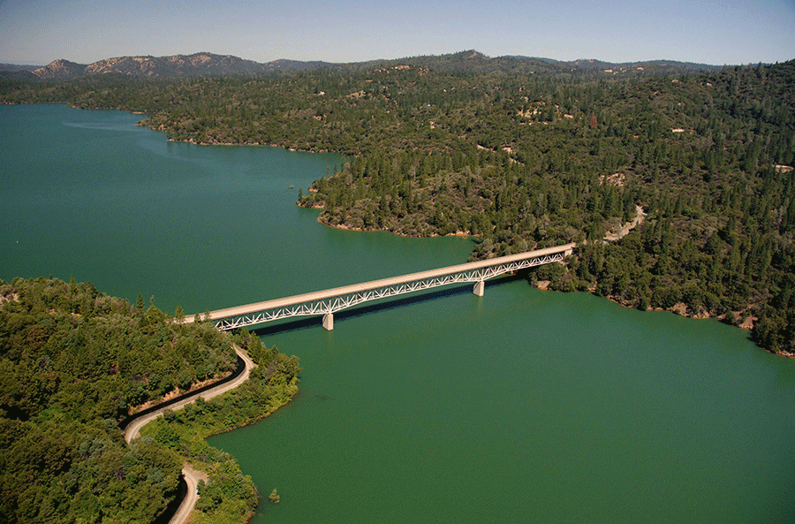
why don’t we always use renewable energy?
Sometimes renewable energy isn’t always available like:
If the sun isn’t shining (nighttime).
Solar panels DO work when it’s cloudy, but they just don’t work as well.
If the wind isn’t blowing.
If a drought is causing a river to dry up.

Slide 30
Why should we use renewable energy?
pop quiz…
It can be replenished quickly.
It creates less pollution than nonrenewable energy.
It is easier to use.
A and B.

Slide 31
What is another terms for renewable energy?
pop quiz…
Better energy.
Dirty energy.
Quick energy.
Clean energy.

Slide 32
A solar panel can produce electricity…
pop quiz…
Anytime the sun is shining, even if it’s cloudy.
Only when it’s a clear, sunny day.
At night.
All the time.

Slide 33
True or false? Technology is helping us get better at capturing renewable energy.
pop quiz…
True
False

Slide 34
Which of the following is not a renewable resource?
pop quiz…
The sun.
Water.
Wind.
Oil.

Slide 35
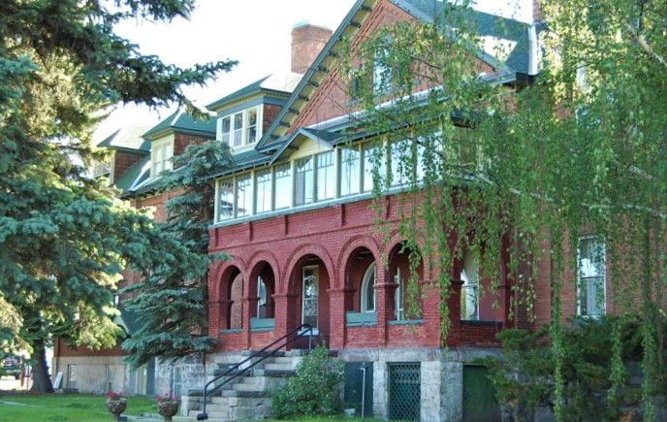
want to learn more?
contact:
name
title
email
(xxx) xxx-xxxx
Our headquarters is located at 3040 Continental Dr. Butte, MT

