Slide 1




intro

Slide 2
pop quiz…
This presentation includes an interactive component using TurningPoint software. You will be asked a series of questions at the start of the presentation and again at the end to help us measure your change in knowledge. Questions are answered by using the remotes handed out.
Let’s do a practice question!

Slide 3
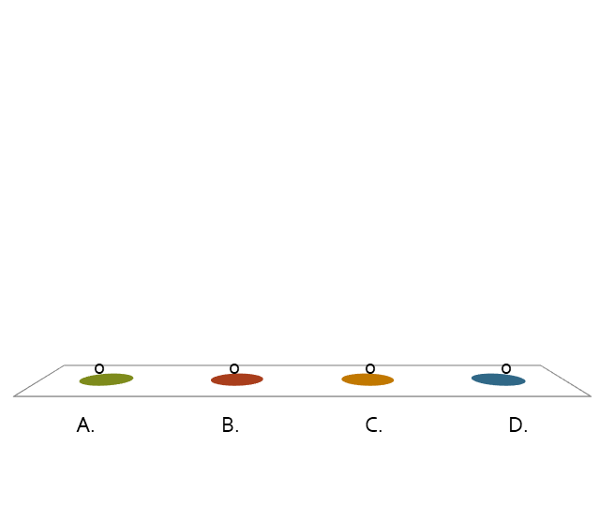
A group of ferrets is called a(n)…
pop quiz…
Fumble.
Pack.
Business.
Enterprise.

Slide 4
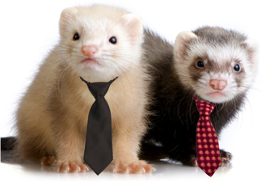

Slide 5
Recycling!

Slide 6
Which is a benefit of recycling?
pop quiz…
Recycling reduces pollution.
Recycling conserves natural resources.
Recycling saves money.
All of the above.

Slide 7
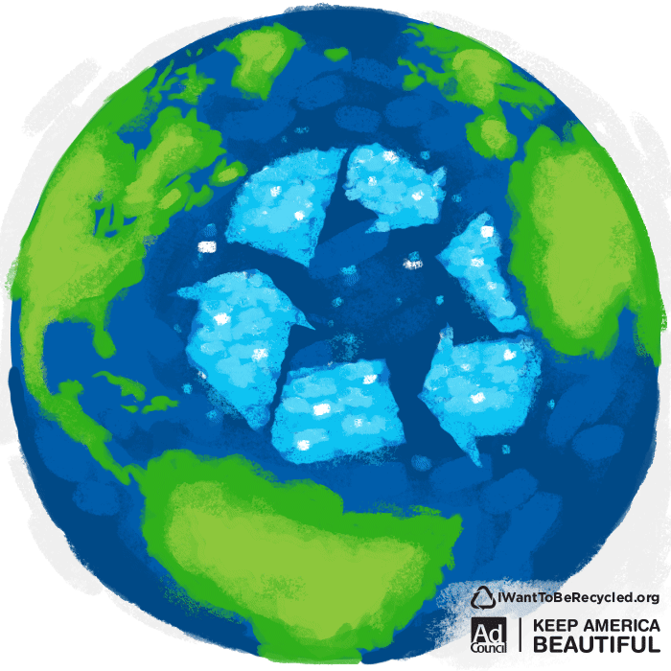
Notes:
Put this slide up while you explain answer to previous question.

Slide 8
What are the three Rs?
pop quiz…
Renew, Restart, Recycle.
Reduce, Reuse, Recycle.
Reduce, Redo, Rihanna.
Reduce, Rinse, Repeat.

Slide 9
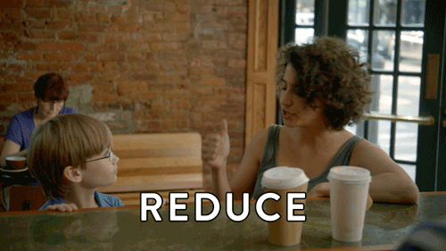
Notes:
Put this slide up while you explain answer to previous question.

Slide 10
Which of these items helps reduce waste?
pop quiz…
Reusable water bottle.
Reusable tote bag.
Recycling bin.
All of them.

Slide 11
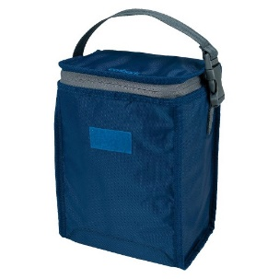
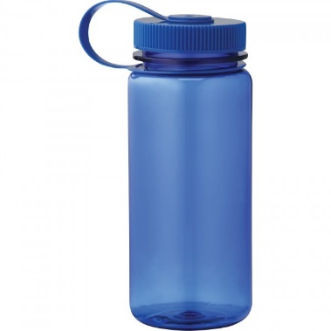

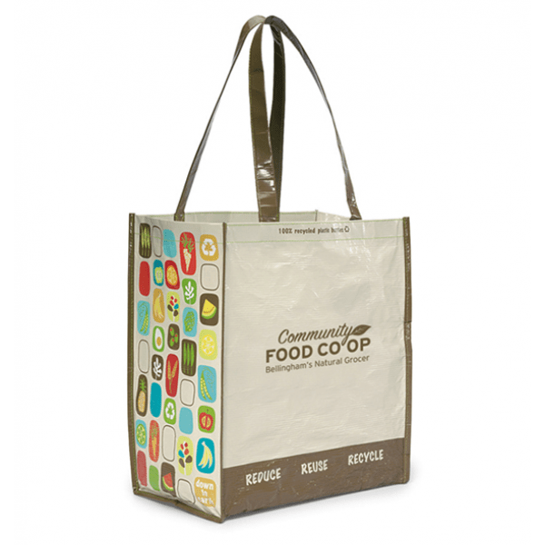
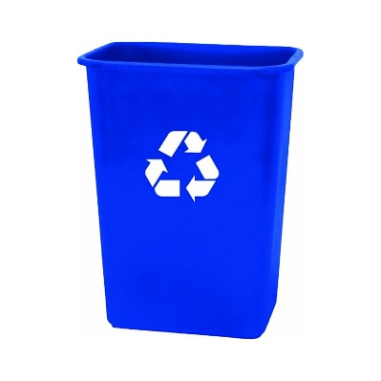
Notes:
Put this slide up while you explain answer to previous question.

Slide 12
Which of these can not be recycled?
pop quiz…
Candy wrappers.
Plastic water bottle.
Smartphone.
Cardboard box.

Slide 13
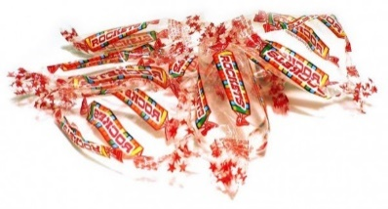

Notes:
Put this slide up while you explain answer to previous question.

Slide 14
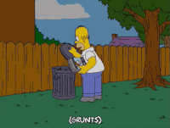
what is waste?
Waste is anything that we throw away that doesn’t get used.

Slide 15
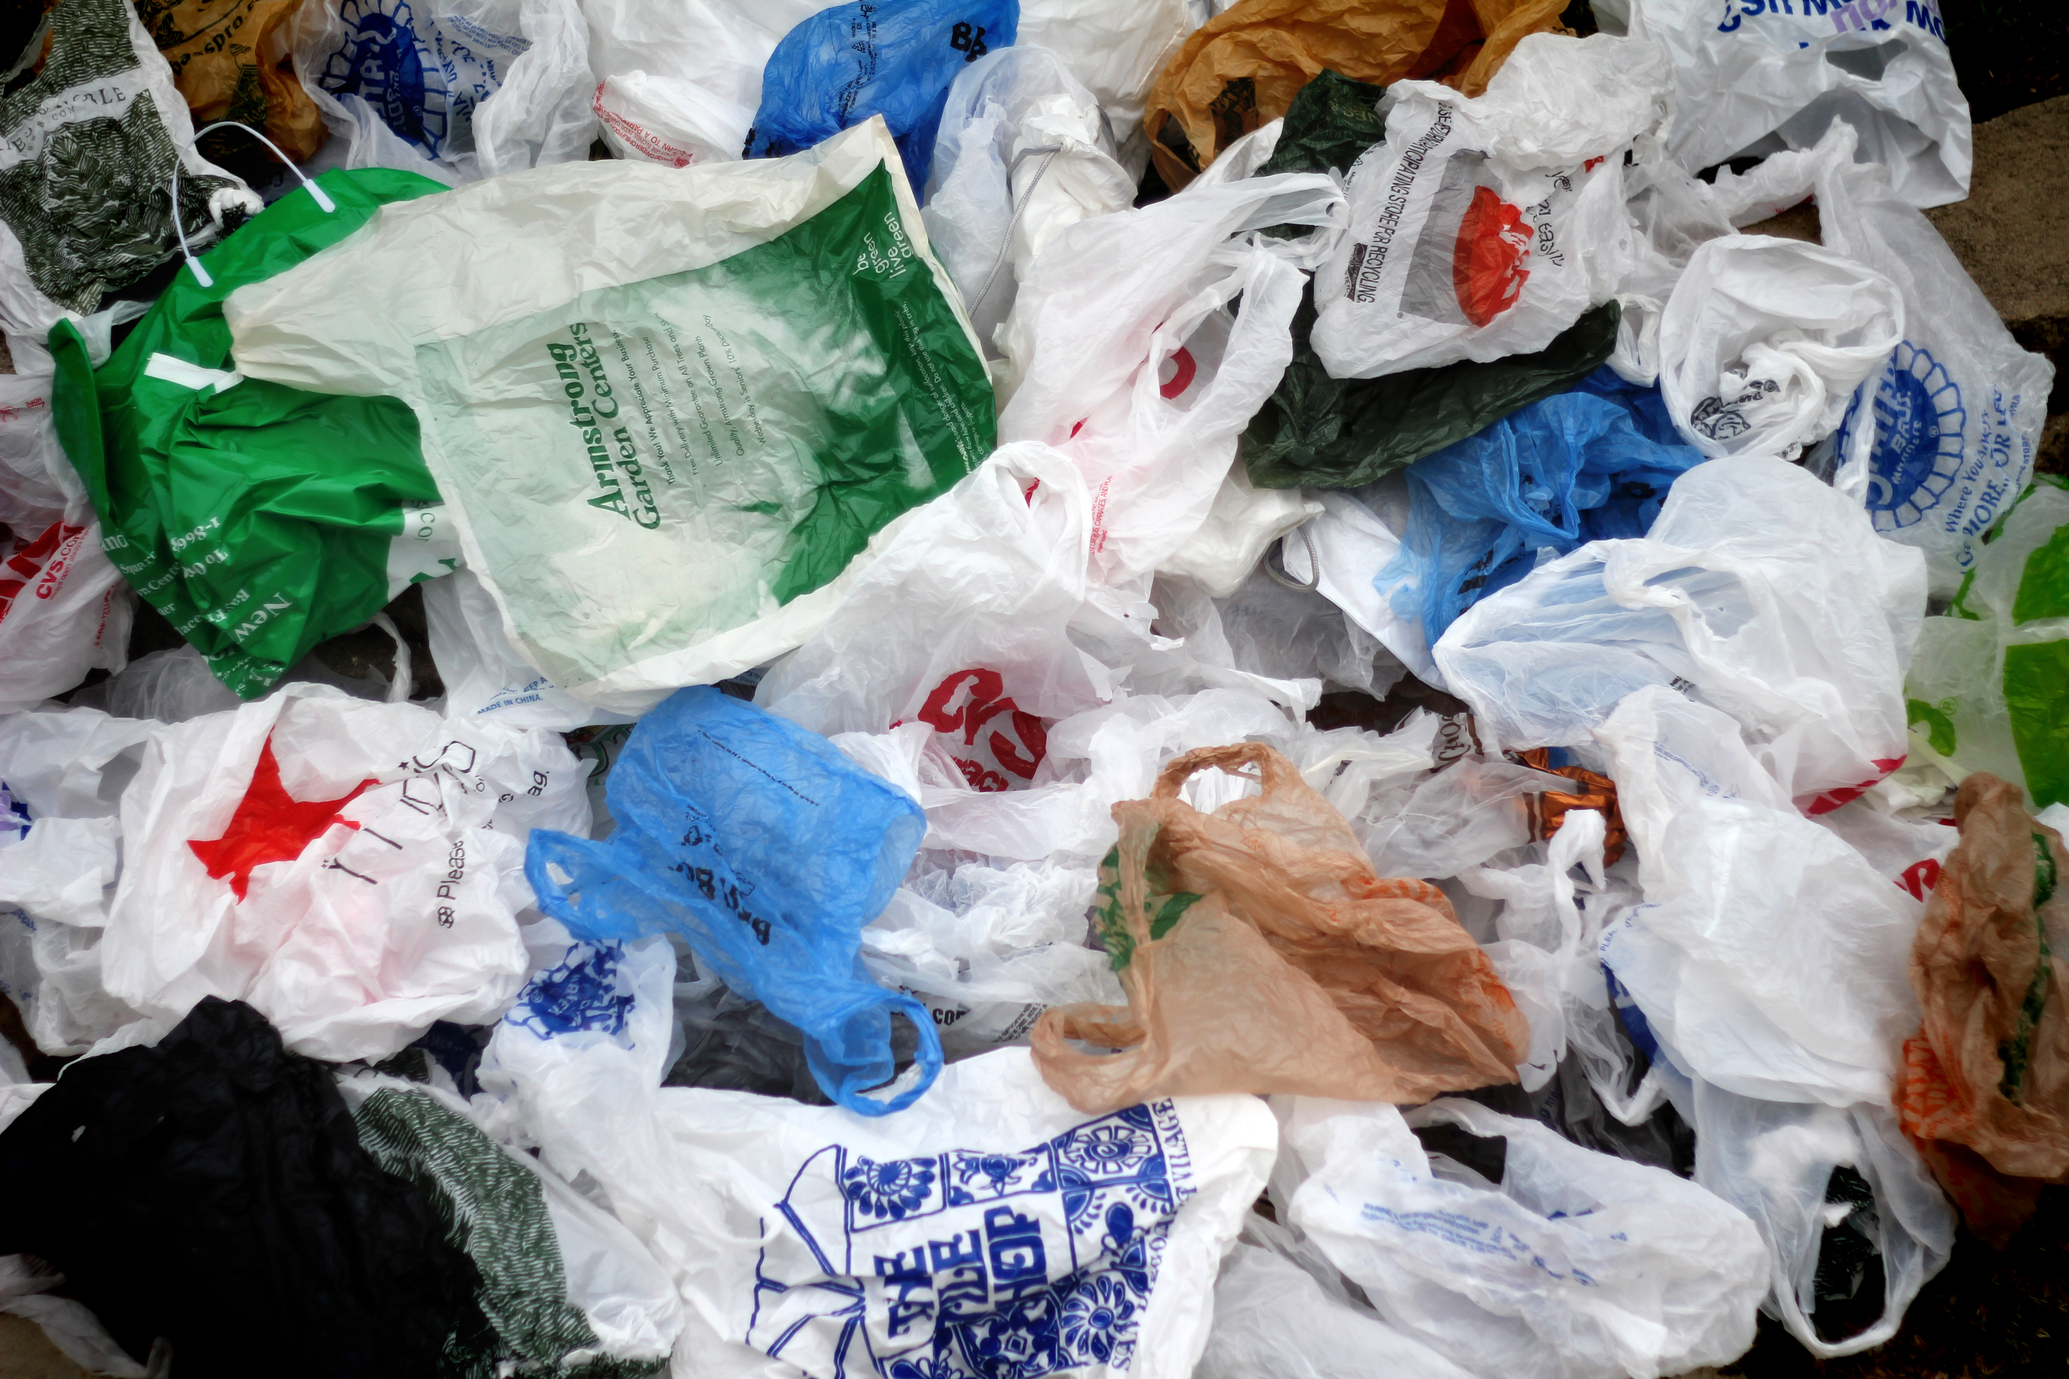
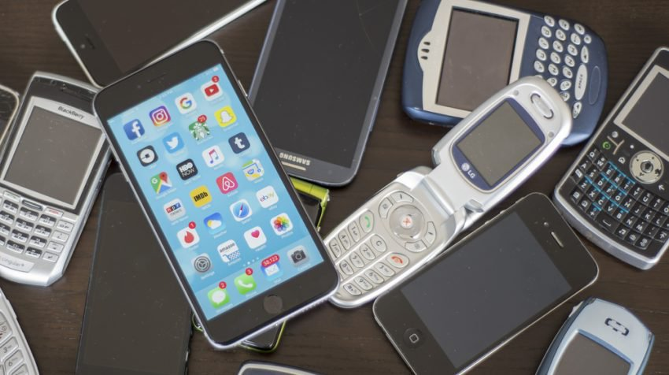
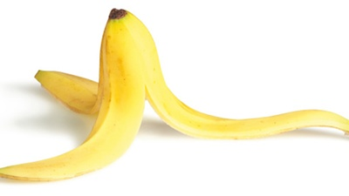
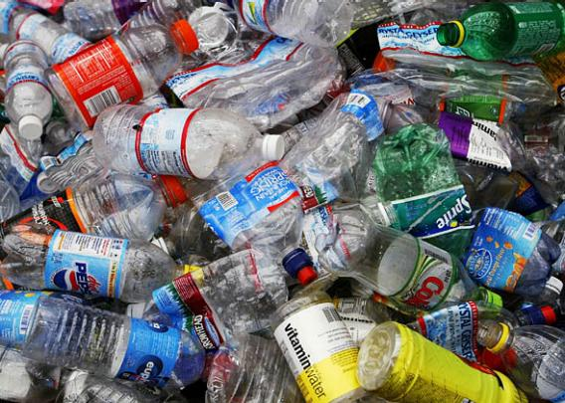
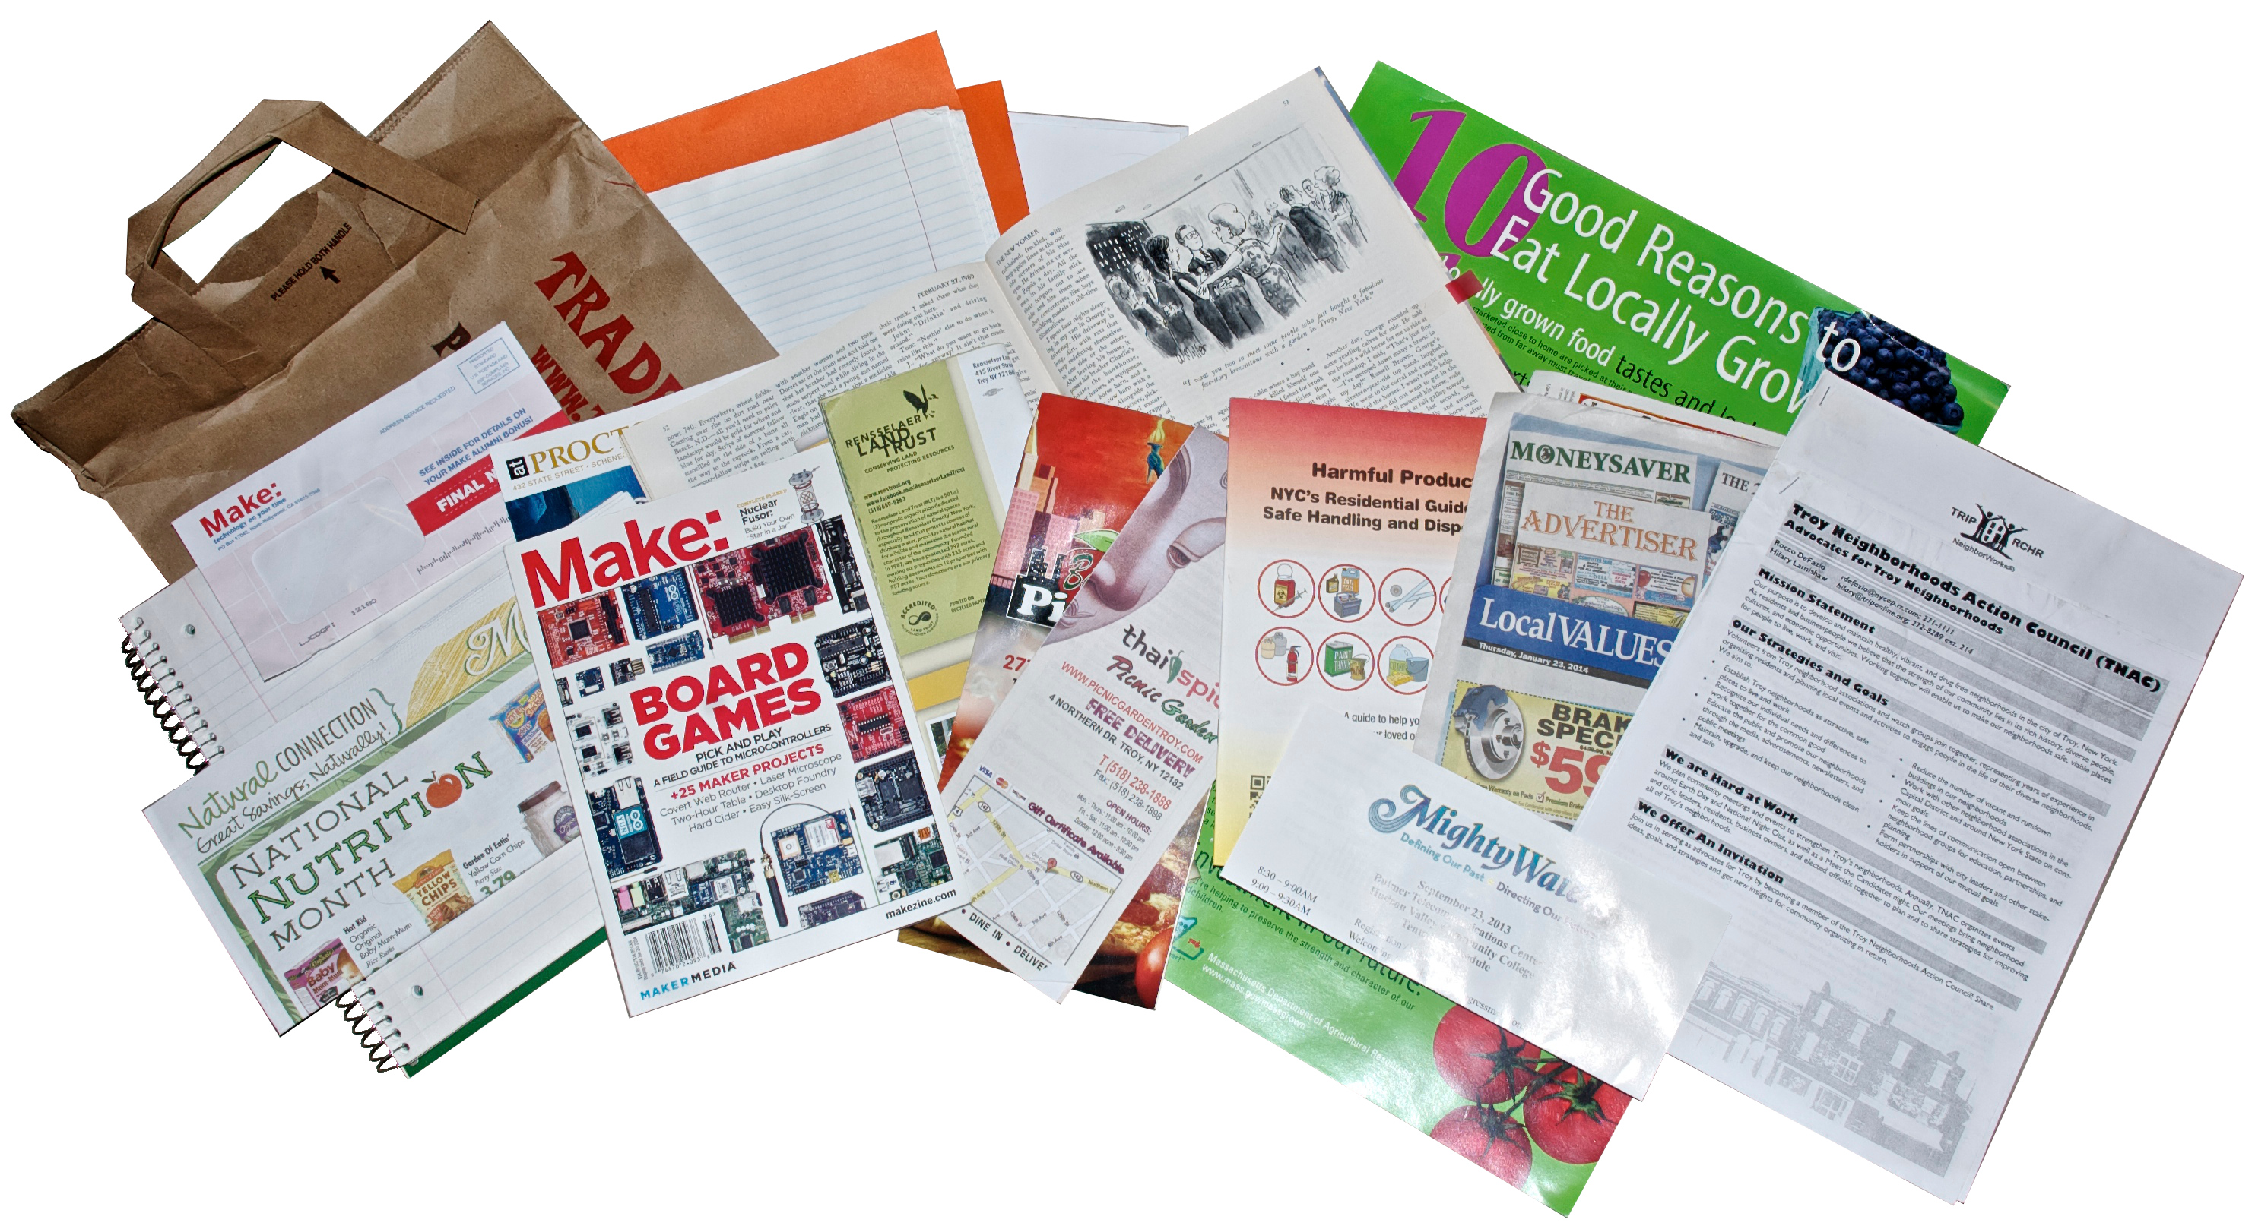
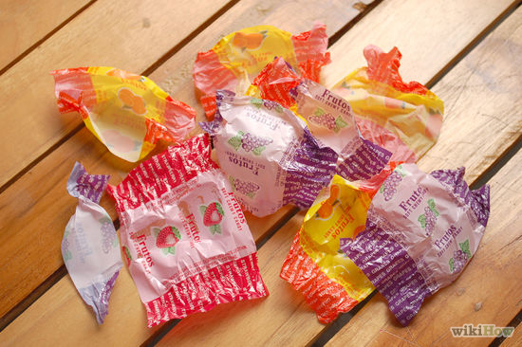
what is waste?
  Things that might get thrown away everyday include:
old
cellphones
plastic bags
spoiled food and peels
empty bottles and cans
food wrappers
paper (like old homework)

Slide 16
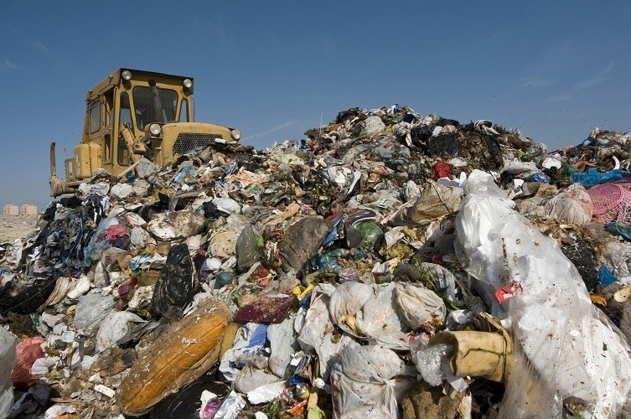
WHERE DOES ALL THE WASTE GO?
Items that are thrown away are picked up and taken to the landfill.
A landfill is basically a big pile of garbage!
yuck!

Slide 17
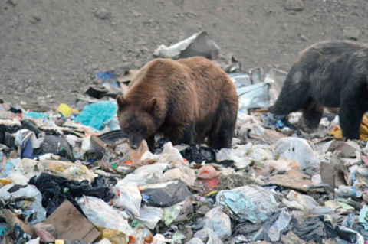

WHERE DOES ALL THE WASTE GO?
  It takes garbage in the landfill hundreds if not thousands of years to break down.
    During this breakdown, decaying material can pollute the surrounding land and water, as well as harm wildlife and plants.

Slide 18
how can we stop landfills from growing?
  Lots of things we use every day can be kept out of the landfill by following each of the 3 R’s.
Any guesses?

Slide 19
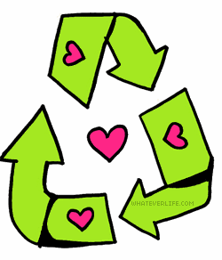
reduce
recycle
reuse

Slide 20

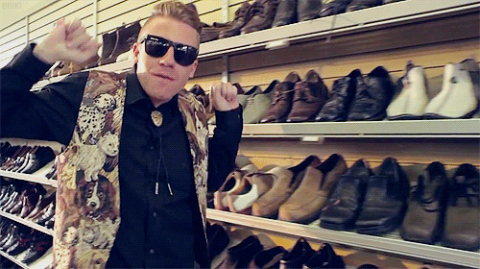
reduce
    The best thing you can do is use less. Some examples of reducing your waste include:
      Consider buying slightly used items before making a new purchase; you can find really cool things at thrift stores, or maybe even get them for free from friends or family
      Buy new items only when you really need them

Slide 21
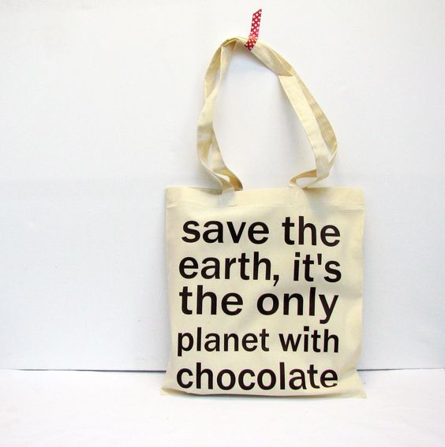
reduce
      Bring reusable grocery bags to the store instead of using plastic or paper
      During meals, take only food that you will eat to prevent extra from getting thrown away

Slide 22
reuse
    Carry items that can be reused. Before you throw something away, consider if there are others ways you can use it.

Slide 23
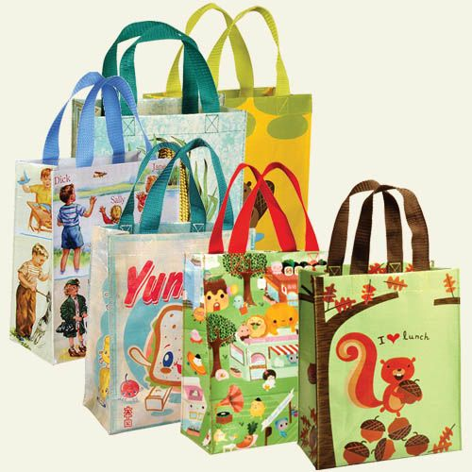
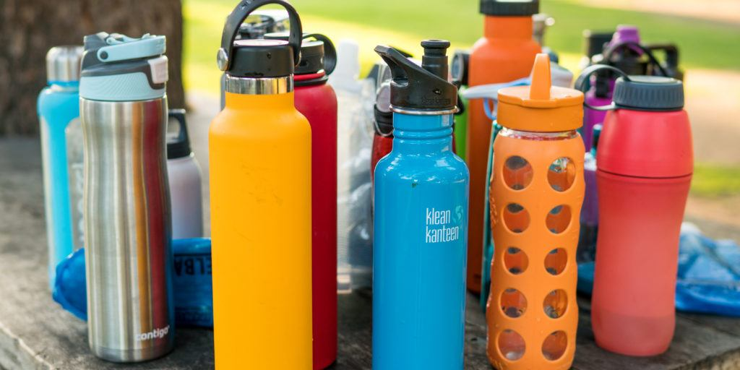
reuse
      Carry around a reusable water bottle and refill it at the sink or refill station
      Bring your lunch and snacks in a reusable lunch box instead of a brown paper bag

Slide 24
reuse
      Instead of throwing away paper scraps, plastic bottles, or other items, see if you can use them for a new art project!
Here’s a few ideas…

Slide 25
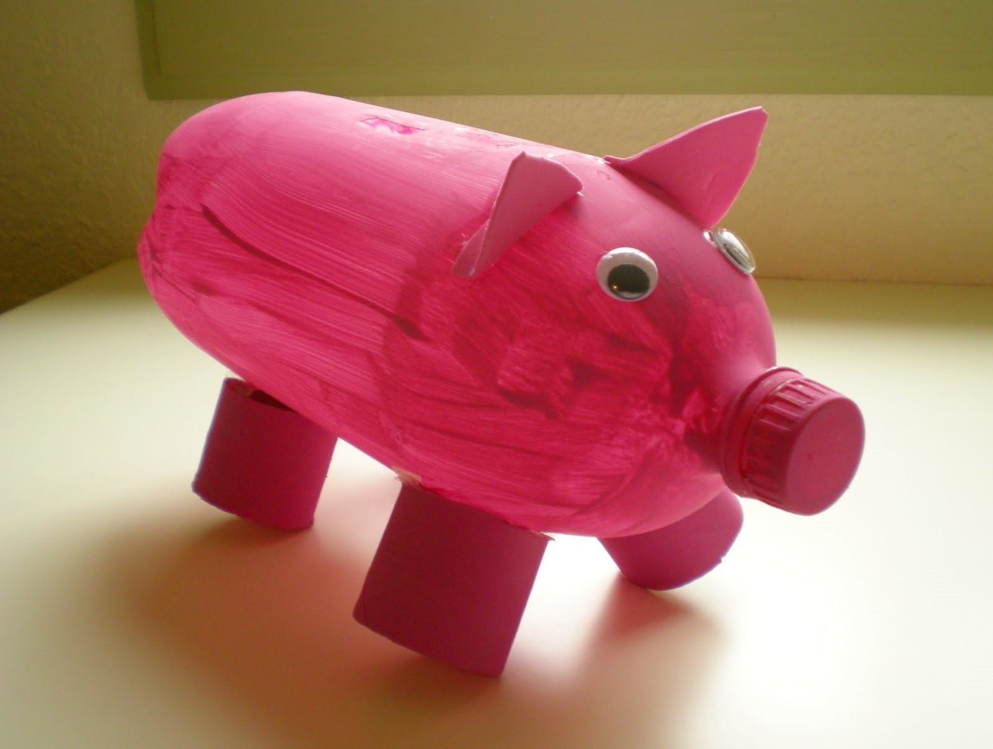
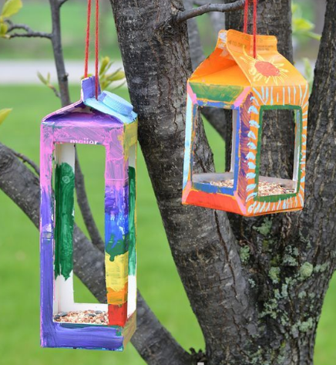
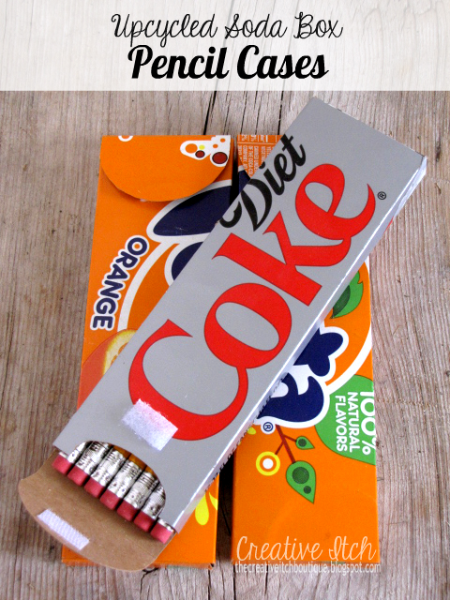
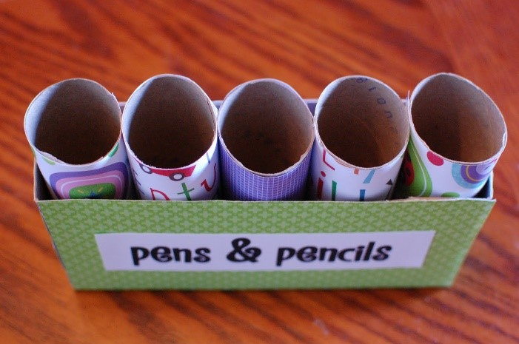
reuse

Slide 26
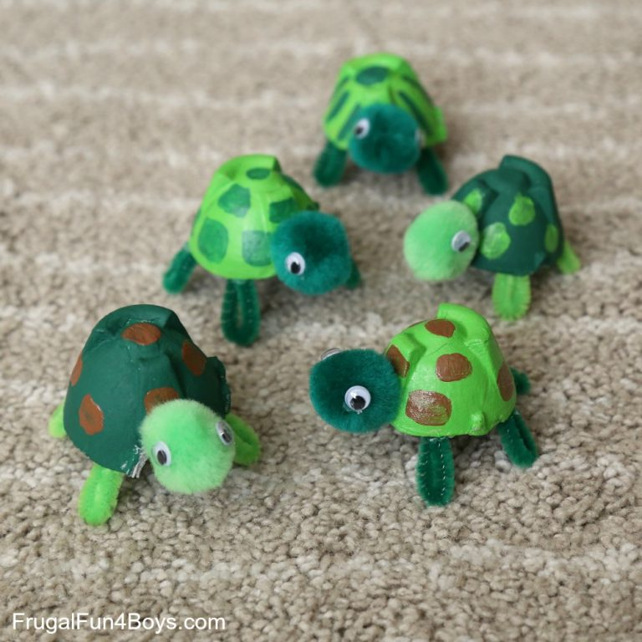
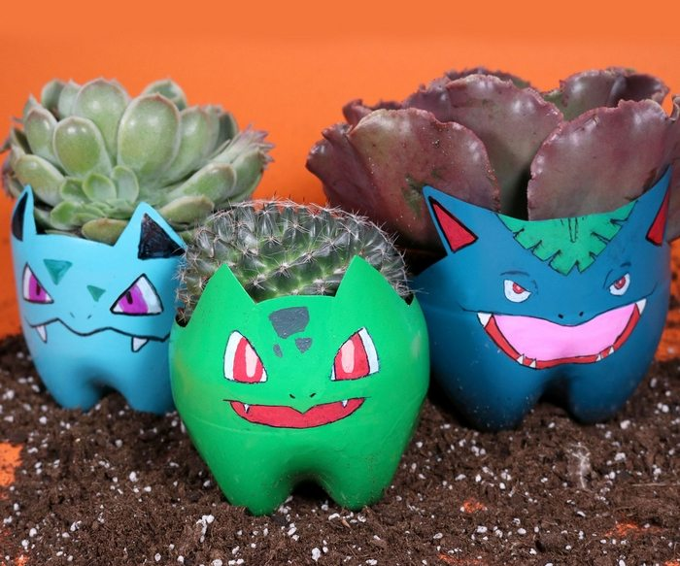
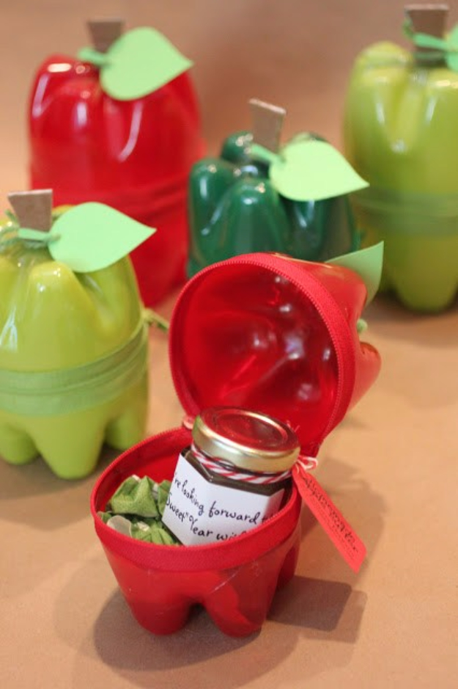
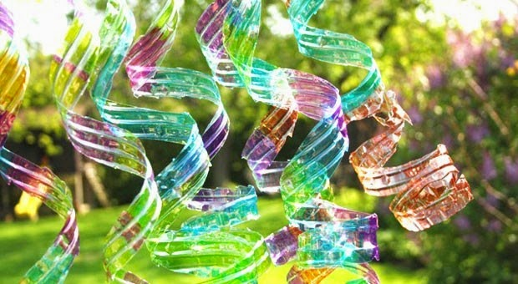
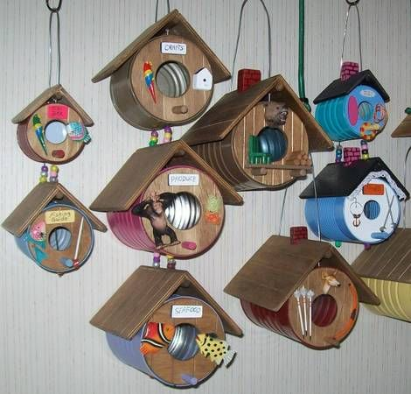
reuse

Slide 27
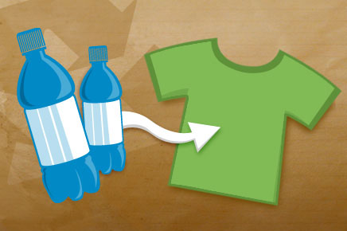
recycle
    This involves taking what would be trash and turning it into something completely new.

Slide 28
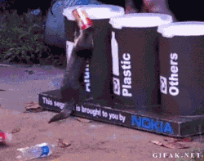
recycle
      Things like plastic water bottles, paper, cardboard, and soda cans can all be recycled in most cities.
      Other items like glass, electronics, and plastic bags can be recycled, though you should check with your city to see where you should take them.

Slide 29
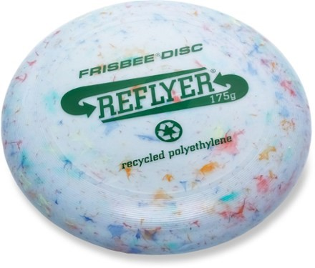
fun recycling facts
        Plastic bottles can be recycled into T-shirts.
        Plastic bags can be recycled into a Frisbee.
        Newspapers can be made into egg cartons.
        Paper can be made into tissues.
        Metal cans can be made into bike and cars parts.

Slide 30
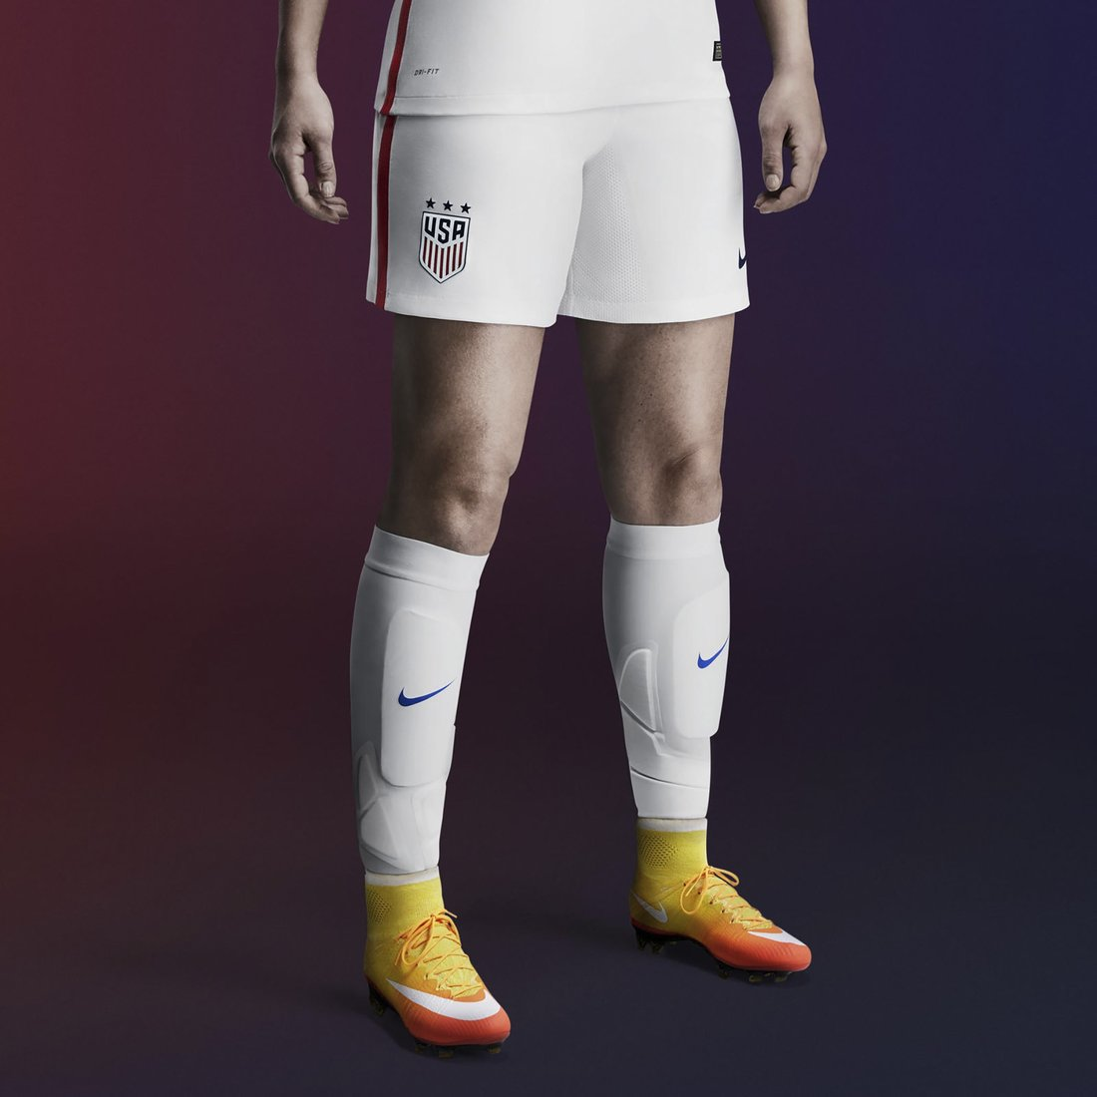
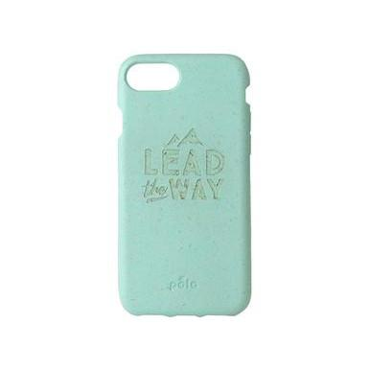
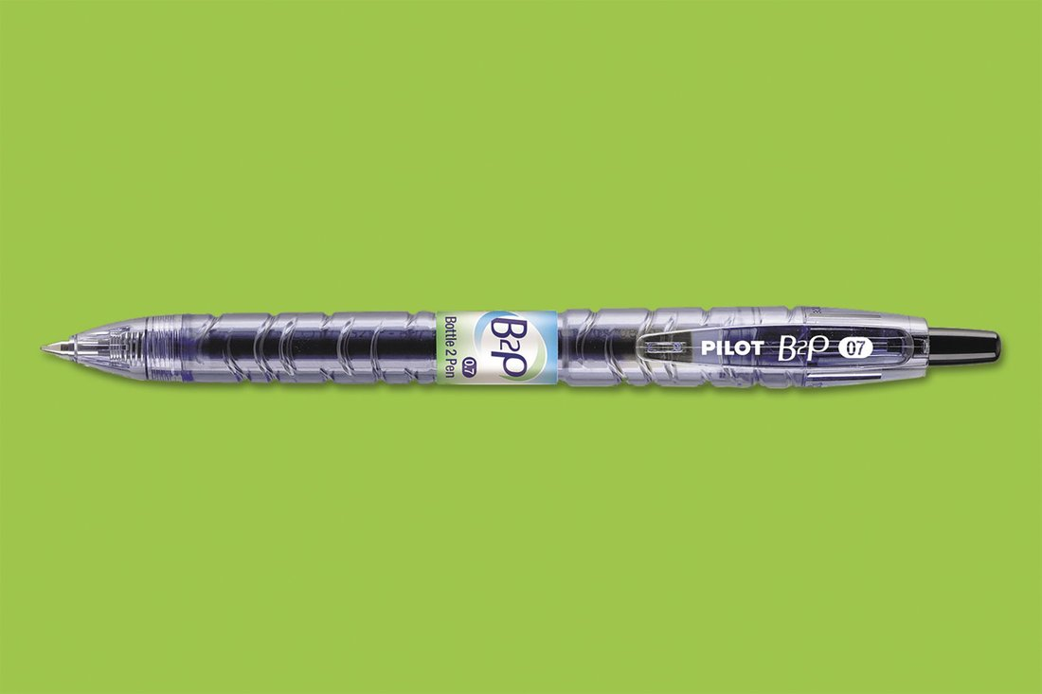
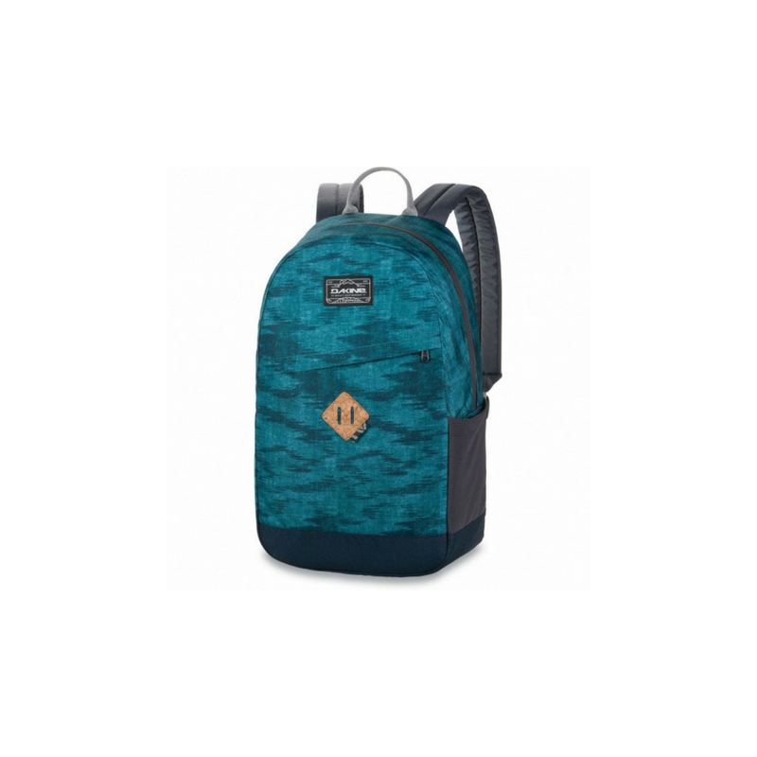
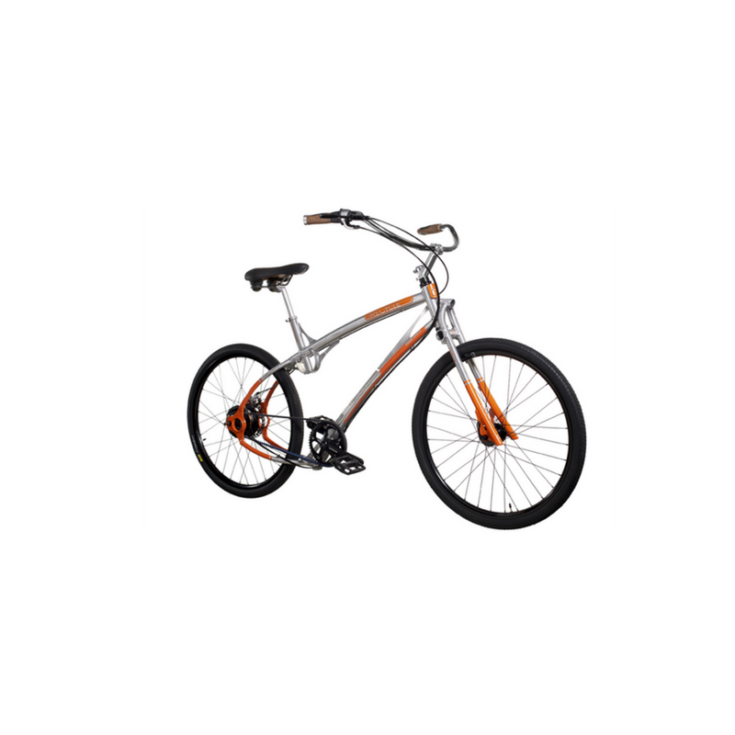
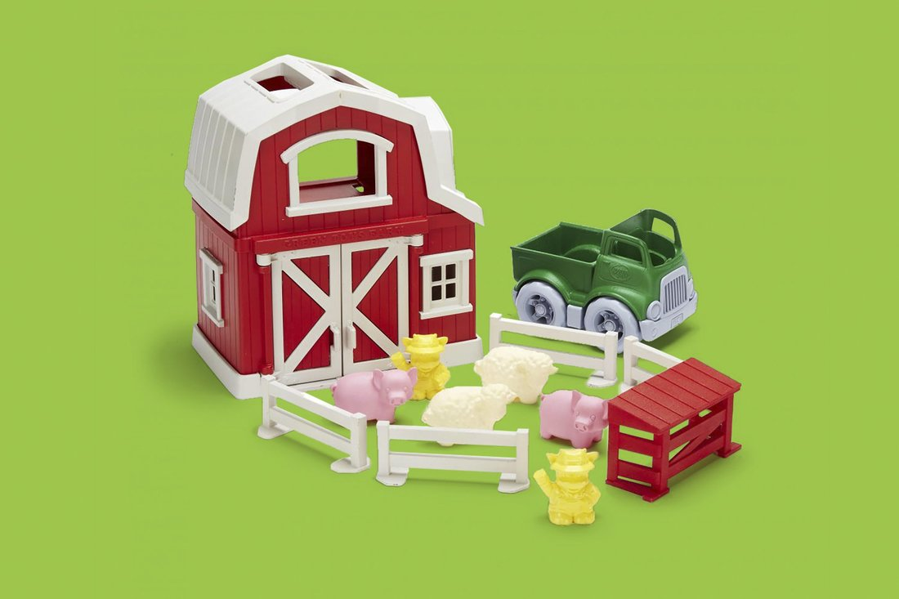
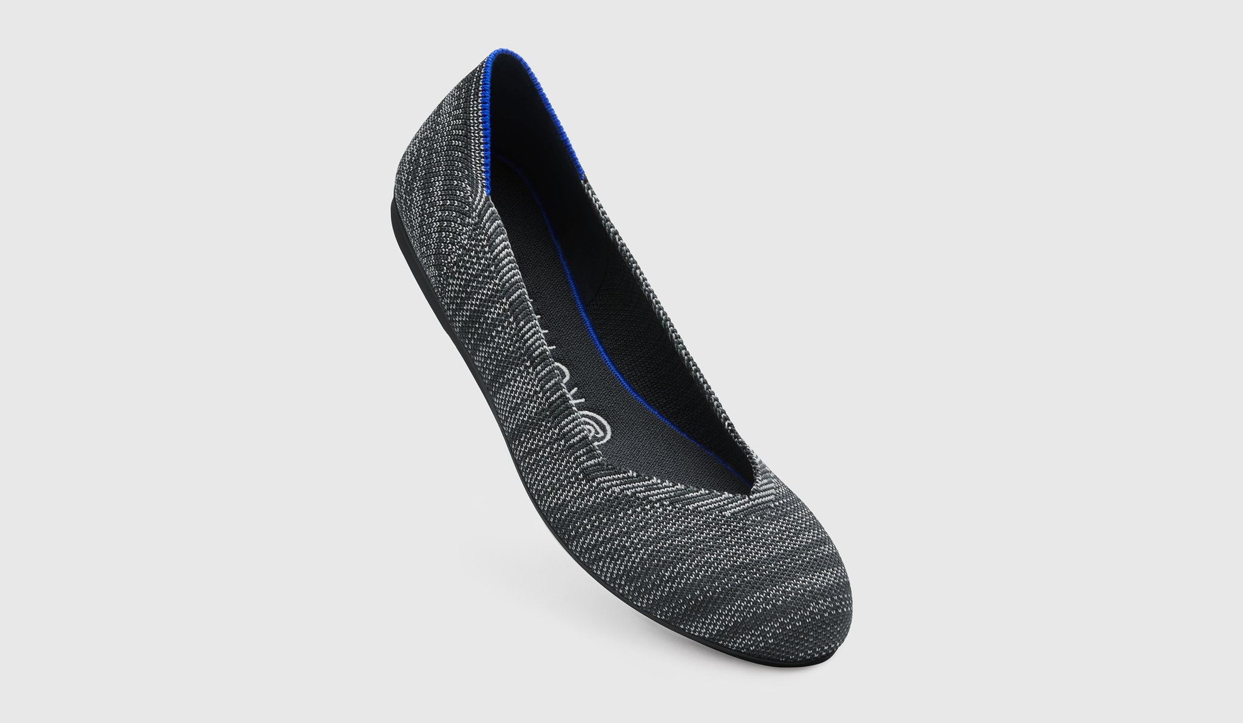
fun recycling facts

Slide 31
Which is a benefit of recycling?
pop quiz…
Recycling reduces pollution.
Recycling conserves natural resources.
Recycling saves money.
All of the above.

Slide 32
What are the three Rs?
pop quiz…
Renew, Restart, Recycle.
Reduce, Reuse, Recycle.
Reduce, Redo, Rihanna.
Reduce, Rinse, Repeat.

Slide 33
Which of these items helps reduce waste?
pop quiz…
Reusable water bottle.
Reusable tote bag.
Recycling bin.
All of them.

Slide 34
Which of these can not be recycled?
pop quiz…
Candy wrappers.
Plastic water bottle.
Smartphone.
Cardboard box.

Slide 35

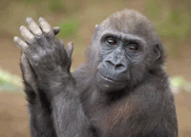


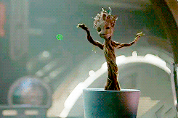

thank you!
Notes:
Put this slide up while you explain answer to previous question.

Slide 36
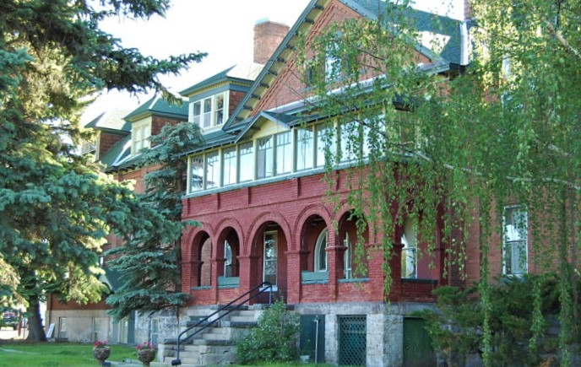
want to learn more?
contact:
name
title
email
(xxx) xxx-xxxx
Our headquarters is located at 3040 Continental Dr. Butte, MT

