Slide 1




intro

Slide 2
pop quiz…
This presentation includes an interactive component using TurningPoint software. You will be asked a series of questions at the start of the presentation and again at the end to help us measure your change in knowledge. Questions are answered by using the remotes handed out.
Let’s do a practice question!

Slide 3
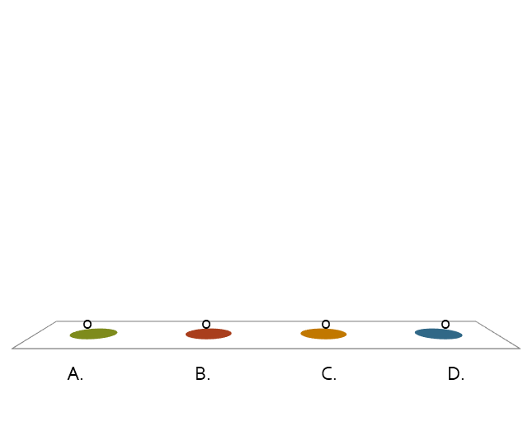
A group of ferrets is called a(n)…
pop quiz…
Fumble.
Pack.
Business.
Enterprise.

Slide 4
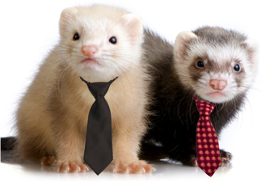

Slide 5
Home energy education

Slide 6
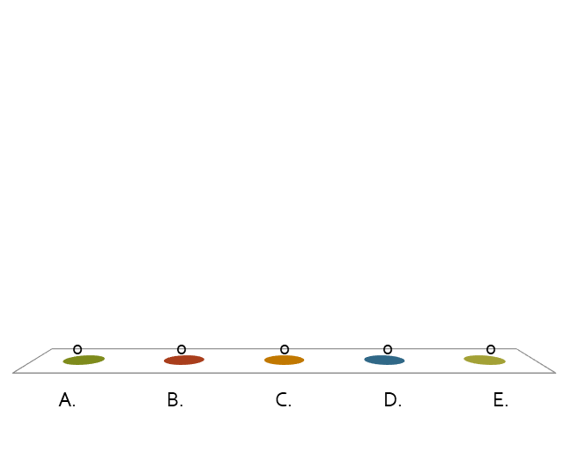
Which of these use energy?
pop quiz…
A light bulb.
A bike.
A car.
An iPhone.
All of them!

Slide 7



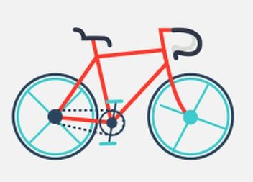
Notes:
Put this slide up while you explain answer to previous question.

Slide 8
Which of the following are examples of renewable energy?
pop quiz…
Wind turbines.
Solar panels.
Coal.
Gasoline.
A and B

Slide 9
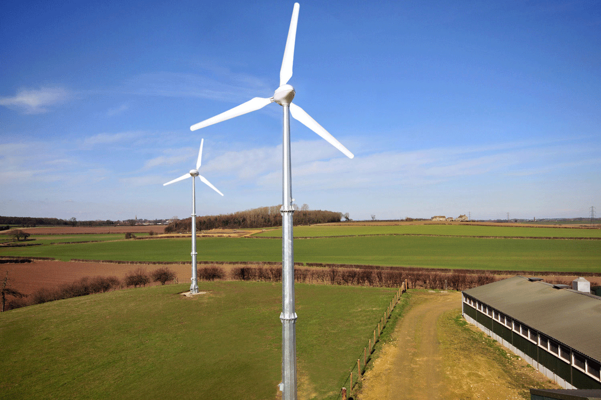
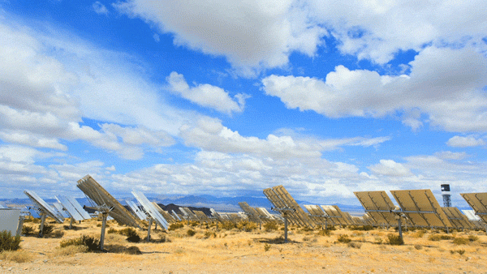
Notes:
Put this slide up while you explain answer to previous question.

Slide 10
Which of the following are ways you can save energy?
pop quiz…
Turn off the TV when you aren’t watching it.
Ride your bike instead of driving.
Take shorter showers.
All of the above.

Slide 11


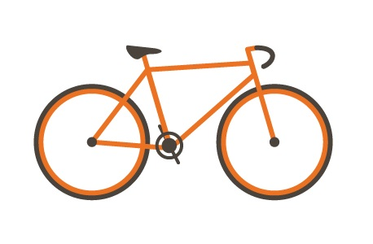
Notes:
Put this slide up while you explain answer to previous question.

Slide 12
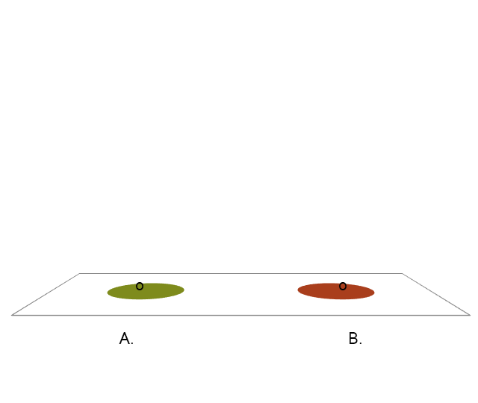
True or False? Saving energy can save money!.
pop quiz…
True.
False.

Slide 13
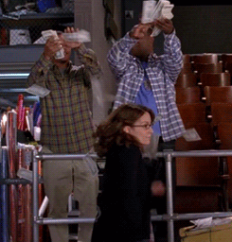
Notes:
Put this slide up while you explain answer to previous question.

Slide 14


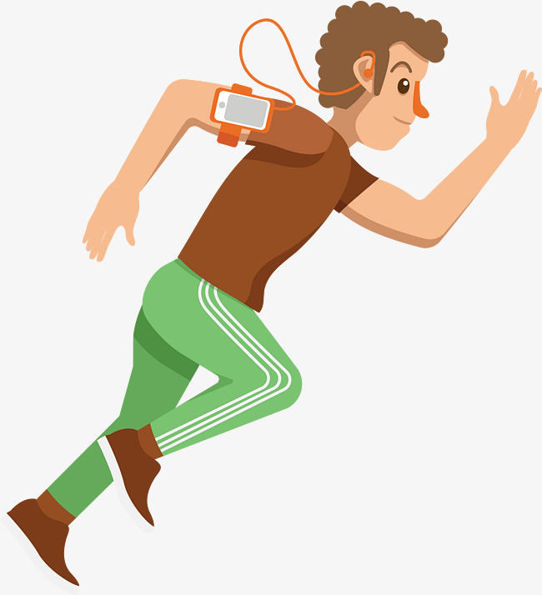


what is energy?
  Energy comes in many forms like:
light
electricity
motion
sound
heat

Slide 15
what is energy?
  Energy is something we all use every single day. Some things that use energy that you might have at your house include:

Slide 16
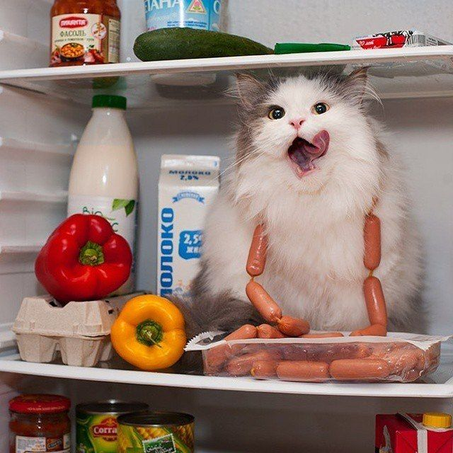
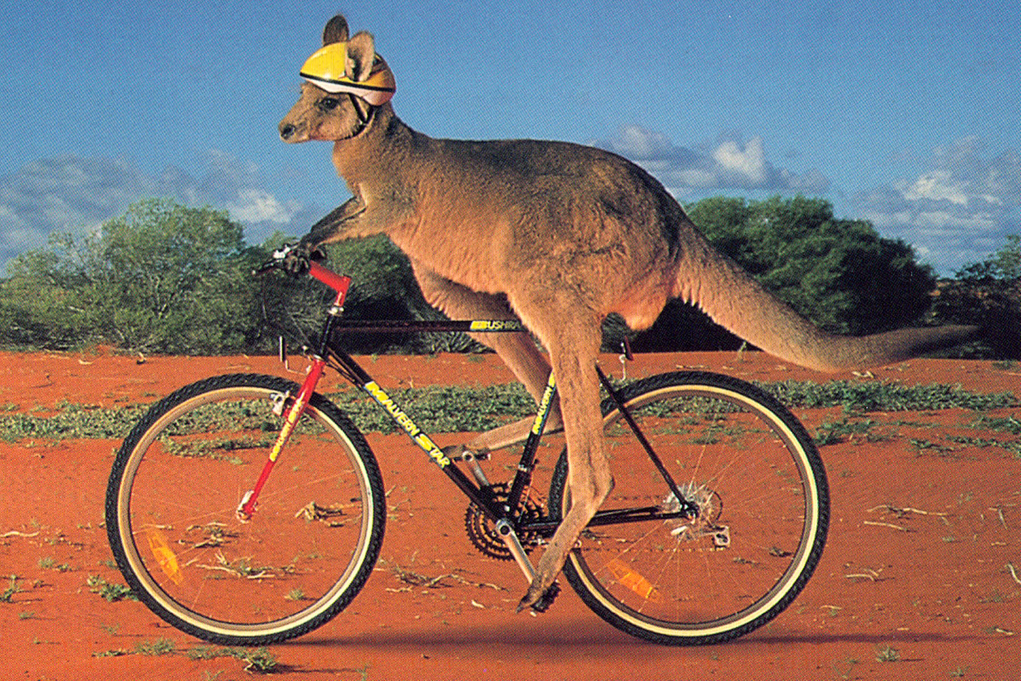
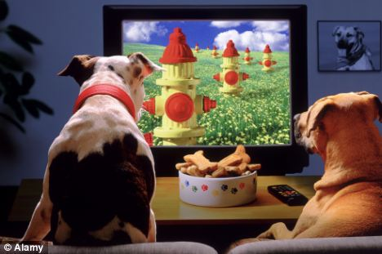
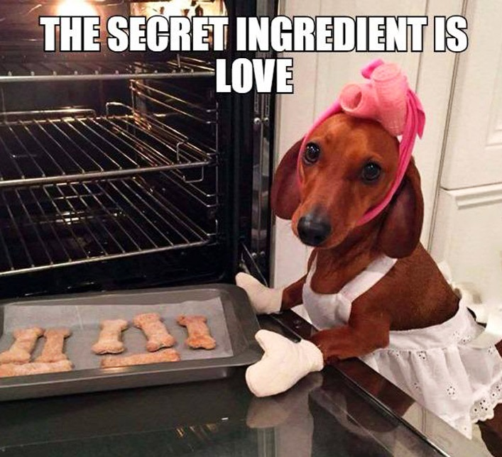
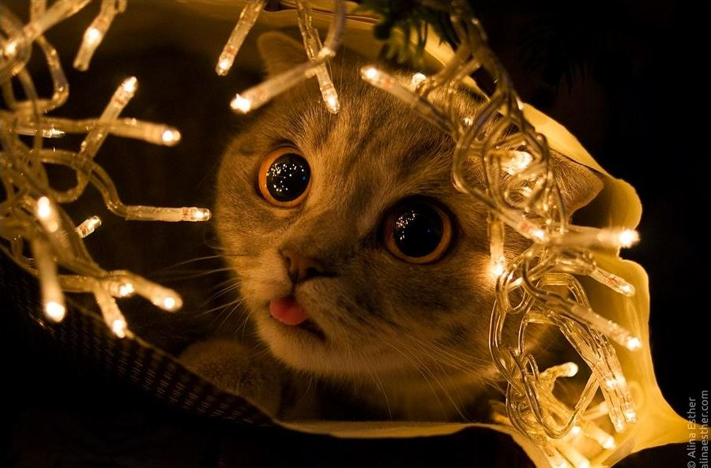
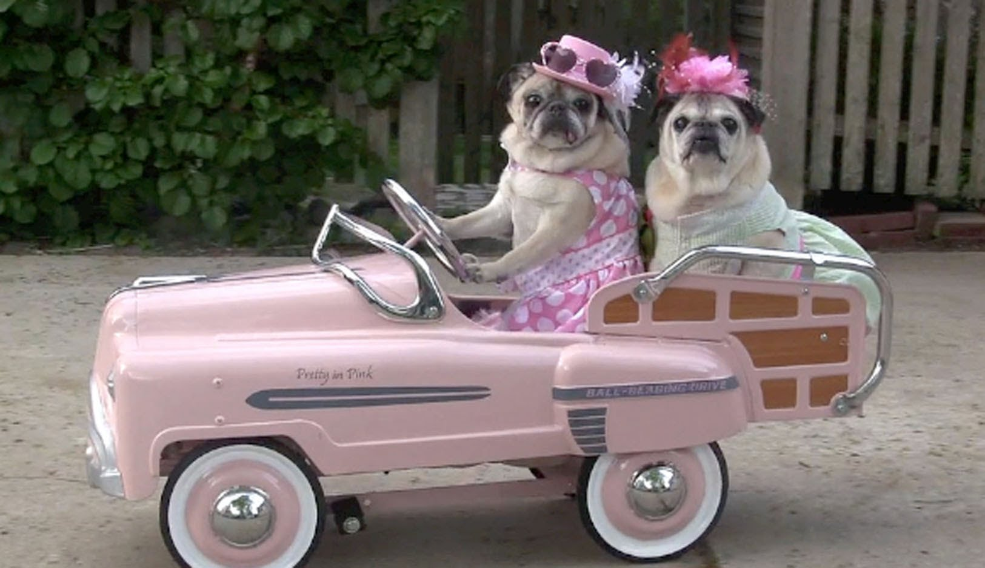
what is energy?
bicycles
televisions
refrigerators
cars
ovens
lights

Slide 17

where do we get energy?
ENERGY
  Energy is everywhere! However, that doesn’t mean we can always use it. First we must find a way to capture energy

Slide 18

where do we get energy?
  We can capture energy that comes in two forms:
    Renewable: energy that won’t run out.
wind
water
sun

Slide 19
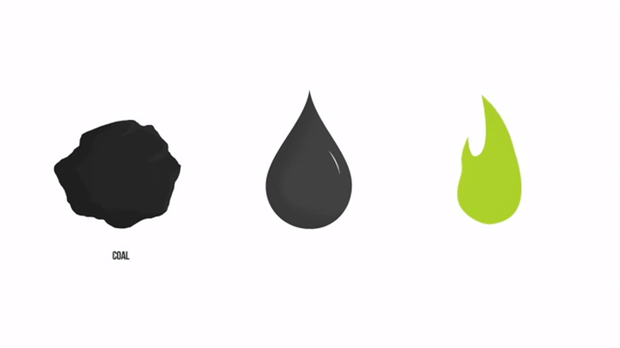
where do we get energy?
    Nonrenewable: energy that will run out.

Slide 20
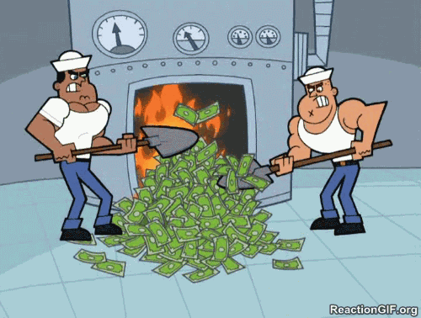
why should we conserve energy?
    Energy costs money
      You may not pay for energy, but your parents do!
      Wasting energy is like wasting money

Slide 21
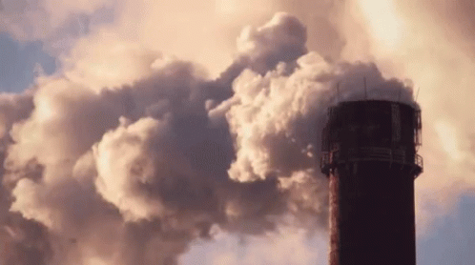
why should we conserve energy?
    Using energy can be bad for the environment too
      Using energy, especially nonrenewable energy, creates pollution which is bad for plants, animals, and humans.
    We always want energy to be there when we need it. This means we should conserve it when we don’t need it!

Slide 22
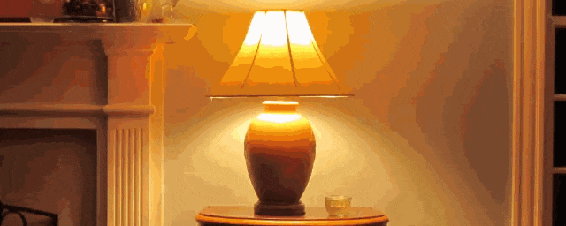
how can you save energy?
  Turn off lights and electronics when you’re not using them.

Slide 23
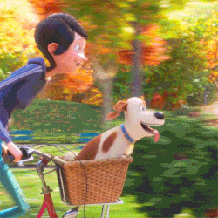
how can you save energy?
  Ride your bike to school, or take the bus if you can, instead of driving in your car.

Slide 24


how can you save energy?
  Save water by turning off the faucet when you’re brushing your teeth and take shorter showers.

Slide 25
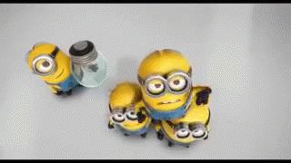
how can you save energy?
  Help your parents switch to energy saving light bulbs.

Slide 26
how can you save energy?
  Help your friends and family save energy by teaching them what you know!

Slide 27
Which of these use energy?
pop quiz…
A light bulb.
A bike.
A car.
An iPhone.
All of them!

Slide 28
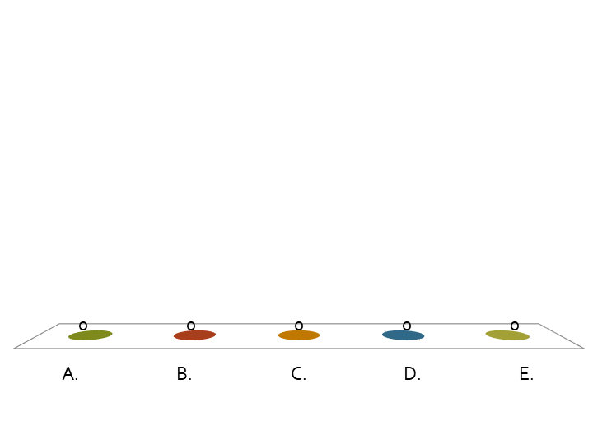
Which of the following are examples of renewable energy?
pop quiz…
Wind turbines.
Solar panels.
Coal.
Gasoline.
A and B

Slide 29
Which of the following are ways you can save energy?
pop quiz…
Turn off the TV when you aren’t watching it.
Ride your bike instead of driving.
Take shorter showers.
All of the above.

Slide 30
True or False? Saving energy can save money!.
pop quiz…
True.
False.

Slide 31

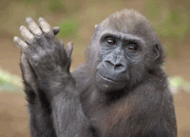


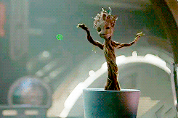

thank you!
Notes:
Put this slide up while you explain answer to previous question.

Slide 32
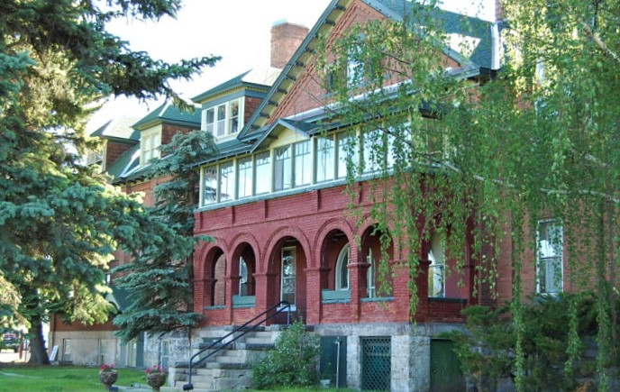
want to learn more?
contact:
name
title
email
(xxx) xxx-xxxx
Our headquarters is located at 3040 Continental Dr. Butte, MT

