Slide 1
introduction

Slide 2
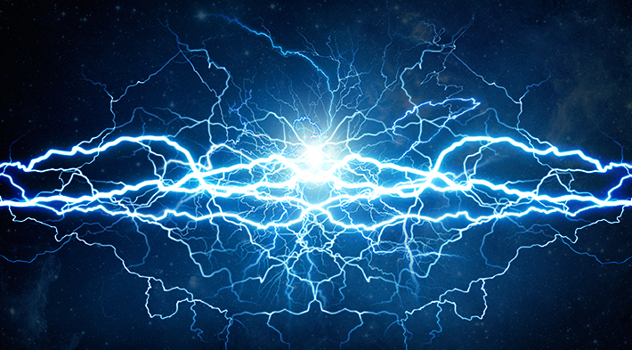
what is energy?
Energy is the measure of the ability of a body or system to do work or produce a change.
The total amount of energy in the universe is fixed. Energy can neither be created nor destroyed.
However, the amount of energy available to do work decreases as it is transferred from step to step in a process. This is why using energy efficient methods is important!

Slide 3
pop quiz…
This presentation includes an interactive component using TurningPoint software. You will be asked a series of questions at the start of the presentation and again at the end to help us measure your change in knowledge. Questions are answered by using the remotes handed out.
Let’s do a practice question!

Slide 4
A group of ferrets is called a(n)…
pop quiz…
Fumble
Pack
Business
Enterprise

Slide 5
Have that report on my desk by noon, Bob.
You got it, Steve.

Slide 6
Renewable energy

Slide 7
Renewable energy sources account for what percentage of US energy production?
pop quiz…
Less than 1%
5-10%
10-15%
20-25%

Slide 8
What is the current efficiency rate that can be reached by a typical solar panel?
pop quiz…
8%
14%
20%
25%

Slide 9
Biomass fuels can be made from which of the following feedstocks?
pop quiz…
Lumber mill scraps
Corn grains
Soybeans
All of the above

Slide 10
What is the minimum wind speed required for a windmill to produce reliable electricity?
pop quiz…
1-2mph
4-6mph
8-10mph
10-12mph

Slide 11
Which of the following are benefits of a ground source heat pump?
pop quiz…
They are 25-50% more efficient that existing heating systems.
GSHPs release significantly less emissions than typical home heating systems.
A and B
None of the above

Slide 12
What are the two biggest sources of renewable energy?
pop quiz…
Solar and wind
Wind and hydro
Biomass and hydro
None of the above

Slide 13
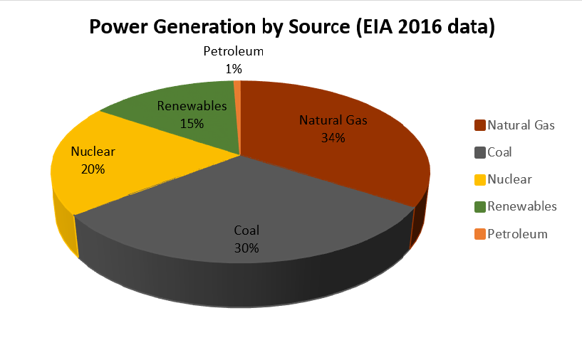
general
In the last several years, natural gas has surpassed coal as the greatest source of power generation.
Renewable energy accounts for 10-15% of current US energy production.
Currently, two biggest renewable energy sources are hydroelectric and wind.

Slide 14
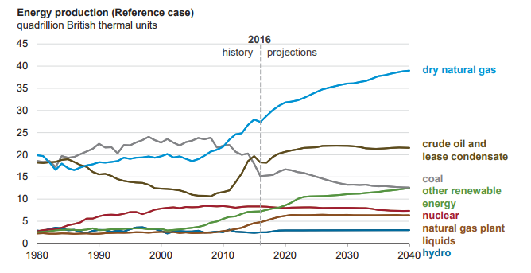
general

Slide 15
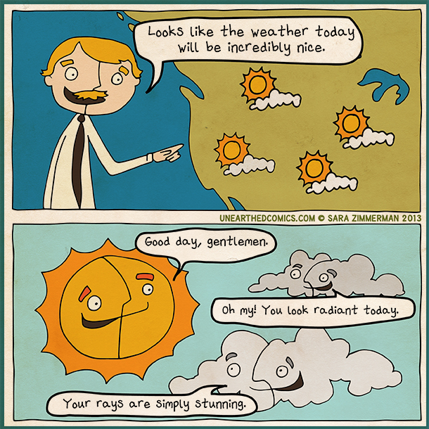
solar
The sun is our greatest power source.
173,000 terawatts of energy are hitting the earth at any moment (10,000x the world’s energy use!).
Solar panels can help capture this energy and convert it into energy.

Slide 16
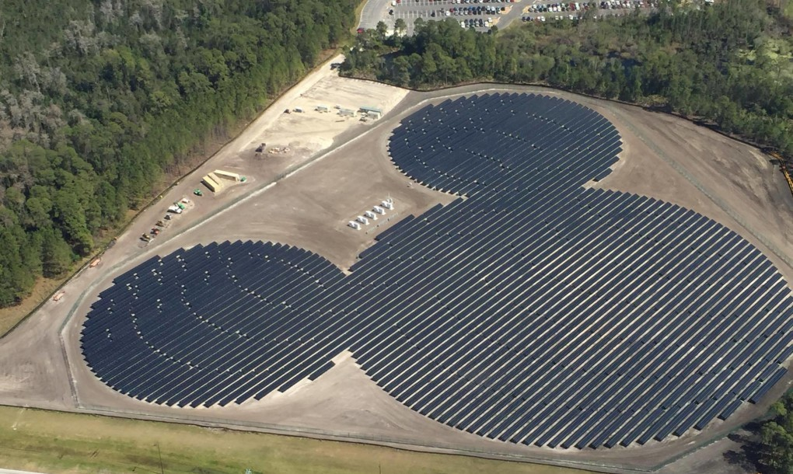
solar
Typical solar panels convert 14% of available energy to electricity.
The best solar panels convert up to 22%.
Efficiency is improving every year!
The typical lifespan of solar panels is about 25 years. (energysage.com)
Mickey-shaped solar farm near Walt Disney World Epcot.

Slide 17
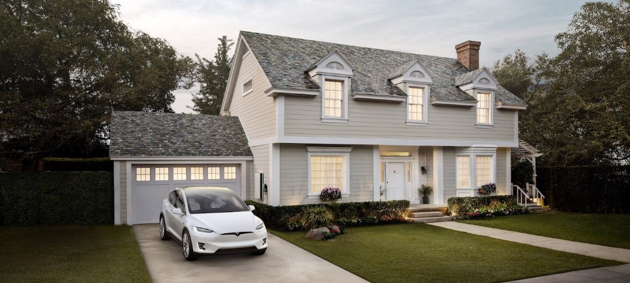
solar
Contrary to popular belief, solar panels can still capture energy on a cloudy day.
The amount of solar capacity installed in the last 10 years has smashed 2006 set goals by 4,813%!
Companies like Tesla are even beginning to make solar panel roof shingles to renewably power your home.
Solar Roof via Tesla.com

Slide 18
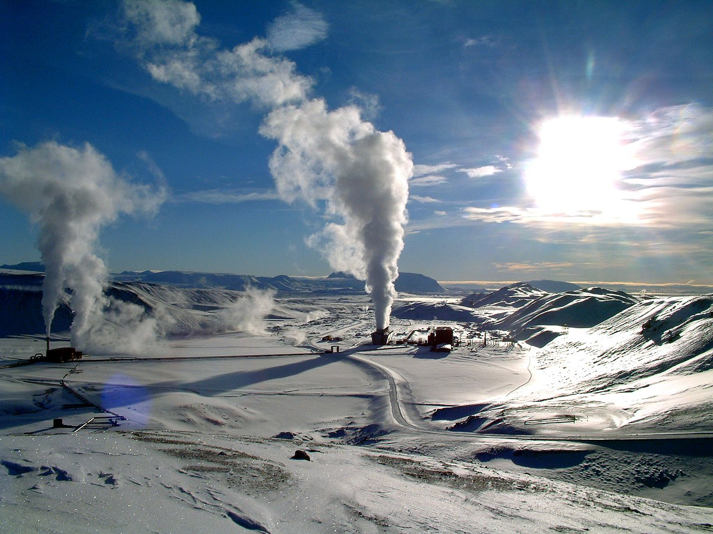
geothermal/ground source
Ground source heat pumps utilize the relatively constant heat of the Earth (~50 degrees F) to heat and cool homes.
How it works:
Fluid (usually water and antifreeze) is passed through a tubing system in the ground.
As the fluid passes through the pipes, it either picks up heat from the earth (heating mode) or expels heat into the earth (cooling mode).
The fluid then returns to heat or cool the house via a heat exchanger.

Slide 19
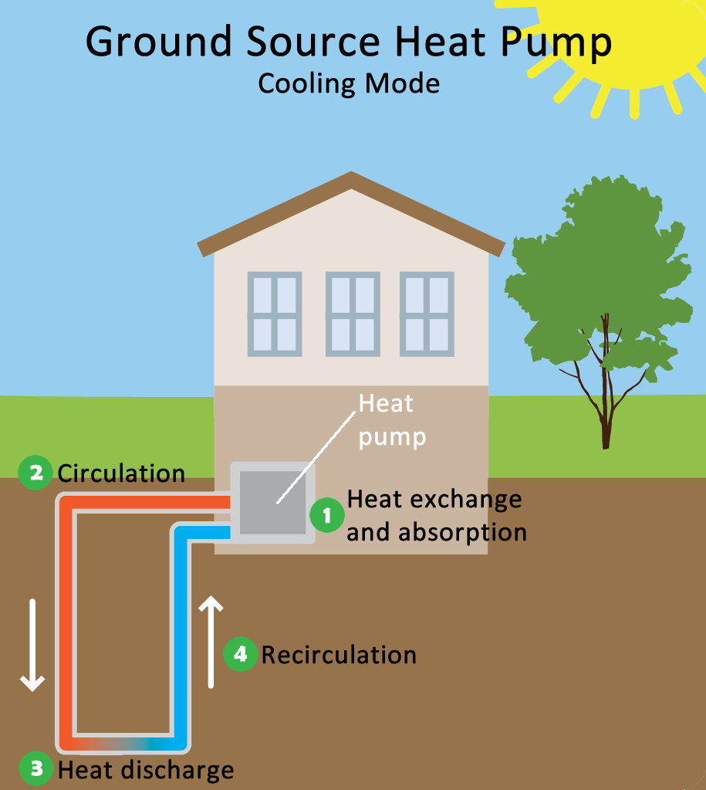
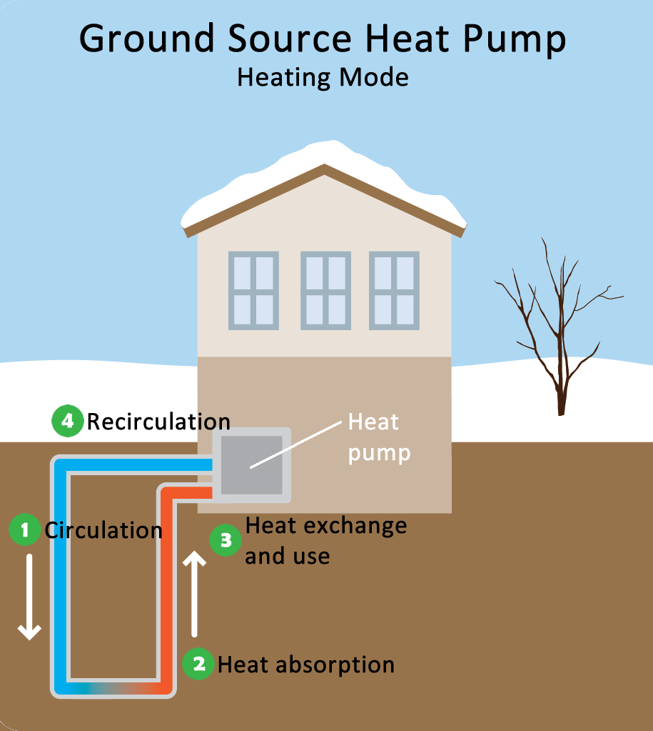
geothermal/ground source
epa.gov

Slide 20
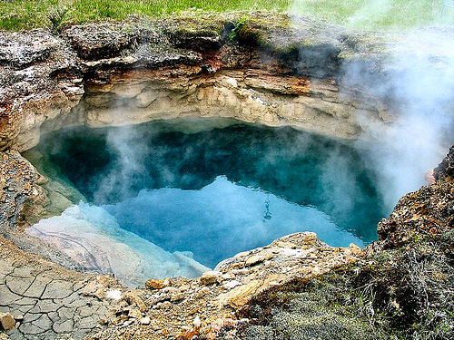
geothermal/ground source
GPHS are typically 25%-50% more efficient than standard home heating/cooling systems (furnace, A/C, electric baseboards) and have substantial emissions reductions.
Systems last 25 years for in-home components; 50+ years for the ground loop (energy.gov).

Slide 21
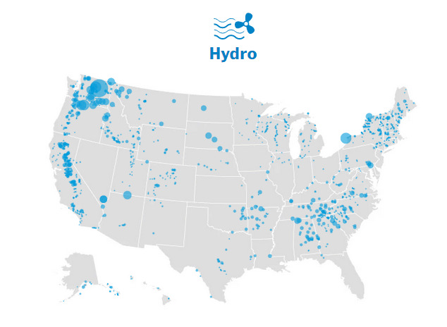
hydroelectric
Water is constantly moving around the globe in the form of rivers, oceans, clouds, and precipitation. Capturing energy from the movement of water is a great way to generate renewable electricity. In fact, hydropower is the biggest generator of renewable energy in the US.

Slide 22
hydroelectric
How it works:
Water moving downstream flows through turbines (such as those housed in a dam), causing the turbines to spin, which drives a generator to produce electricity.
The reservoir behind the dam acts similar to a battery-- storing the water’s kinetic energy until it is needed. When energy demands are high, water can be released to spin through the turbines to generate electricity.
While hydroelectric power doesn’t lead to as much air and water pollution, it can significantly alter the surrounding environment, negatively impacting plants, wildlife, and people living in nearby communities.

Slide 23
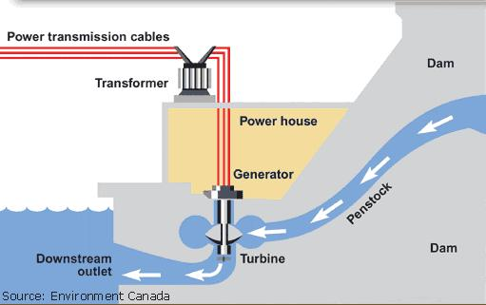
hydroelectric

Slide 24
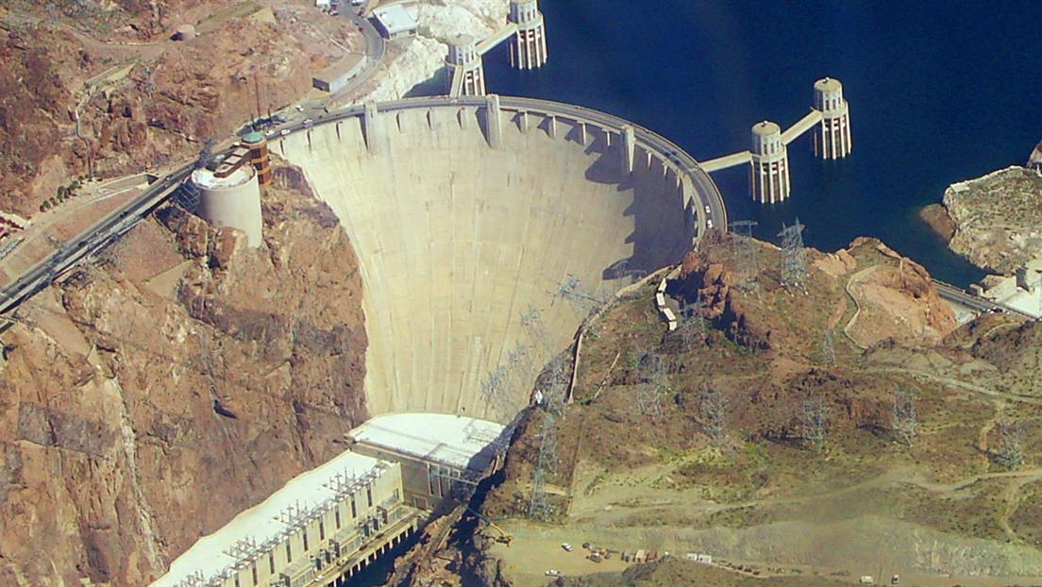
hydroelectric
Presently, the Hoover Dam can produce over 2,000 megawatts of capacity and a yearly average generation of 4.5 billion kilowatt hours to serve the annual electrical needs of nearly 8 million people in Arizona, southern California, and southern Nevada. (powerauthority.org)

Slide 25
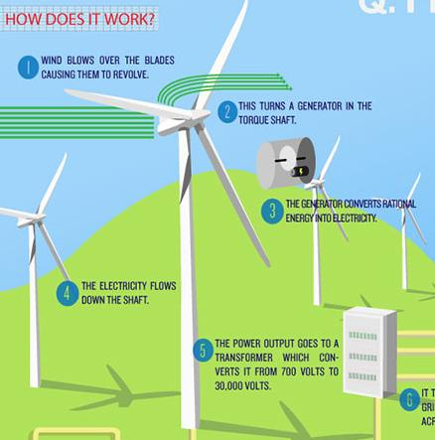
wind
Wind energy can be used in a similar scope as solar (to power homes or other small buildings).
How it works:
Wind drives a turbine which drives a generator which produces electricity.
A minimum wind speed of 4-6 mph is needed to reliably produce electricity.
Because wind speed increases with height, the taller the turbine the greater wind speed they’ll be able to access. However due to regulations, most turbines can only be 30m tall.
Wind energy is highly site specific, as wind speed varies greatly throughout the country.

Slide 26
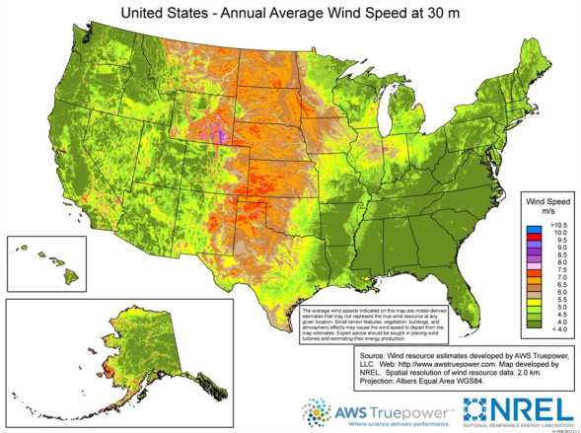
wind

Slide 27
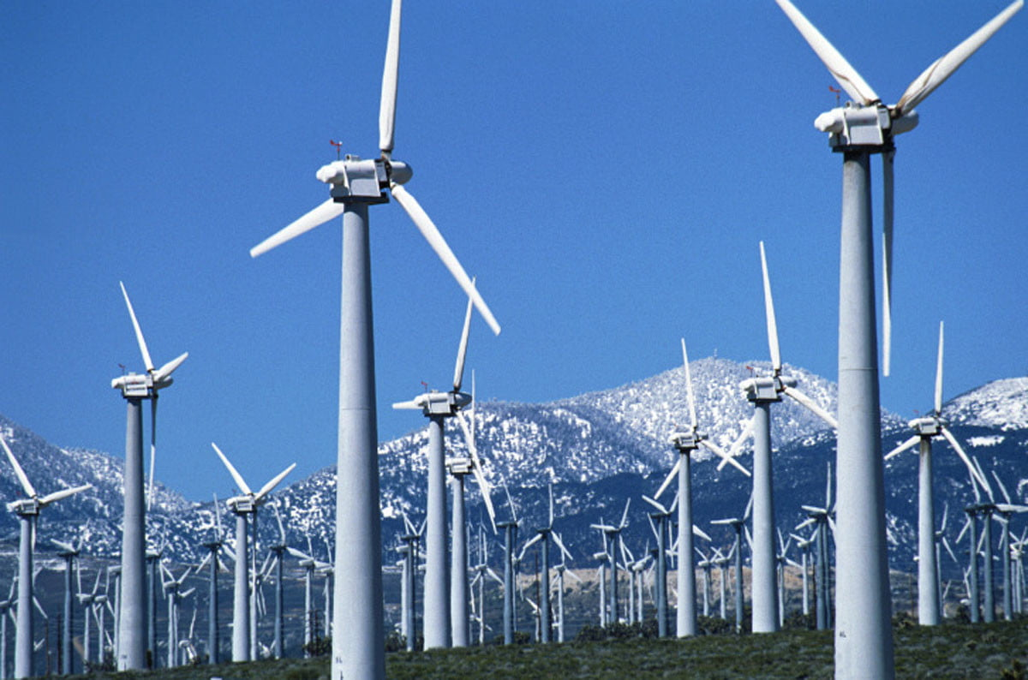
wind
Wind turbines convert about 45% of the wind passing through the blades to electricity. (energy.gov)
It is one of the lowest priced energy sources today! (energy.gov)
Unfortunately wind power can cause disruptions in bird and bat migrations, causing many fatalities every year. Practices are being implemented to help mitigate these fatalities.

Slide 28
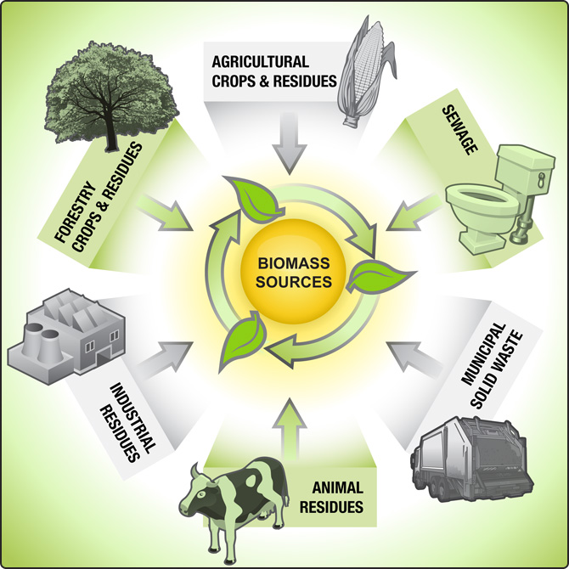
biomass
Biomass energy is energy derived from burning plants and other organic materials such as crops, woody plants, algae, and the organic components of municipal and industrial waste.
How it works:
Biomass can be burned directly as a power source, or converted into a variety of fuels that can be used to power equipment and machinery.
Common biomass feedstocks include lumber mill scraps, corn grain (ethanol), and soybeans (biodiesel).
This feedstock is converted into power or fuel to be used in a variety of instances.

Slide 29
biomass
Biomass reduces our dependence on fossil fuels.
Because biomass fuels can be made from many different organic products, locations can use whatever feedstock is most readily available.
Biomass doesn’t produce carbon emissions and can help reduce industrial waste.

Slide 30
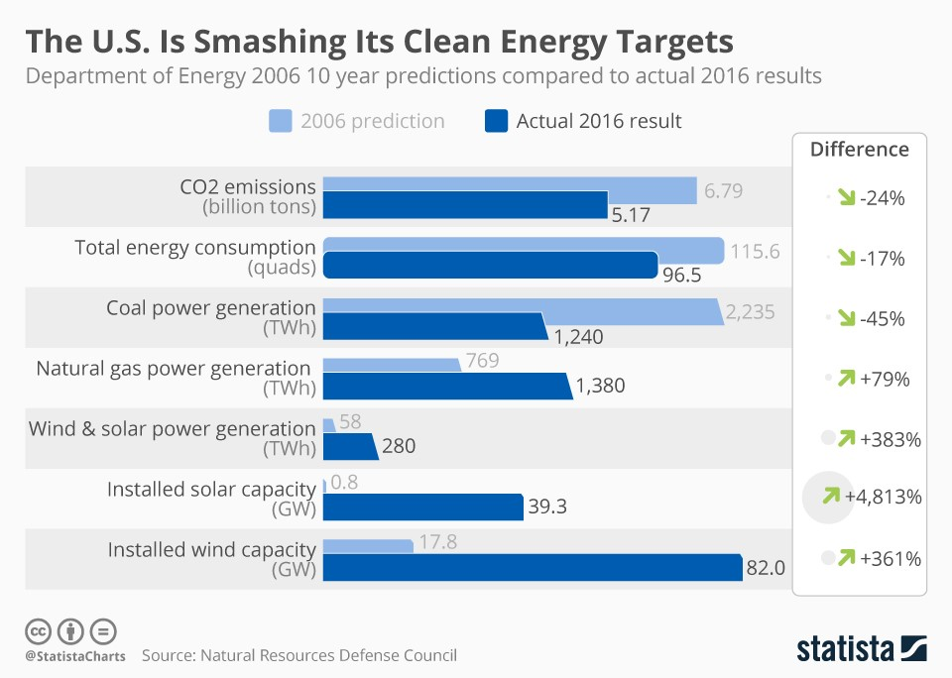
the future
Renewable energy like solar and wind have become much more economically viable options in the recent decade due to significant advancements in technology.
According to recent analysis performed by the Natural Resources Defense Council, the US is greatly surpassing the clean energy targets it set in 2006.

Slide 31
Renewable energy sources account for what percentage of US energy production?
pop quiz…
Less than 1%
5-10%
10-15%
20-25%

Slide 32
What is the current efficiency rate that can be reached by a typical solar panel?
pop quiz…
8%
14%
20%
25%

Slide 33
Biomass fuels can be made from which of the following feedstocks?
pop quiz…
Lumber mill scraps
Corn grains
Soybeans
All of the above

Slide 34
What is the minimum wind speed required for a windmill to produce reliable electricity?
pop quiz…
1-2mph
4-6mph
8-10mph
10-12mph

Slide 35
Which of the following are benefits of a ground source heat pump?
pop quiz…
They are 25-50% more efficient that existing heating systems.
GSHPs release significantly less emissions than typical home heating systems.
A and B
None of the above

Slide 36
What are the two biggest sources of renewable energy?
pop quiz…
Solar and wind
Wind and hydro
Biomass and hydro
None of the above

Slide 37
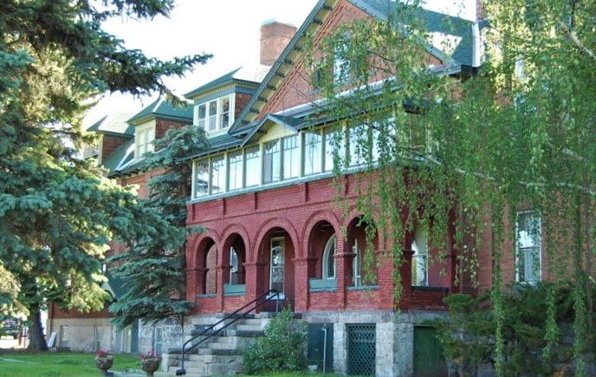
want to learn more?
contact:
name
position
name@ncat.org
(xxx) xxx-xxxx
Our headquarters is located at 3040 Continental Dr. Butte, MT

