Slide 1
introduction

Slide 2
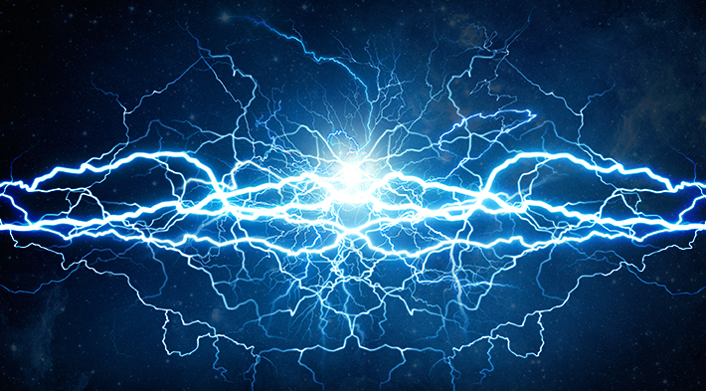
what is energy?
Energy is the measure of the ability of a body or system to do work or produce a change.
The total amount of energy in the universe is fixed. Energy can neither be created nor destroyed.
However, the amount of energy available to do work decreases as it is transferred from step to step in a process. This is why using energy efficient methods is important!

Slide 3
pop quiz…
This presentation includes an interactive component using TurningPoint software. You will be asked a series of questions at the start of the presentation and again at the end to help us measure your change in knowledge. Questions are answered by using the remotes handed out.
Let’s do a practice question!

Slide 4
A group of ferrets is called a(n)…
pop quiz…
Fumble
Pack
Business
Enterprise

Slide 5
Have that report on my desk by noon, Bob.
You got it, Steve.

Slide 6
Home energy savings
simple ways to lower energy bills

Slide 7
Why are LED bulbs the most efficient?
pop quiz…
They generate little heat, so the majority of energy they consume is given off as just light.
They last longer.
They contain mercury gas which extends their life span.
Both A and B

Slide 8
What installations can be made in a home to reduce water use?
pop quiz…
Low-flow toilets
Low-flow showerheads
Sink aerators
All of the above

Slide 9
What combination represents the most energy efficient type of window?
pop quiz…
Single-pane window.
Double-pane window with low-e coating and a gas fill.
Double-pane window.
Double-pane window with low-e coating.

Slide 10
What is the term for a yard that utilizes native plants and rocks instead of typical grass?
pop quiz…
Desertiscaping
Xeriscaping
Rock gardening
Ungrassification

Slide 11
What device can you install in your house that controls temperature based on predetermined time settings?
pop quiz…
Programmable thermostat
HVAC
Thermometer
Ventilator

Slide 12
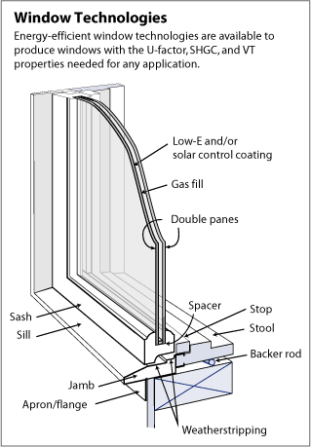
windows
Windows are rated for efficiency based on their thermal transmittance (noted as the U-value).
Characteristics of EE windows includes:
Double or triple pane.
Can be filled with a gas, such as Argon, to decrease the thermal transmittance (retain more heat).

Slide 13
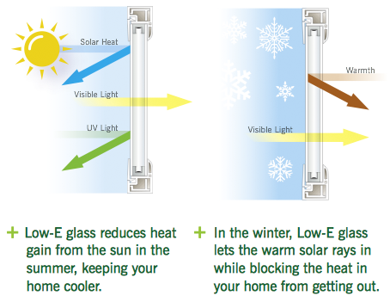
windows
Low- E coating: a coating that helps reflect heat back into the house in the winter and sunlight back to the outside in the summer.

Slide 14
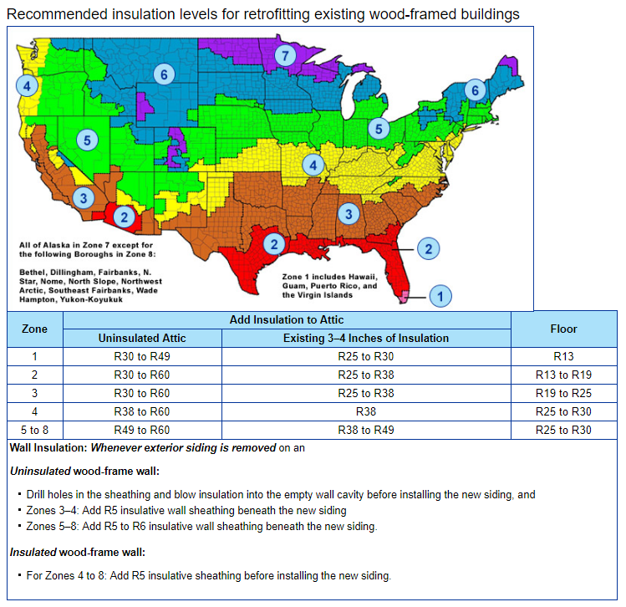
insulation
Home insulation levels are rated based on their thermal resistance (noted as the R-value; this is the opposite of U-value).
Appropriate levels of insulation depend on the area of the country one lives in.

Slide 15
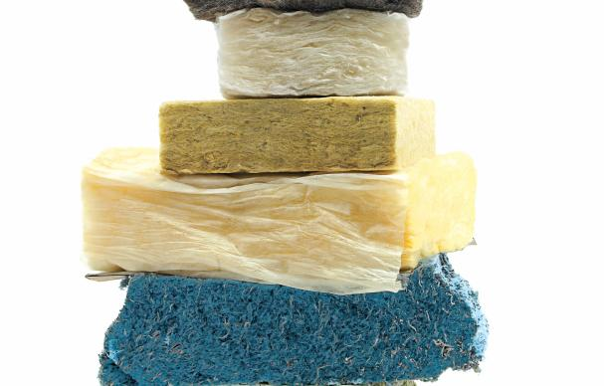
insulation
The R-value provided is dependent on the type of insulation as well the heating type of the home (furnace, electric baseboards, etc.)
Common types of insulation include:
Loose fill fiberglass
Fiberglass batts
Spray foam insulation
Cellulose (blown-in or spray)

Slide 16
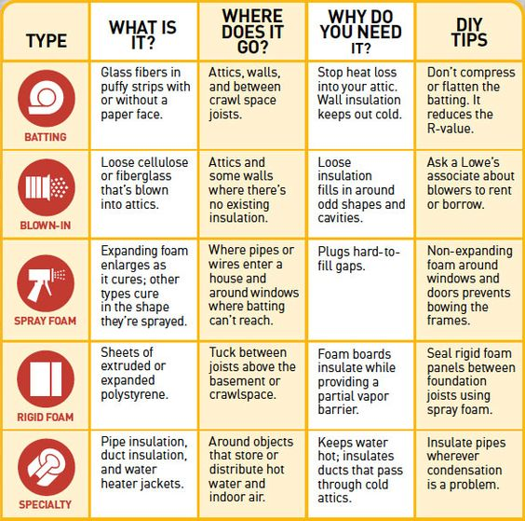
insulation

Slide 17
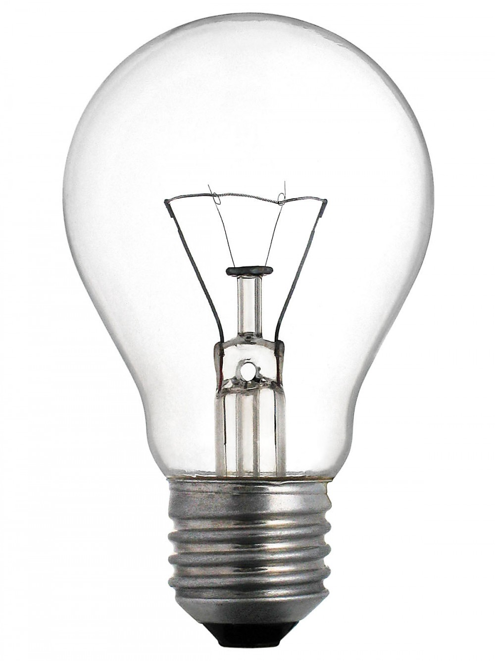
lighting
Here’s a comparison of lightbulb types:
Incandescent:
This is the standard Edison bulb with the glowing filament.
90% of the energy consumed by incandescent bulbs is actually given off as heat!
Typically only last 3-4 years.
Cost less initially, but because they must be replaced more often, they end up costing more in the end.

Slide 18
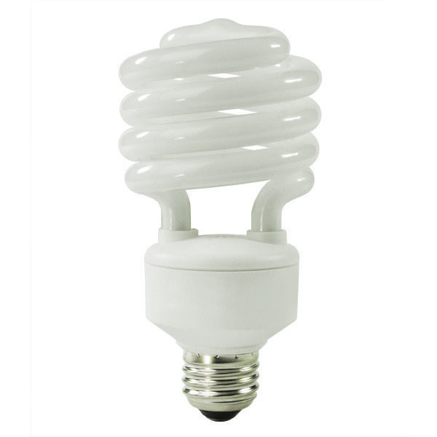
lighting
CFLs (Compact Fluorescent Lighting):
CFLs are a form of efficient lighting.
CFLs use 75-80% less energy than incandescent bulbs.
They are typically cheaper than LEDs, though they don’t last quite as long.
Come in all shapes, sizes, and color temperatures.
Don’t work as well in cold weather (need to heat up to full brightness).
Wear out quicker when turned on and off frequently.
Contain mercury gas, which must be disposed of properly when broken or at the end of lifespan (check with local recycling guidelines).

Slide 19
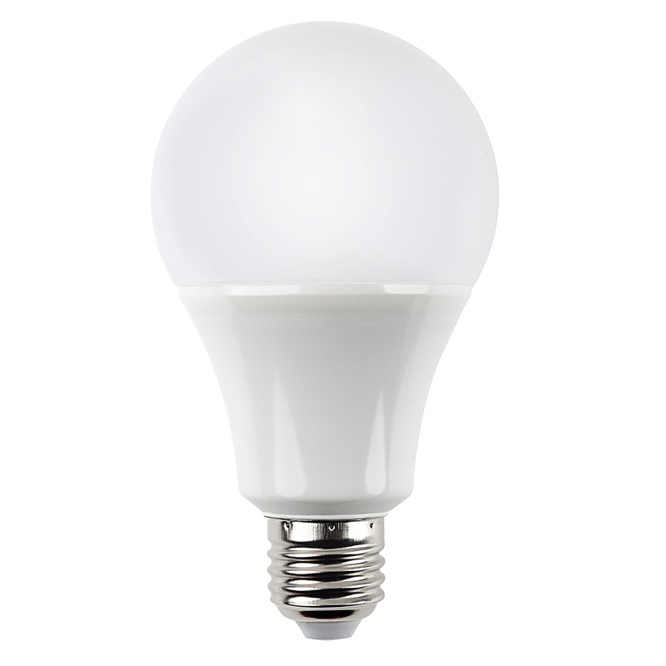
lighting
LEDs (Light Emitting Diode):
LEDs are the most efficient form of lighting on the market today.
LEDs produce little to no heat, meaning the majority of the energy they consume is given off as light (what we want!).
LEDs also last much longer (8-10 years under typical use) and come in all shapes and sizes.

Slide 20
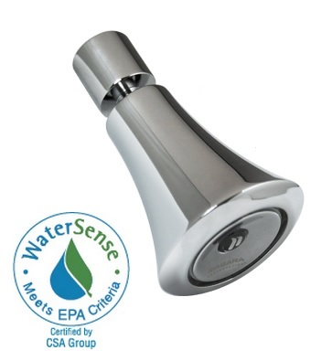
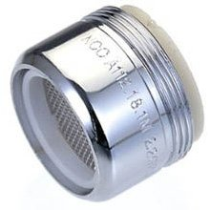
water
Quick, low cost installations:
Converting to low flow shower heads on average saves 1 gallon/minute/shower.
Sink aerators in the kitchen and bathroom reduce water flow while still maintaining pressure. They save on average 1 gallon/minute.

Slide 21
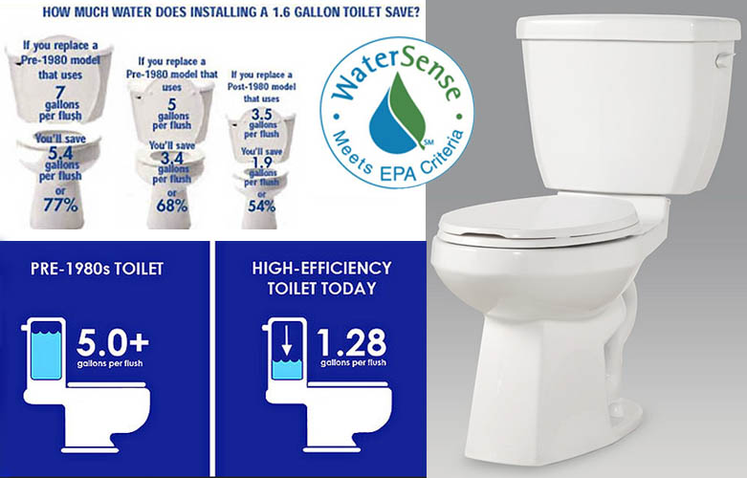
water
Efficient toilets use as little as 0.8 gallons per flush, though 1.28 gallons/flush is most common:
Converting a post-1992 toilet to an efficient toilet saves 1/3 -1/2 gallon per flush.
Converting from a pre-1992 toilet can save anywhere from 2.2-6 gallons per flush (depending on the age of the toilet).
Look for the WaterSense label to know you’re getting an efficient fixture.

Slide 22
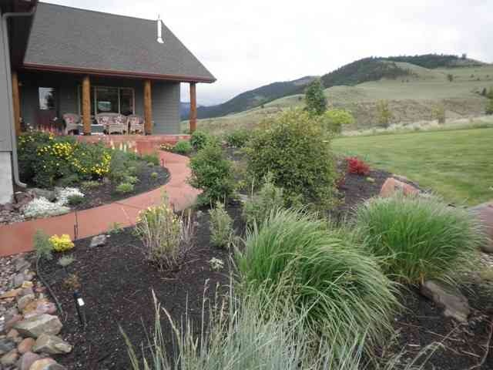
water
Consider xeriscaping your yard (less grass, more native plants that are suited to the environment, rocks).
Visit The Landscape Design Site to learn how.

Slide 23
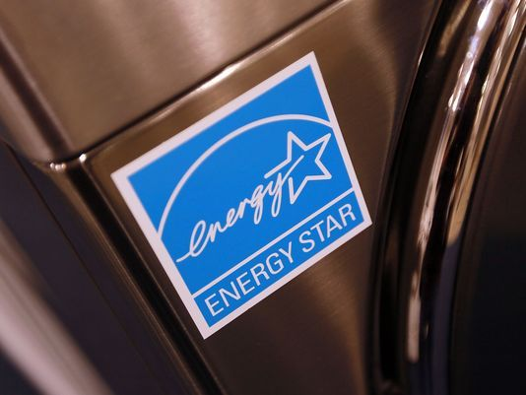
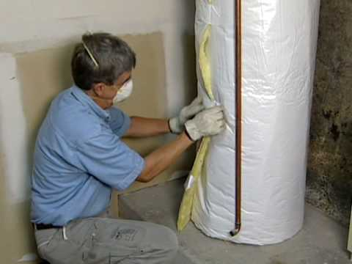
energy efficiency
Buy efficient appliances (Energy Star rated).
Insulate water heater and pipes (saves 7%-16% of energy bill/year).
Install a programmable thermostat.

Slide 24
Why are LED bulbs the most efficient?
pop quiz…
They generate little heat, so the majority of energy they consume is given off as just light.
They last longer.
They contain mercury gas which extends their life span.
Both A and B

Slide 25
What installations can be made in a home to reduce water use?
pop quiz…
Low-flow toilets
Low-flow showerheads
Sink aerators
All of the above

Slide 26
What combination represents the most energy efficient type of window?
pop quiz…
Single-pane window.
Double-pane window with low-e coating and a gas fill.
Double-pane window.
Double-pane window with low-e coating.

Slide 27
What is the term for a yard that utilizes native plants and rocks instead of typical grass?
pop quiz…
Desertiscaping
Xeriscaping
Rock gardening
Ungrassification

Slide 28
What device can you install in your house that controls temperature based on predetermined time settings?
pop quiz…
Programmable thermostat
HVAC
Thermometer
Ventilator

Slide 29
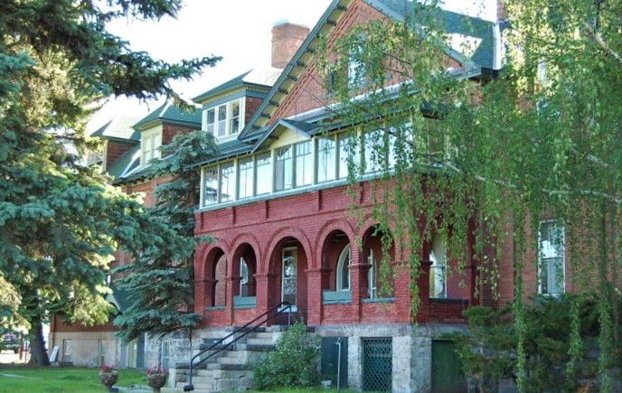
want to learn more?
contact:
name
position
name@ncat.org
(xxx) xxx-xxxx
Our headquarters is located at 3040 Continental Dr. Butte, MT

