Slide 1
introduction

Slide 2
what is energy?
Energy is the measure of the ability of a body or system to do work or produce a change.
The total amount of energy in the universe is fixed. Energy can neither be created nor destroyed.
However, the amount of energy available to do work decreases as it is transferred from step to step in a process. This is why using energy efficient methods is important!

Slide 3
pop quiz…
This presentation includes an interactive component using TurningPoint software. You will be asked a series of questions at the start of the presentation and again at the end to help us measure your change in knowledge. Questions are answered by using the remotes handed out.
Let’s do a practice question!

Slide 4
A group of ferrets is called a(n)…
pop quiz…
Fumble
Pack
Business
Enterprise

Slide 5
Have that report on my desk by noon, Bob.
You got it, Steve.

Slide 6
Food energy and systems

Slide 7
What is one way you can change your consumption patterns to reduce energy use?
pop quiz…
Buy more food.
Buy more animal products.
Only buy food that is on sale.
Buy more plant based, local, organic, and in-season food.

Slide 8
In what phase of the food system is the most energy spent?
pop quiz…
Production.
Processing.
Distribution.
Consumption.

Slide 9
You have the option to buy a tomato grown in location A, where it is tomato season, or in location B, where is not in season. Which tomato will require LESS energy to be grown?
pop quiz…
Location A.
Location B.
The energy use is the same.

Slide 10
What is a benefit of growing your own food?
pop quiz…
Reduces gasoline consumption.
Saves time spent preparing food.
Requires less packaging.
Both A and C.

Slide 11
Approximately how much produced food is wasted every year in the various steps of the food system?
pop quiz…
20%
25%
33%
50%

Slide 12
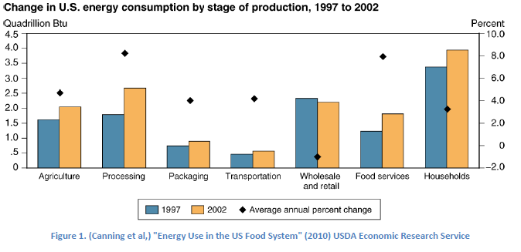
food energy breakdown

Slide 13
5 phases of the food systems

Slide 14
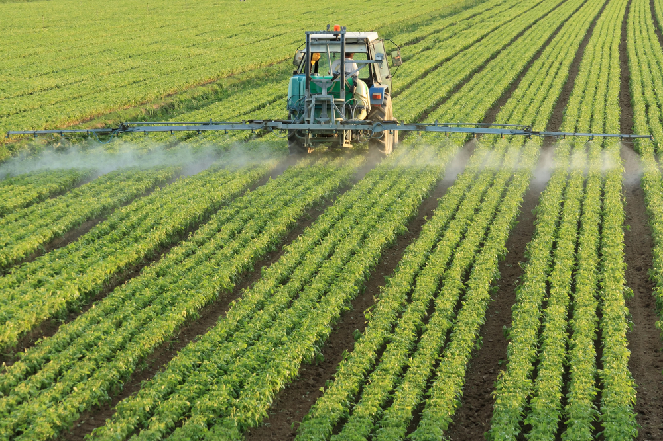
production
Involves the process of growing, raising, managing, and harvesting the raw materials that make up the various foods we eat.
Includes agriculture, livestock, and fish.

Slide 15
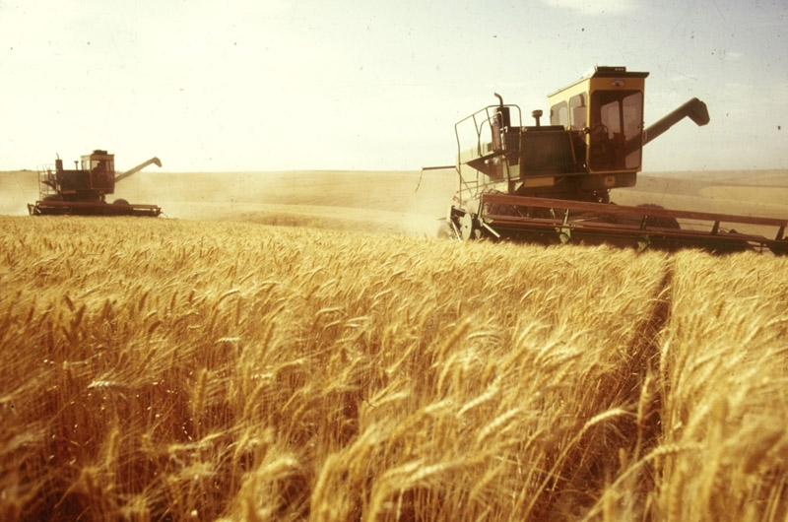
production
Energy inputs are necessary to all aspects of our food production system.
Agriculture relies on:
Water
Energy for irrigation equipment
Fuel for operating farming machinery
Fertilizers and pesticides

Slide 16
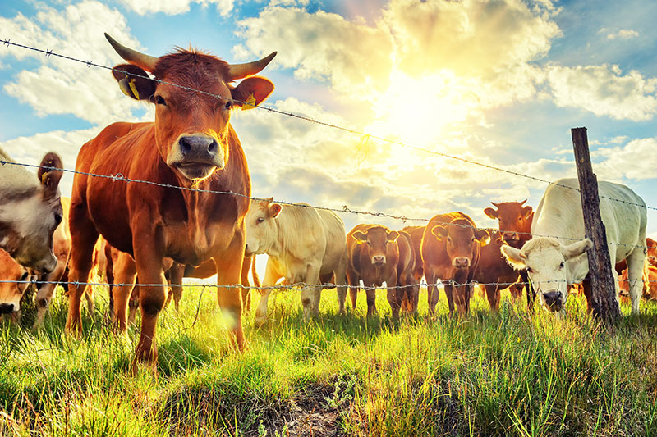
production
Livestock relies on:
Food and water via feed lots or open fields
Energy for lighting, heating, and equipment within processing plants
Fuel for operating livestock management machinery
We put nearly as much energy into producing food for livestock as we put into producing crops for ourselves!

Slide 17
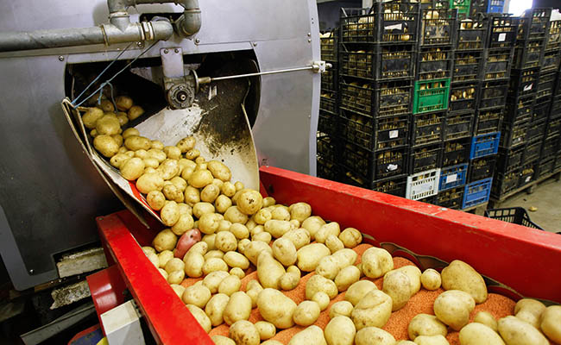
processing
Involves transporting goods from farm to processing and packaging plants, as well as the energy needed to turn raw goods into store products.
Some goods are processed on site and may not undergo transportation to a separate processing facility.
Processing can include cleaning, cutting, shaping, freezing, cooking, concentrating, and adding preservatives/additives to foods.

Slide 18
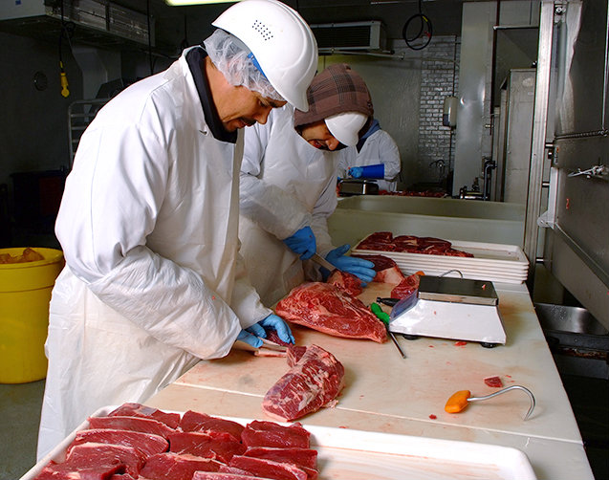
processing
Energy inputs involve:
Transportation to processing plants
Energy needed to operate processing and packaging machinery
Energy concentrated in processing stage:
30% - Beef, poultry, fish, and pork
Packaging only makes up 5% of this use
40% - Baked goods, cereals, processed fruits and veggies, condiments, and beverages
Packaging makes up 10-20% of this stage

Slide 19
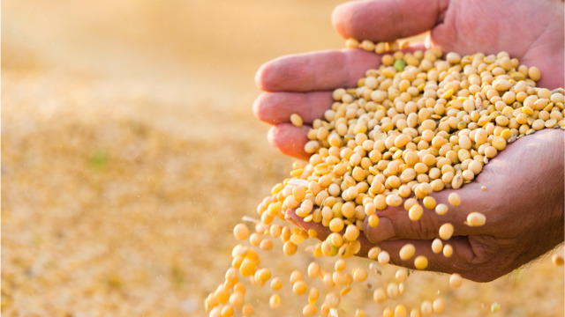
processing
Non-animal proteins (like soy products, tofu, etc.) are very energy intensive to process as well, meaning a vegetarian lifestyle is not necessarily less energy consumptive.
Being an energy conscious eater is more than just adopting a vegetarian, organic, or locavore lifestyle.
Considering the whole of the process of food system is essential in understanding your energy impact.

Slide 20
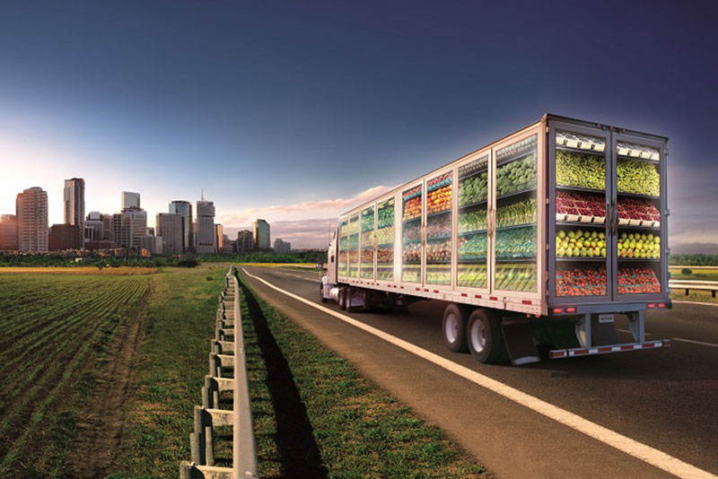
distribution
Involves transportation to stores and storage facilities where products will be sold, as well as energy costs for stores such as fridge and freezer cases, lighting, heating, etc.

Slide 21
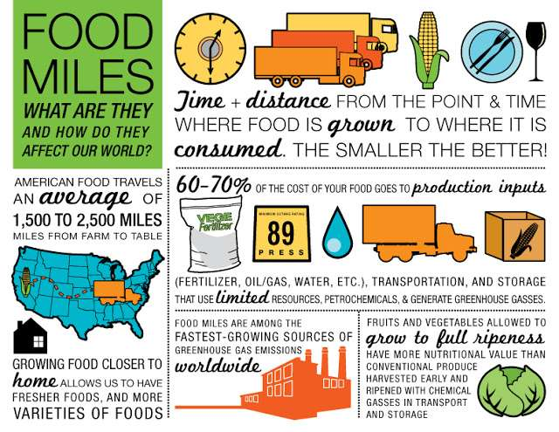
distribution
“Food miles” – how far a food has travelled before it arrives on our plates; can be affected by travel distance AND mode of transportation (i.e. more efficient transportation can use less energy than a shorter travel distance).
This is an important consideration in determining energy efficiency of foods.

Slide 22
consumption
Involves energy used driving to stores, running our fridges, freezers, stoves, microwaves, grills, and dishwashers. Also includes restaurant visits
This is the largest piece of the “food energy pie.”
The ring around the outside of the pie illustrates that waste occurs at every stage of the process.

Slide 23
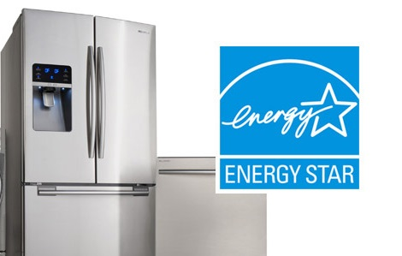
consumption
Important energy considerations include:
Purchasing choices (ex. animal products use more overall energy than plant products, and buying more food requires more storage and prep energy).
Food prep/storage appliances
Energy efficient appliances are essential

Slide 24
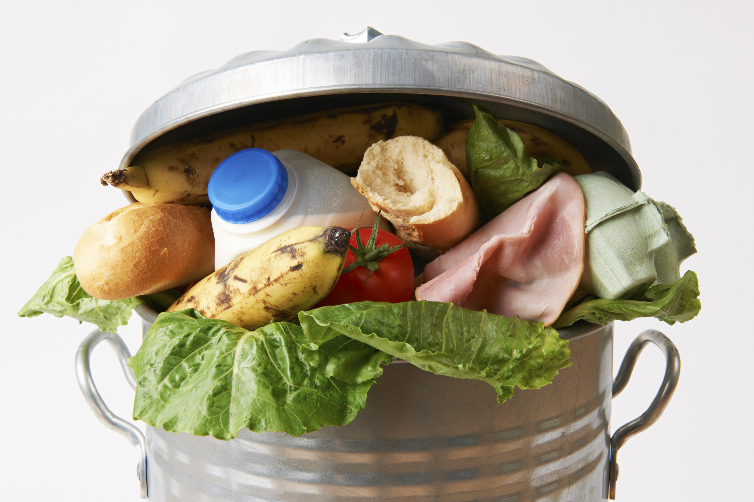
waste
Involves food spoiling before it can be consumed, which can occur during growing, transportation, at the store, or after purchase
Appx 33% of food grown is wasted every year! (FAO.org)
In more developed countries, most food is wasted by the consumer, whereas more food is wasted during the production and processing phases in developing countries

Slide 25
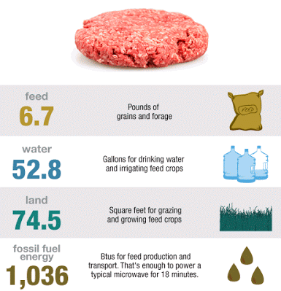
ways to reduce energy use!
Reduce consumption of energy intensive foods. This involves meat, poultry, seafood, foods with a lot of packaging or processing involved, and frozen goods

Slide 26
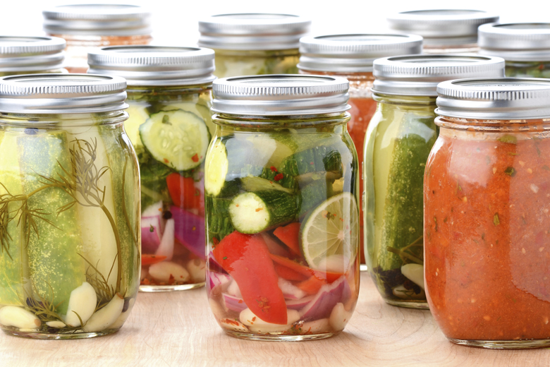
ways to reduce energy use!
Store, prepare, and use foods efficiently.
Buy energy efficient appliances.
Use or preserve food before it spoils.
Compost food scraps.

Slide 27
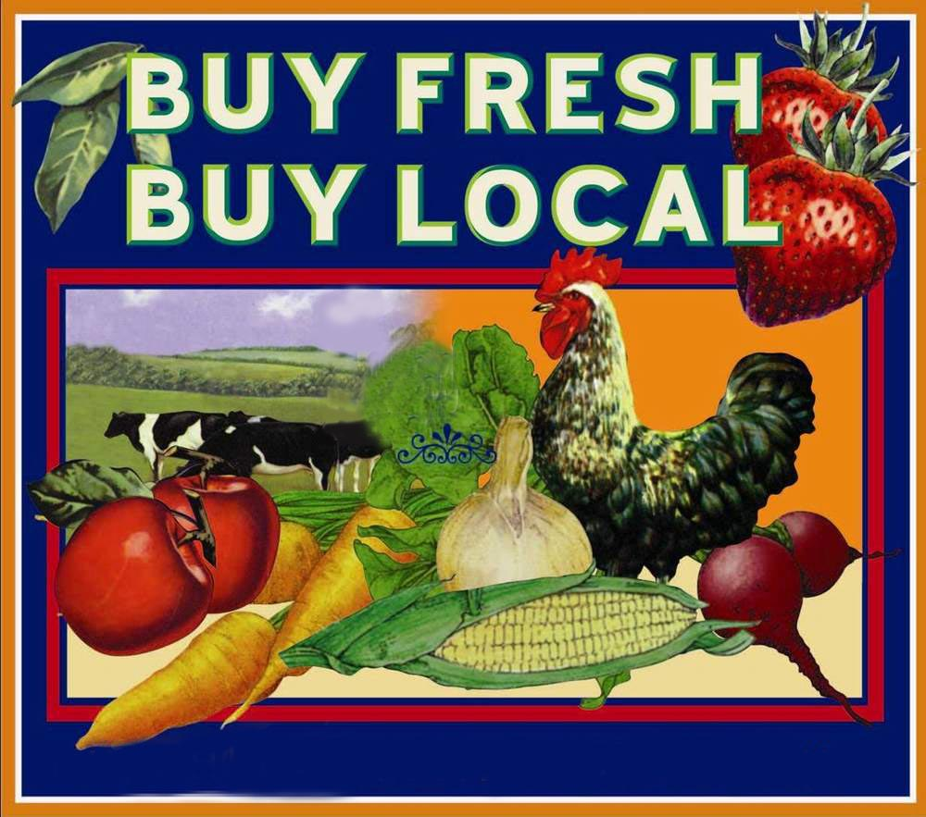
ways to reduce energy use!
Buy more food that is in season, local, or organic
Consider and compare energy consumption factors from growing something out of season vs. transporting something from far away
Look first for in-season food, then if it is locally grown, and lastly if it’s grown organically

Slide 28
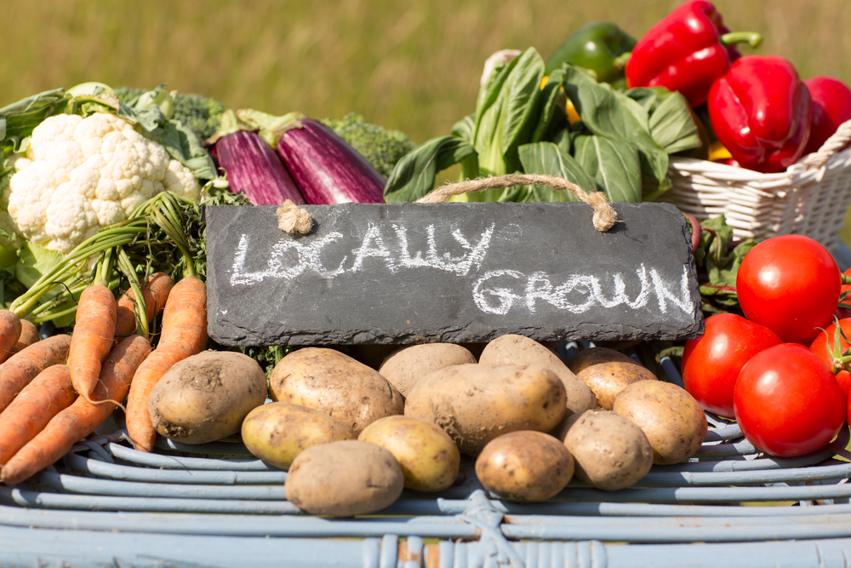
ways to reduce energy use!
While not all farms may be certified organic, many still utilize organic practices in growing their food. Do your own research into what practices different growers use.
Don’t be deterred by “less pretty food”. Large quantities of food are wasted simply because of minor blemishes, which have no effect on food quality.

Slide 29
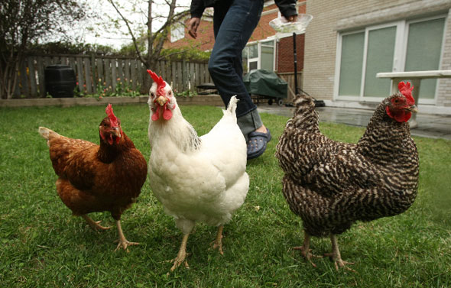
ways to reduce energy use!
Growing your own food allows you to control every aspect of the process, so you know exactly how it was grown, what was put in it, how it was processed, etc.
This can be as simple as a few herbs on your windowsill, backyard chickens, or a vegetable garden.

Slide 30
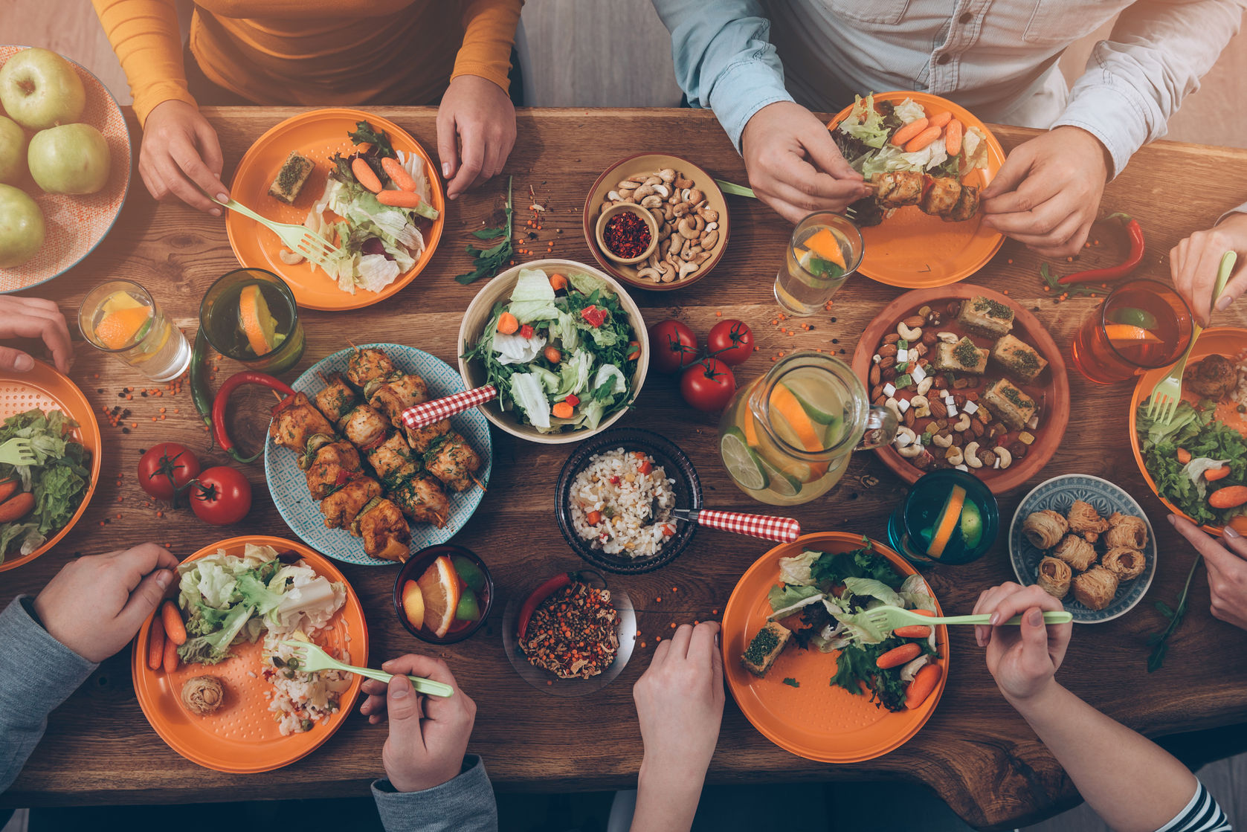
to summarize
The food process is intricate and involves many different factors. Educating yourself on how to be a conscious consumer is the best way to reduce your energy impact on the food system. Start small, don’t get discouraged if everything isn’t local or organic every time, and share your knowledge with friends and family! Together we can all do our part to create a more efficient, sustainable food system!

Slide 31
What is one way you can change your consumption patterns to reduce energy use?
pop quiz…
Buy more food.
Buy more animal products.
Only buy food that is on sale.
Buy more plant based, local, organic, and in-season food.

Slide 32
In what phase of the food system is the most energy spent?
pop quiz…
Production.
Processing.
Distribution.
Consumption.

Slide 33
You have the option to buy a tomato grown in location A, where it is tomato season, or in location B, where is not in season. Which tomato will require LESS energy to be grown?
pop quiz…
Location A.
Location B.
The energy use is the same.

Slide 34
What is a benefit of growing your own food?
pop quiz…
Reduces gasoline consumption.
Saves time spent preparing food.
Requires less packaging.
Both A and C.

Slide 35
Approximately how much produced food is wasted every year in the various steps of the food system?
pop quiz…
20%
25%
33%
50%

Slide 36
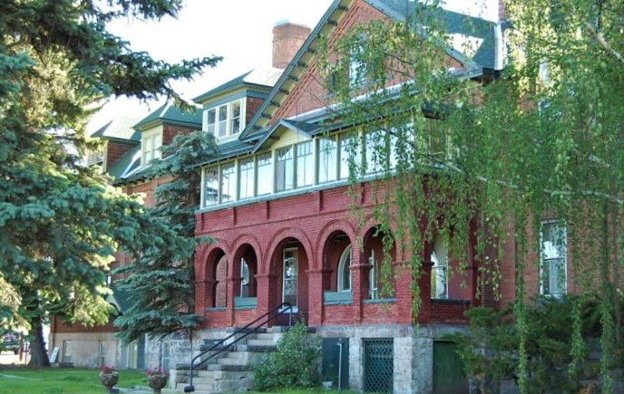
want to learn more?
contact:
name
position
name@ncat.org
(xxx) xxx-xxxx
Our headquarters is located at 3040 Continental Dr. Butte, MT

