Slide 1




introduction

Slide 2

what is energy?
Energy is the measure of the ability of a body or system to do work or produce a change.
The total amount of energy in the universe is fixed. Energy can neither be created nor destroyed.
However, the amount of energy available to do work decreases as it is transferred from step to step in a process. This is why using energy efficient methods is important!

Slide 3
pop quiz…
This presentation includes an interactive component using TurningPoint software. You will be asked a series of questions at the start of the presentation and again at the end to help us measure your change in knowledge. Questions are answered by using the remotes handed out.
Let’s do a practice question!

Slide 4
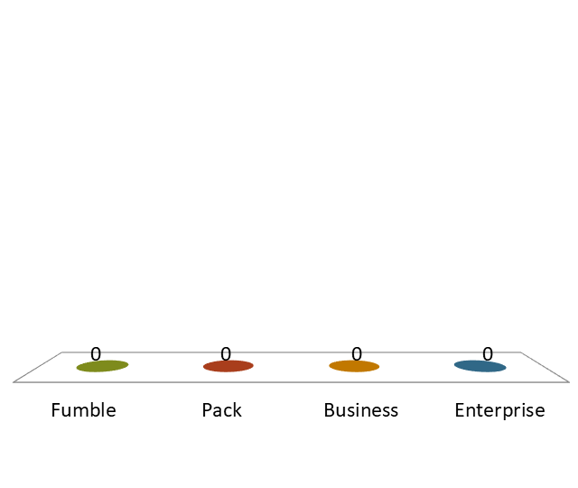
A group of ferrets is called a(n)…
pop quiz…
Fumble
Pack
Business
Enterprise

Slide 5
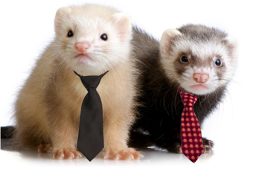
Have that report on my desk by noon, Bob.
You got it, Steve.

Slide 6


community sustainability
10 principles to implement in your community

Slide 7
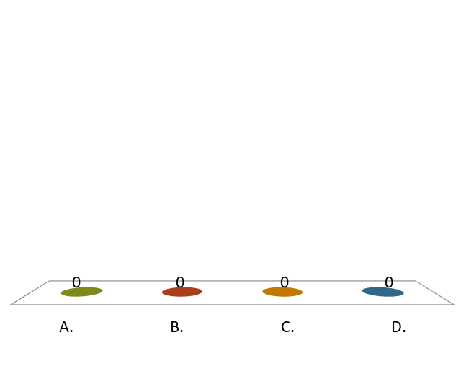
Which of these is an example of a community sustainability principle?
pop quiz…
Mixed land use.
Have a variety of transport options.
Focus development on new communities.
Resist community input in order to streamline development process.

Slide 8
Which of these is not a benefit of preserving natural spaces in cities?
pop quiz…
Decrease negative effects of storms and flooding.
Increase tourism.
Raise property values.
Reduce traffic.

Slide 9
Which is a benefit of compact design?
pop quiz…
Keeps homes close to jobs.
Raises costs for supplying energy, water, sewer services, etc.
Development of natural areas for more useful purposes.
Increases traffic.

Slide 10
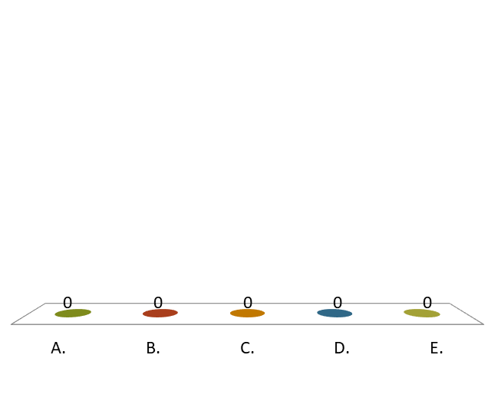
Which of these is a community sustainability principle that can be applied to BOTH rural and urban communities?
pop quiz…
Preserve natural spaces.
Build compact neighborhoods.
Encourage stakeholder and community involvement in decision making.
Provide a range of transportation options.
All the above.

Slide 11
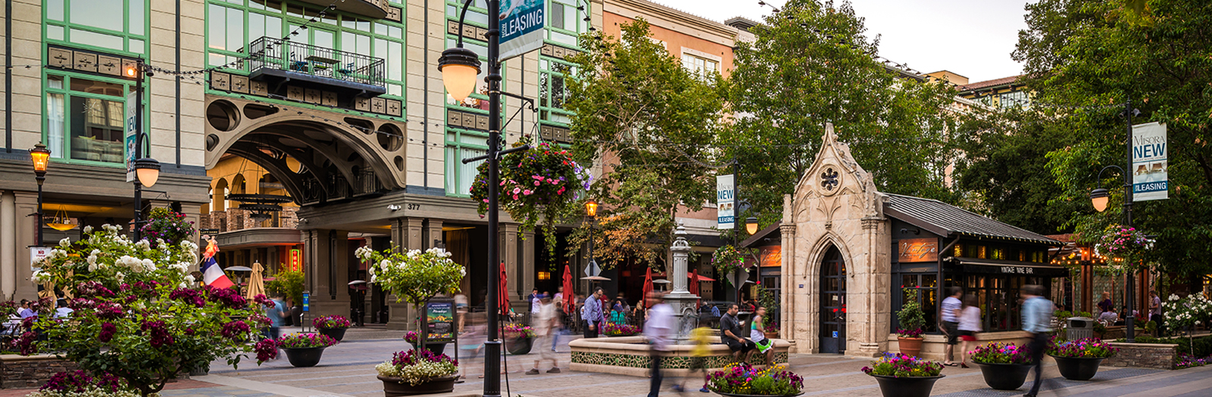
1. mixed land use
Santana Row in San Jose is a great example of a mixed-use neighborhood.
Involves planning to ensure that homes, shops, and recreation are located within close proximity to each other. This increases community sustainability by:
  Making it easier to combine trips.
  Makes mass transit more efficient.
  Creates a better quality of life for community members.

Slide 12
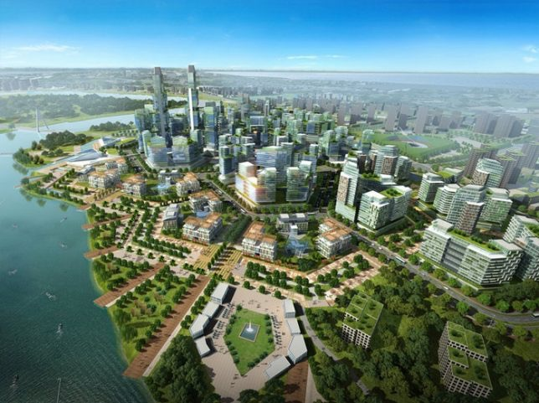
2. compact design
  Reducing the footprint of
  new construction:
    Preserves natural areas.
    Keeps homes close to jobs.
    Allows local governments to save money on water, sewer, electric, transportation, and
    other services.

Slide 13
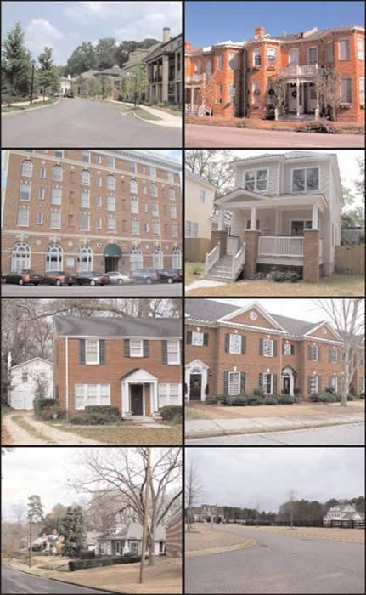
3. range of housing
  Providing a variety of housing options with different price points attracts diversity and encourages equitable distribution of households (as opposed to grouping income levels in the
  same areas).
  This concept helps promote inclusivity for all within the community.

Slide 14
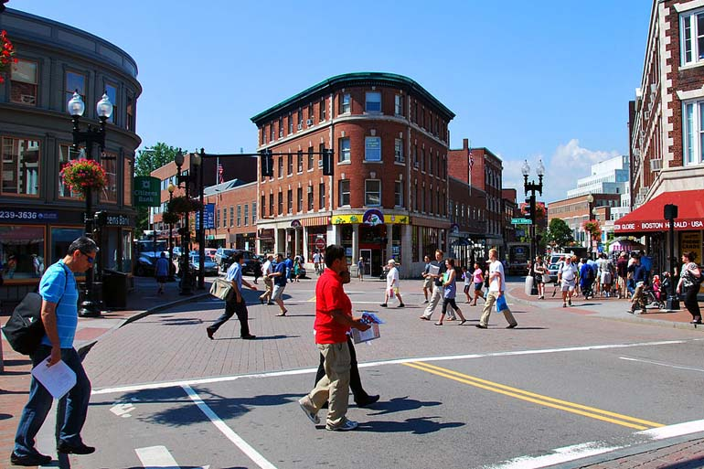
4. walkable areas
  Enhancing walkability within a community allows goods and servicing to be accessed via a safe, easy walk, which lessens the need for automotive transportation and associated transportation costs. It also enhances social life and benefits residents’ health.

Slide 15
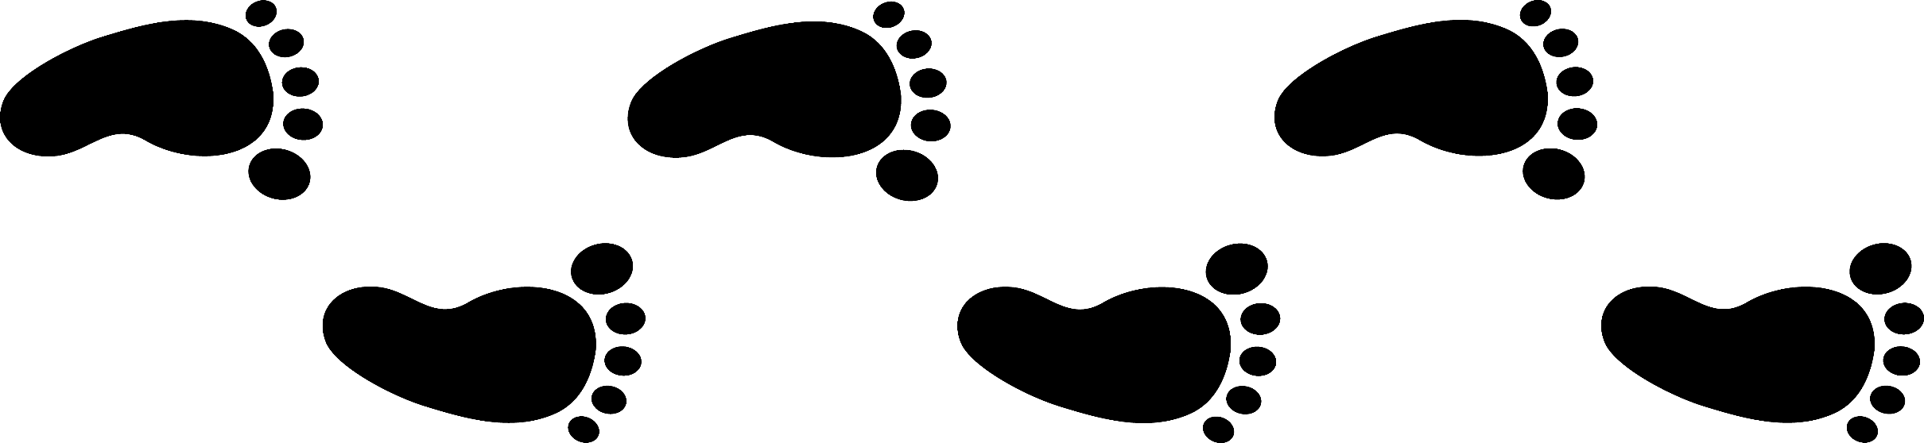
4. walkable areas
Most Walkable US Cities:
Washington D.C.
New York
Boston
San Francisco
Chicago
Source: NBC Nightly News

Slide 16
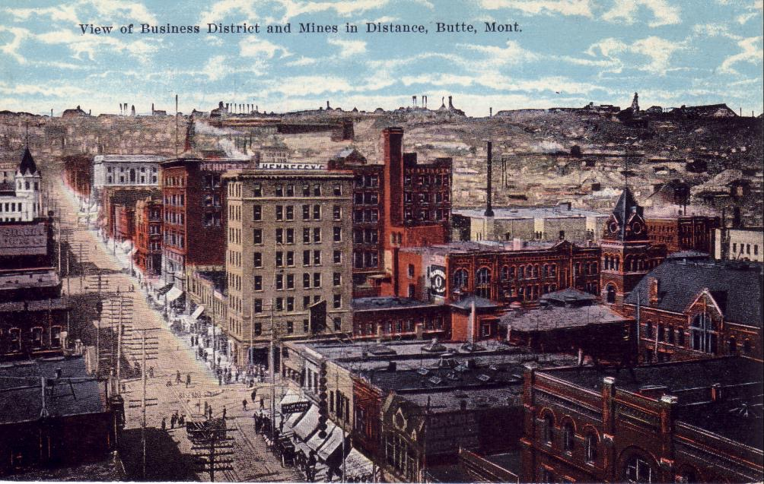
5. create a “sense of place”
  A sustainable community is a cohesive group with a strong identity, unique culture, and strong values. Having a sense of place enables residents to direct future goals toward preserving and bettering the unique qualities of their community.
The preservation of historic uptown Butte has led a unique community with a sense of shared history.

Slide 17
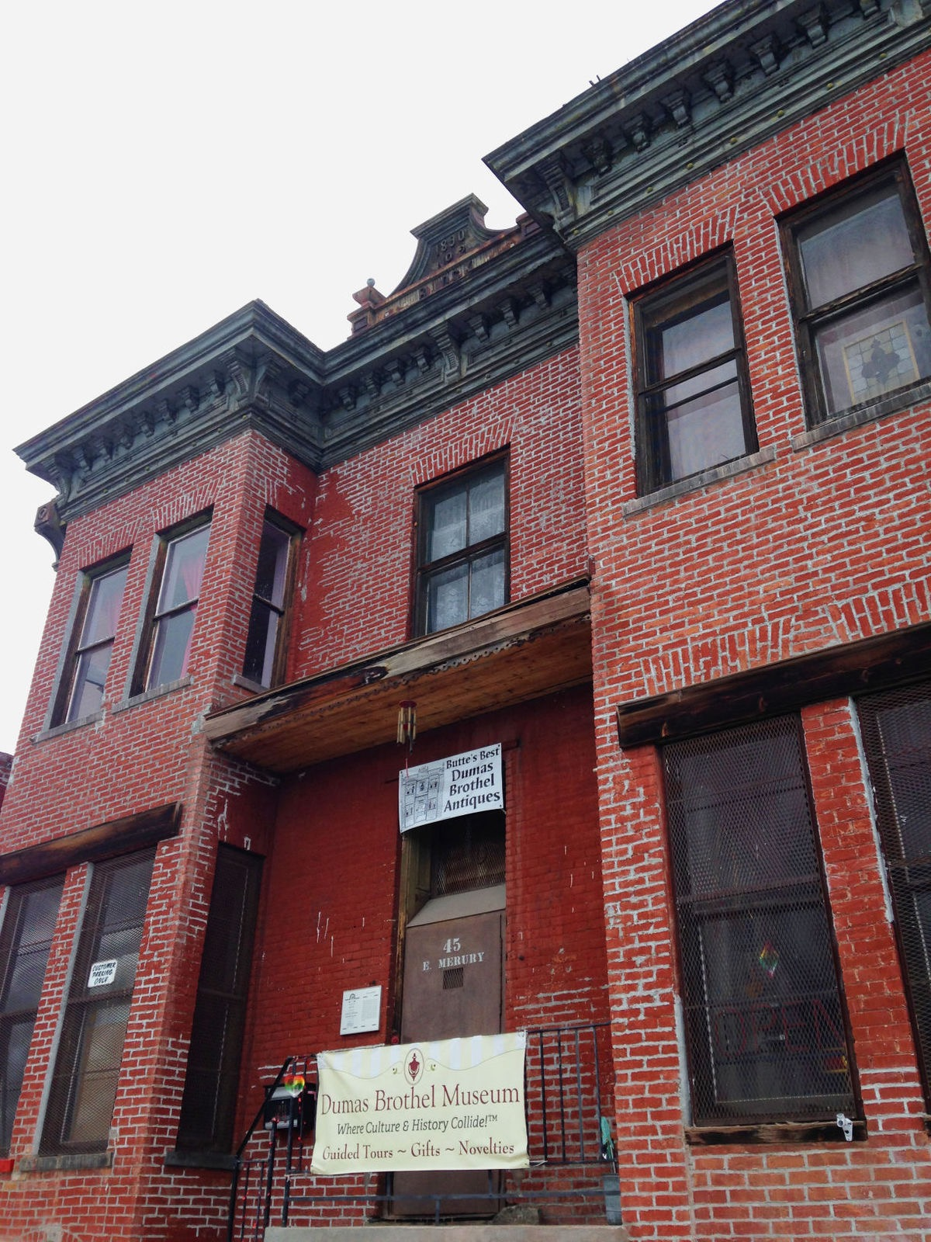
5. create a “sense of place”
  Butte Citizens for Prevention and Revitalization (Butte CPR) works to save historic structures like the Dumas Brothel, to preserve the town’s unique history.

Slide 18
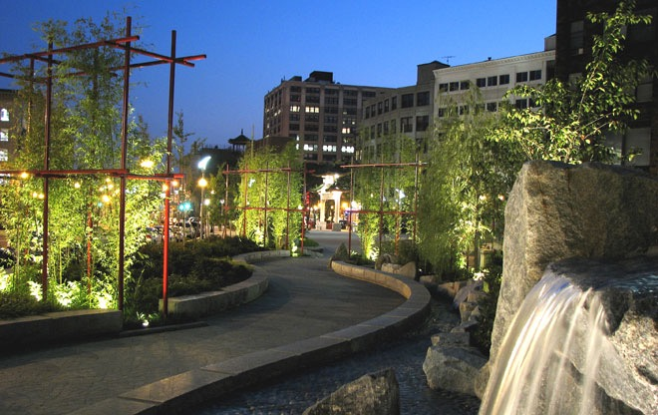
6. preserve open space
  Natural areas enhance quality of life through:
    Providing an easily accessible “escape” from town or city life.
    Mitigating potential floods and other natural disasters.
    Helping preserve environmental health by promoting clean air and water.
    Increasing economic prosperity through tourism and by increasing property values.
The Rose Kennedy Greenway is a linear park that stretches over a mile through several Downtown Boston neighborhoods. It features gardens, walking paths, sculpture parks, plazas, and more.

Slide 19
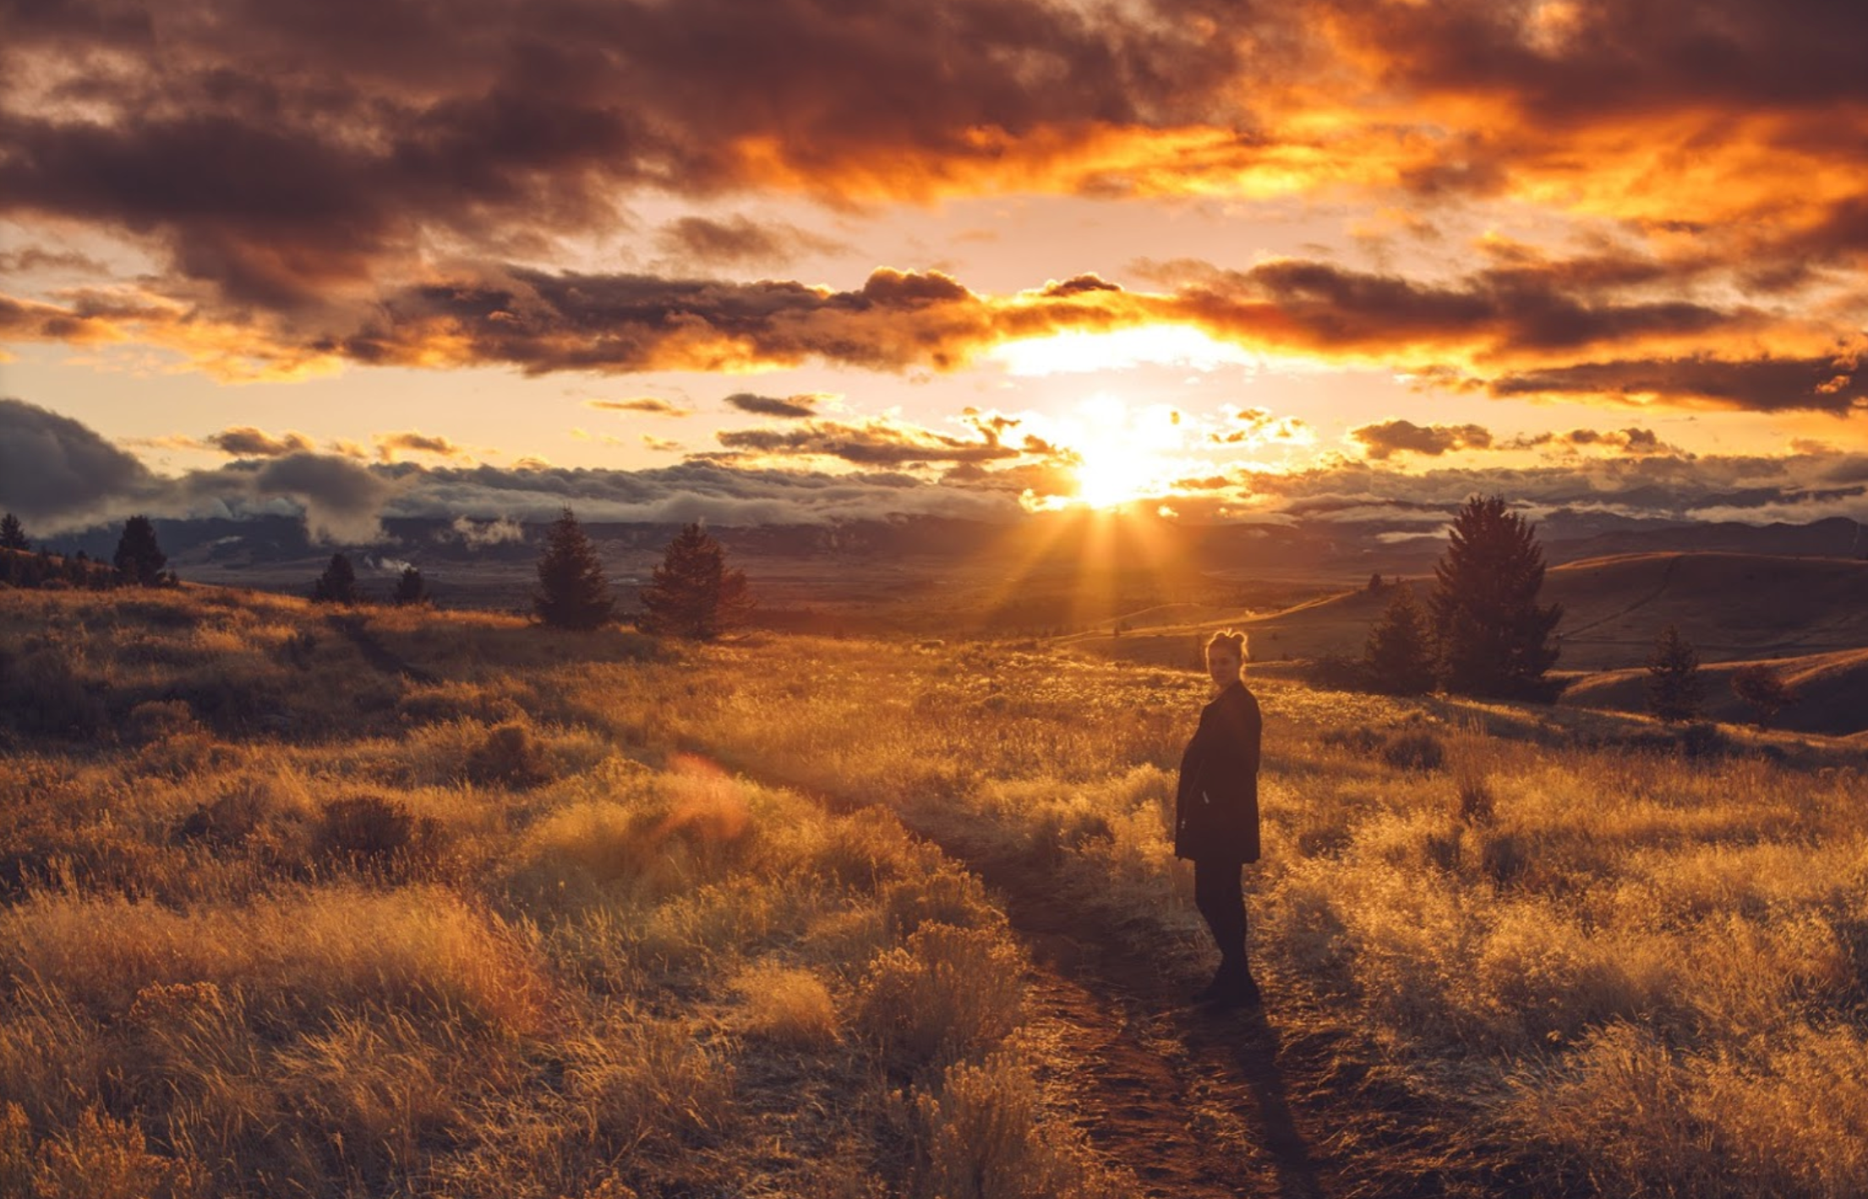
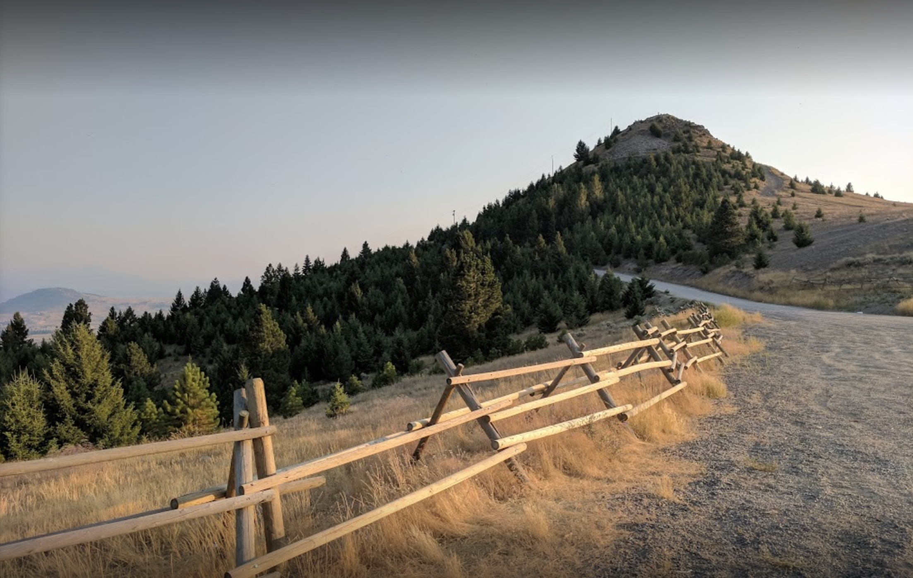
6. preserve open space
The Big Butte Open Space recreation area provides easy access to green space for locals looking to get outdoors.

Slide 20
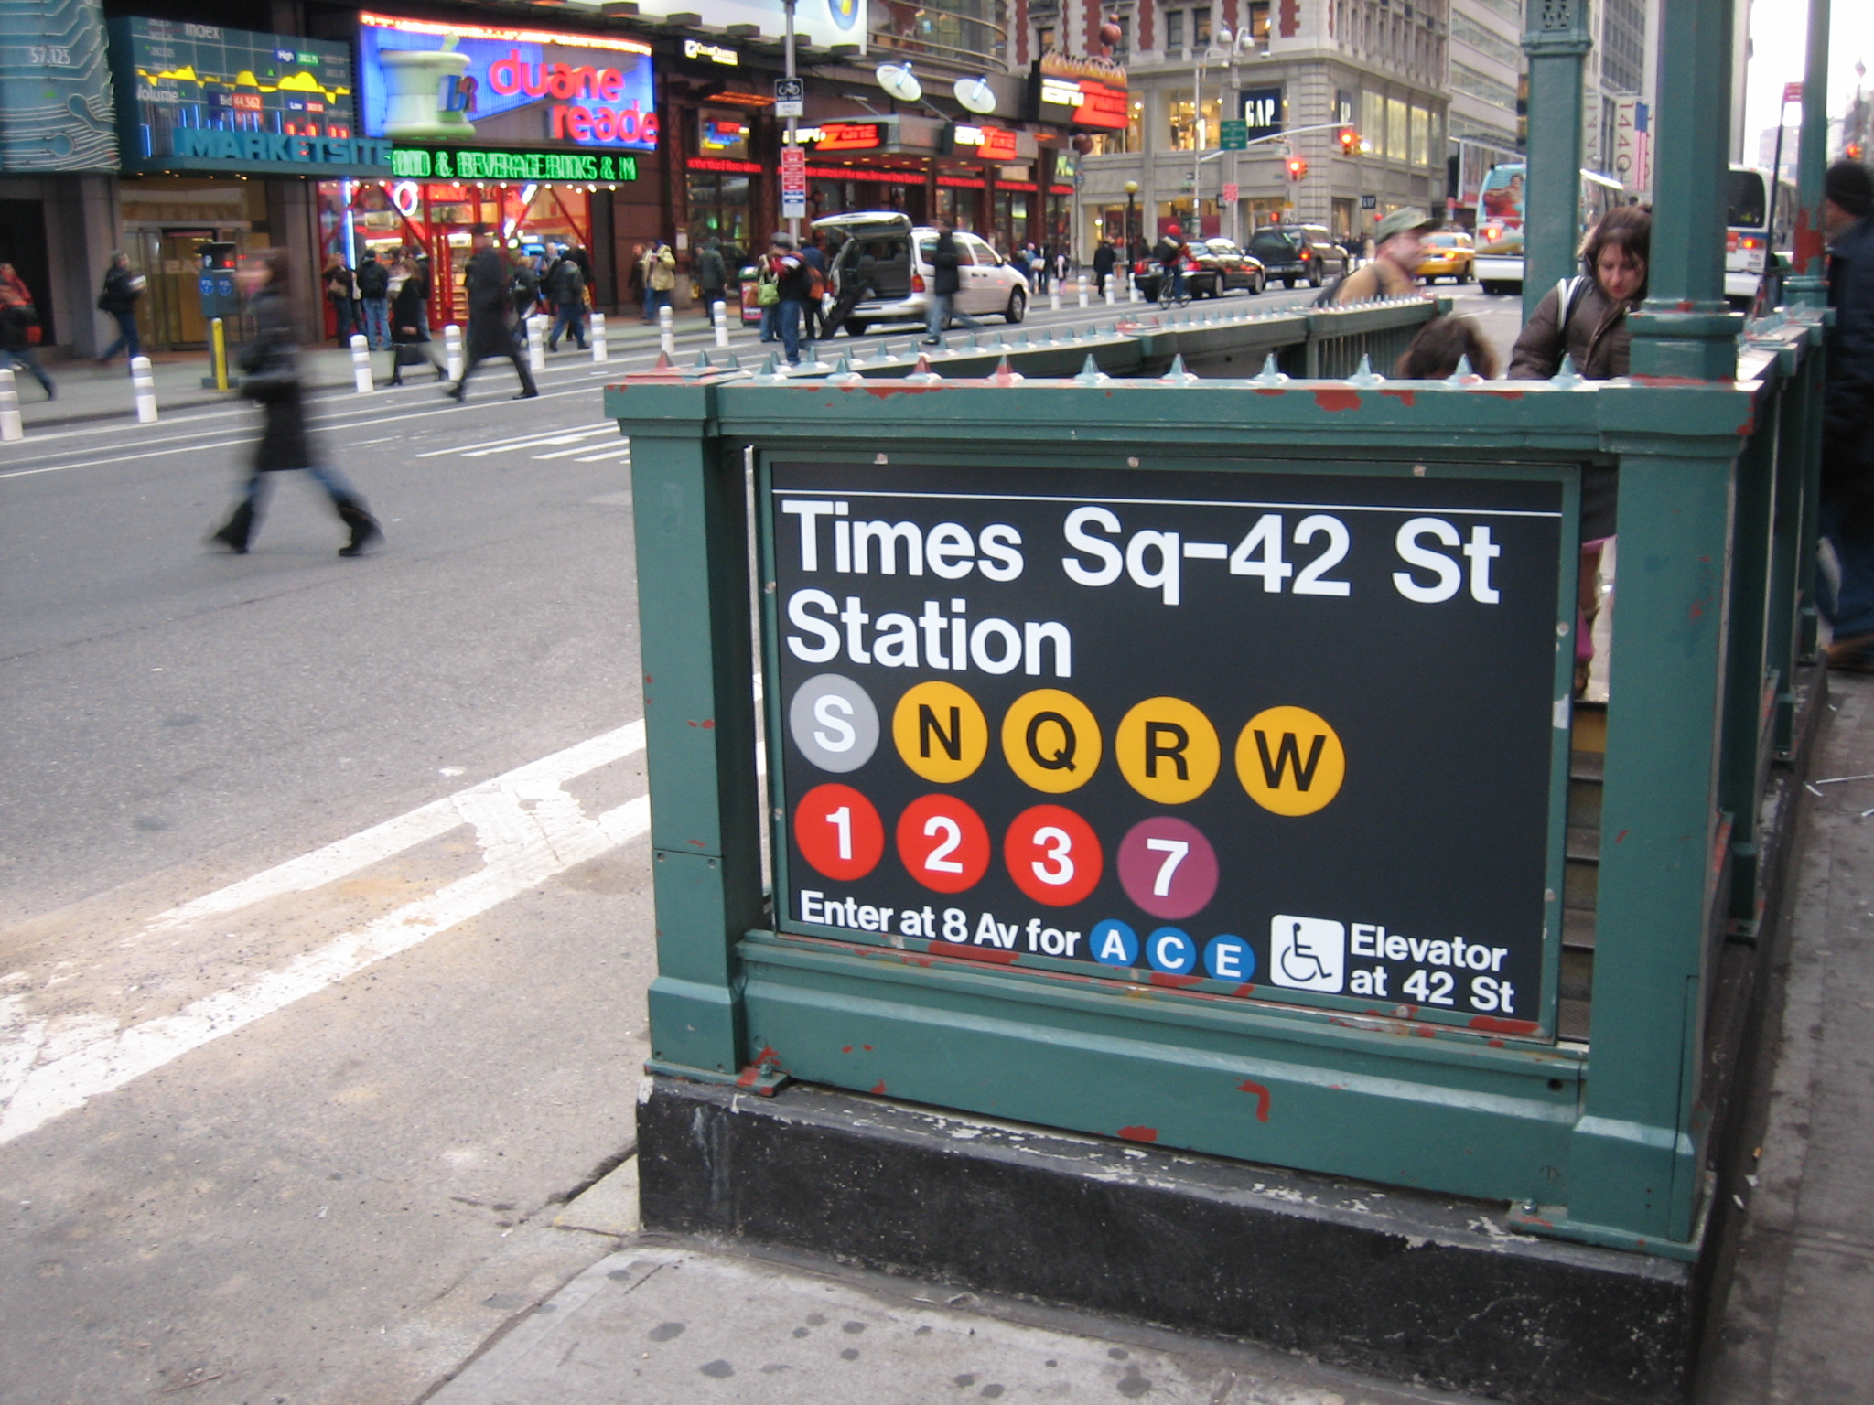
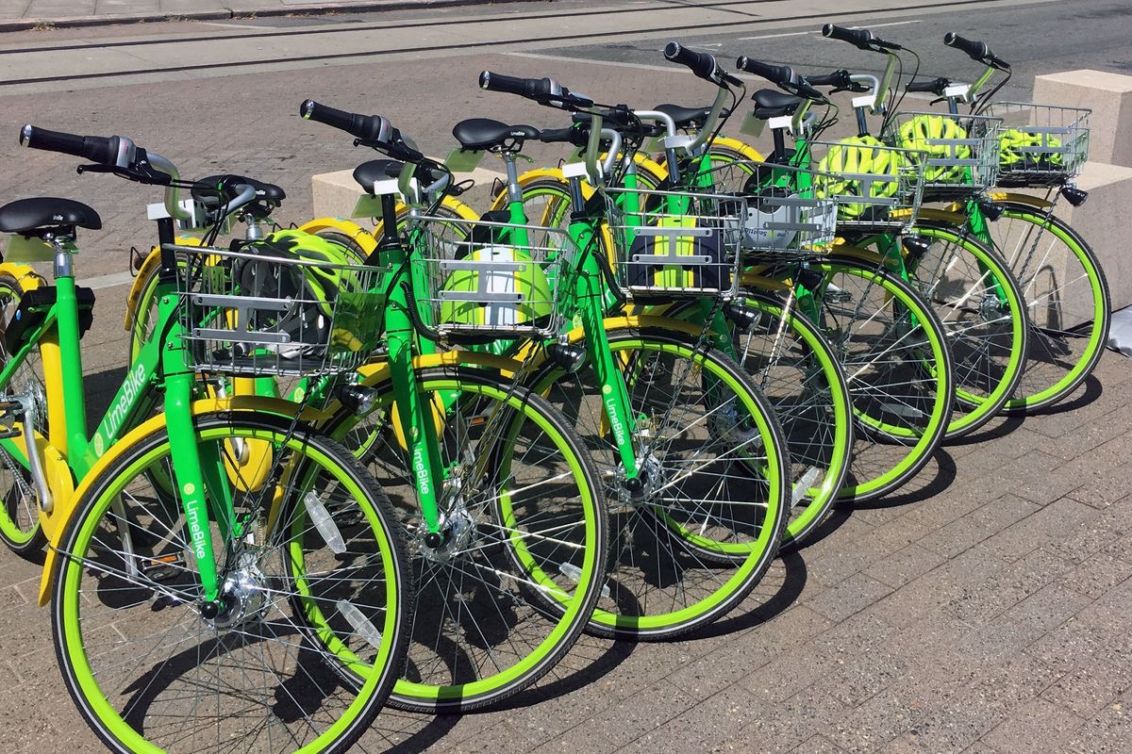
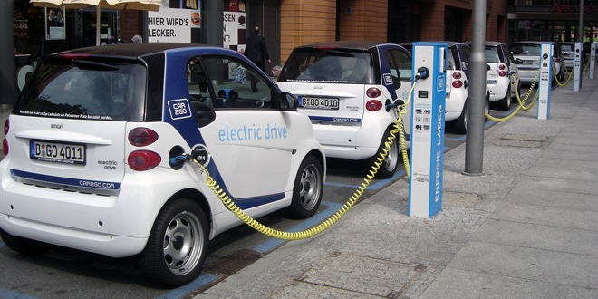
7. transport options
    When communities are not tied to cars, it removes barriers for those who can’t have or don’t want one. Plus, mass transit and self-powered transportation (walking, biking) decreases a community’s dependence on fossil fuels, reduces pollution, and alleviates traffic congestion.

Slide 21
8. predictable/fair development
    Governments at all levels have the ability to promote sustainability by ensuring development projects are affordable and attractive to private investors. This allows the community to continue developing and growing in a sustainable and equitable way.

Slide 22
9. encourage collaboration
  Having a collaborative development process in which everyone’s voice can be heard enables all demographics to have a say in community growth. Encouraging various perspectives also enhances stakeholder collaboration and can lead to a quicker resolution of issues.

Slide 23
10. strengthen direct development
  Directing new development in areas with preexisting infrastructure reduces the amount of resources and energy needed to build new developments. It also makes sure existing infrastructure isn’t going to waste.
  It also helps preserve a community’s natural areas by focusing development in the town center as opposed to on the fringe, where many of these natural areas are found.

Slide 24
Which of these is an example of a community sustainability principle?
pop quiz…
Mixed land use.
Have a variety of transport options.
Focus development on new communities.
Resist community input in order to streamline development process.

Slide 25
Which of these is not a benefit of preserving natural spaces in cities?
pop quiz…
Decrease negative effects of storms and flooding.
Increase tourism.
Raise property values.
Reduce traffic.

Slide 26
Which is a benefit of compact design?
pop quiz…
Keeps homes close to jobs.
Raises costs for supplying energy, water, sewer services, etc.
Development of natural areas for more useful purposes.
Increases traffic.

Slide 27
Which of these is a community sustainability principle that can be applied to BOTH rural and urban communities?
pop quiz…
Preserve natural spaces.
Build compact neighborhoods.
Encourage stakeholder and community involvement in decision making.
Provide a range of transportation options.
All the above.

Slide 28
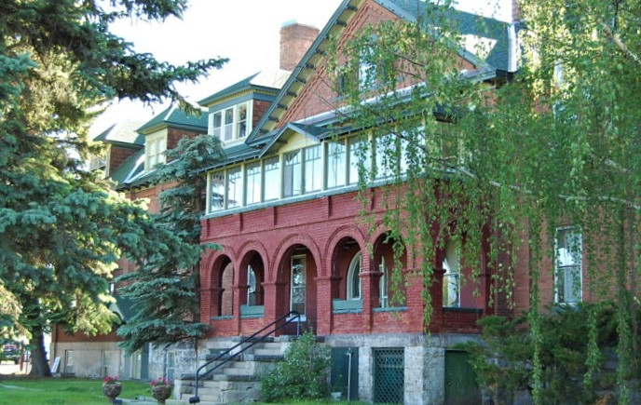
want to learn more?
contact:
name
title
email
(xxx)xxx-xxxx
Our headquarters is located at 3040 Continental Dr. Butte, MT

