Slide 1
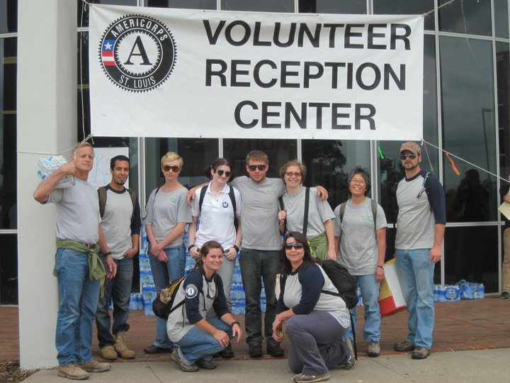
Seeing the change we work for: Energy Corps Performance Measures
March 1, 2012

Slide 2
By the end of this webinar, you should know:
What the performance measures are
How to go about measuring changes in learning and maybe action
What resources at your disposal to measure change in learning and action
How to create a path where none exists!

Slide 3
Energy Corps Community Service Performance Measures
1000 people will receive hands-on energy assistance from Energy Corps members’ projects. 80% of those beneficiaries of that assistance report that the service was of high quality.
4000 students and youth receive energy education or training; 3500 of them demonstrate basic knowledge of key energy concepts.
Energy Corps members will receive 50 hours of green jobs training over the course of their service terms.

Slide 4
What are we aiming for?
Youth and adults learn to reduce energy consumption, reduce carbon footprint, increase home comfort…
Change in….
Learning (KSAs)
Action (Behavior)
Conditions (Environmental, economic, social, institutional)

Slide 5
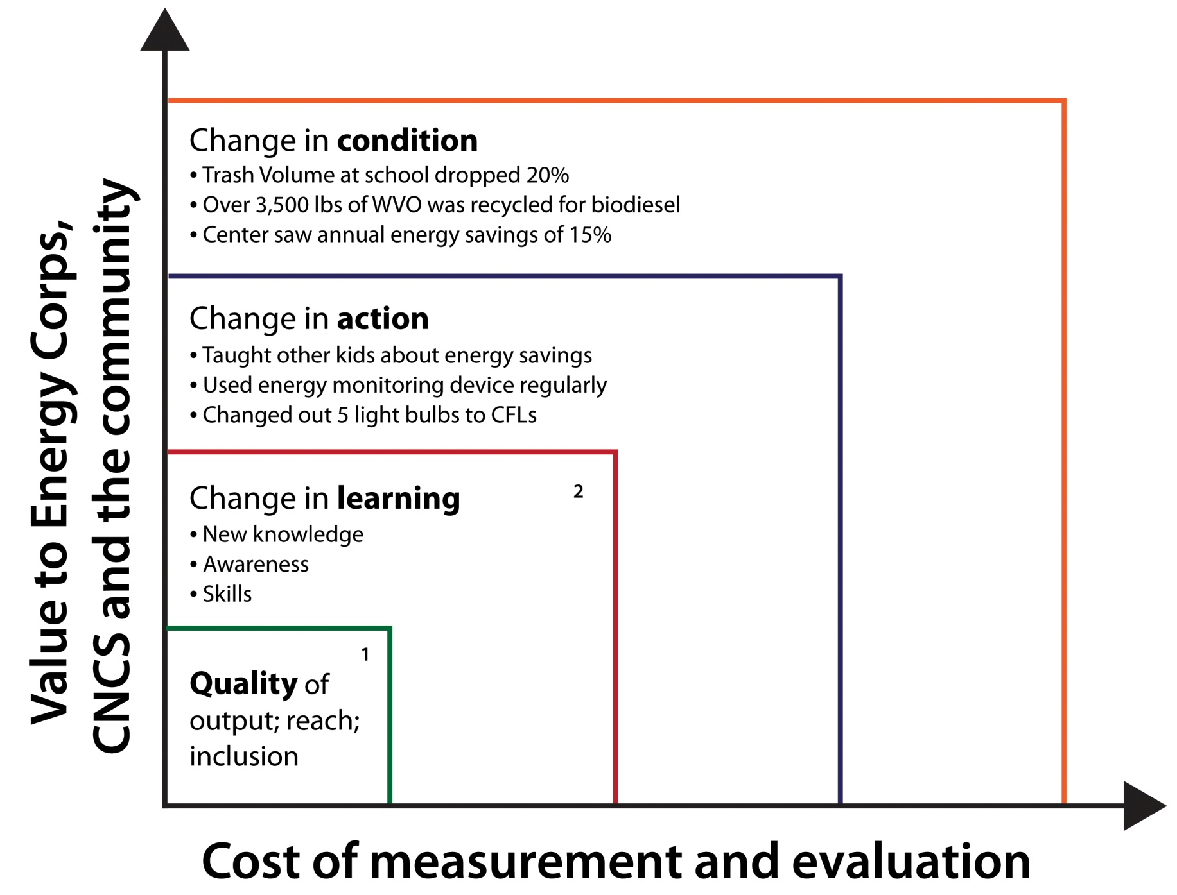

Slide 6
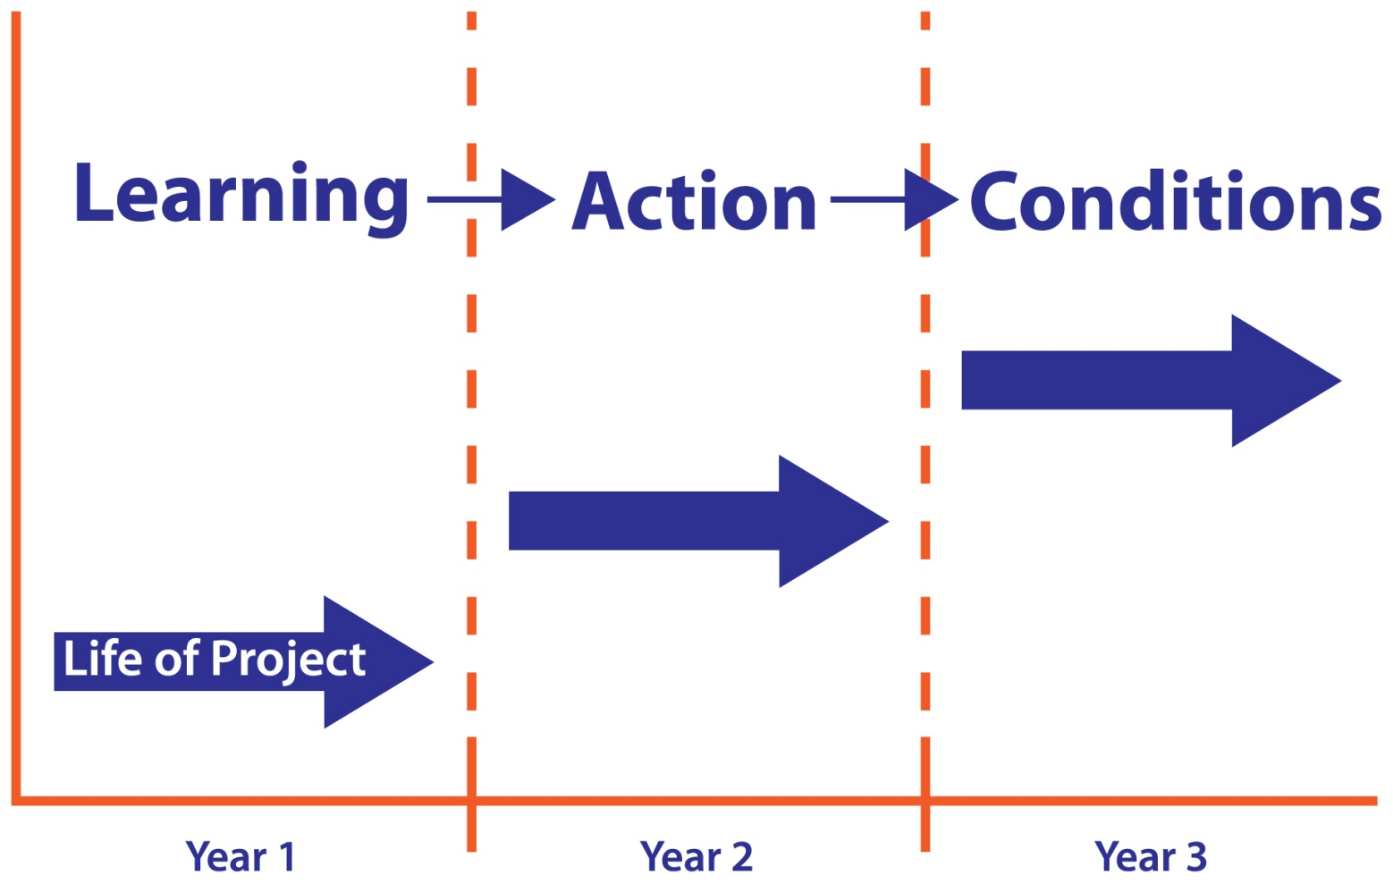
So little time, so much to do

Slide 7
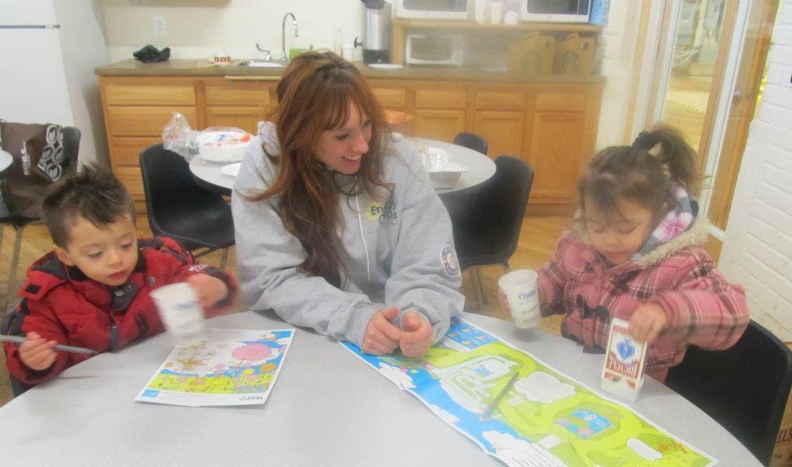
Time, tools and money
What will you measure?
Using what tools and processes?
What will it cost?
Who will do the work?
At what time intervals?

Slide 8
More to keep in mind
Tools: Does your host site have them? If not, go to Member Resources page of the Energy Corps website.
Process: K-12 and Youth education – collaborate with teacher or organizer of youth education event to create the test/exam or get access to data.
Measure after the event, at 6 months or end of project.
Other evidence: Keep a “paper trail” of participants – service recipients contact database

Slide 9
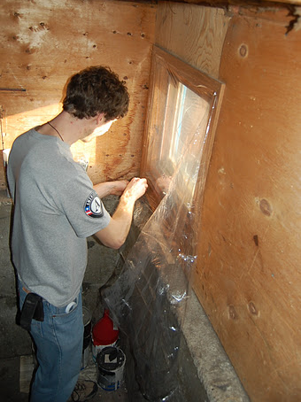
Barriers to getting good data
Time! Too much on my plate!!
Access to client information is restricted
Educational event doesn’t lend itself to getting feedback
Resistance on the part of host organization or other partners
Others?

Slide 10
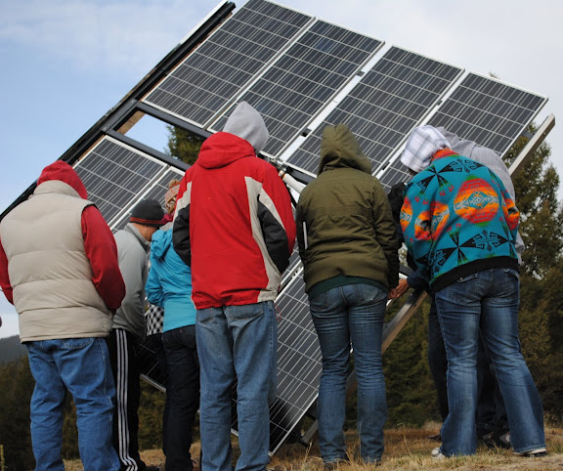
Overcoming Barriers
Talk to project partner and host
site supervisor
Use member resources on the website
Contact state EC coordinator, Al Kurki or Holly Hill
Don’t be silent

Slide 11
Jordan Scheibel
Host site
Imagine Grinnell
Grinnell, Iowa
Founded in 1985 as Grinnell 2000
Our mission is to:
improve the quality of life for our people
promote a healthy environment
complement economic development efforts
Use non-profit status and the strength of the Grinnell community to harness donations, grants, and volunteers for a wide variety of community projects
Example projects:
Grinnell Farmers Market
Curbside recycling and E-waste recycling
Grinnell Area Recreation Trail
E-Community project
Position
Environmental Program Coordinator
Part-time, 2nd term
Initiate and maintain community based programs related to sustainability and environmental awareness
Develop partnerships and collaborations with individuals, community organizations, and businesses
Write grants, fundraise for programs, and manage program budgets
Work directly with executive director and college apprentice
Lead monthly meetings of Environmental Committee and report to Imagine Grinnell’s board of directors

Slide 12
Projects
Green Home Showcase
Sun 4 Schools grant for Grinnell Middle School
Energy Awareness Workshops
Green Energy Showcase
Municipal rain barrel sale
Grinnell Community Garden
Single-stream recycling

Slide 13
Energy Awareness Workshops
Gave 10 workshops to small community groups (avg. size ~ 10) from January through June 2011
Focus on home energy literacy – where energy comes from, how it is used, how it is wasted, and how to cut down on waste
Used “home energy audit toolkits” from public library as a demonstration
Ended with overview of utility and government incentives for energy efficiency and renewable energy

Slide 14
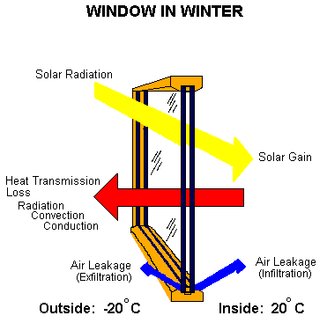
Two ways to lose or gain heat
Air infiltration
Air leaking in and out of envelope
Inadequate insulation
Heat lost or gained through envelope

Slide 15
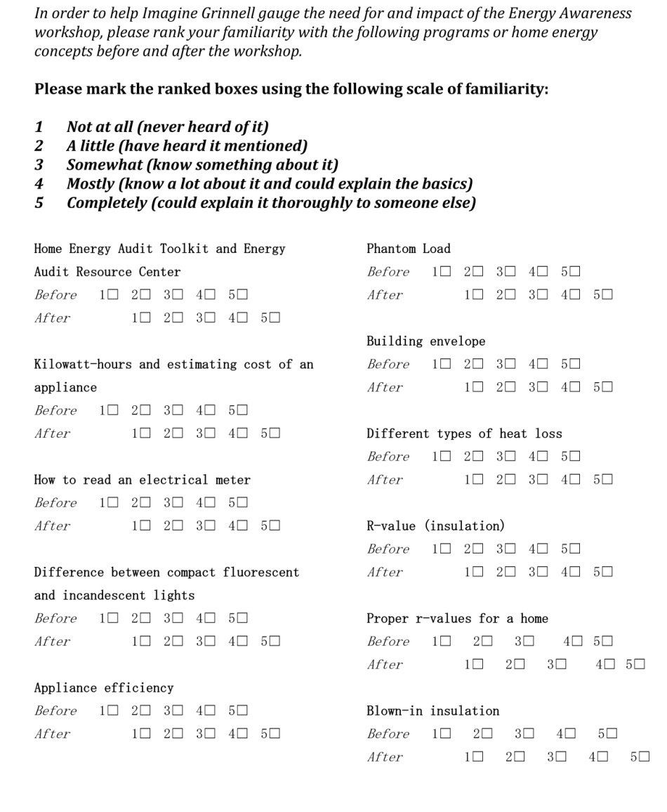
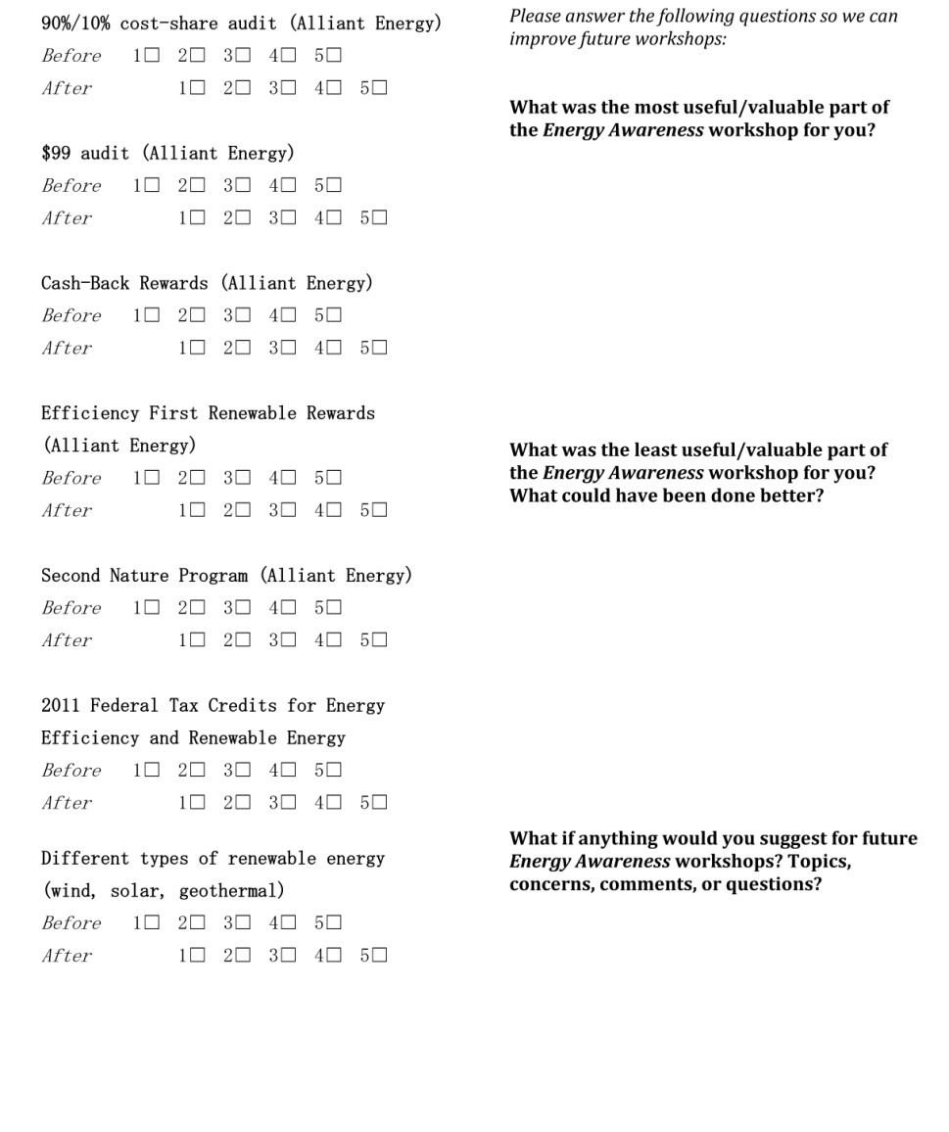
Imagine Grinnell Energy Awareness Workshop

Slide 16
WIPP Mail Follow Up Survey

Slide 17
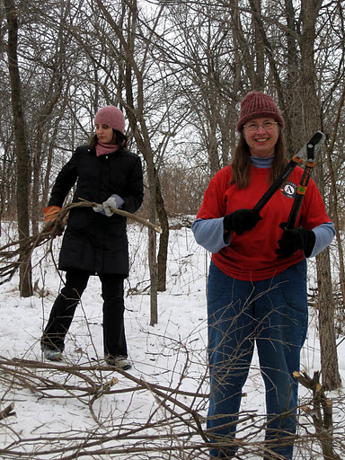
Feedback and Your Questions
About performance measurement in general?
How it might apply at your host site or project?
What level of support on this topic would be helpful for you to get started?

Slide 18
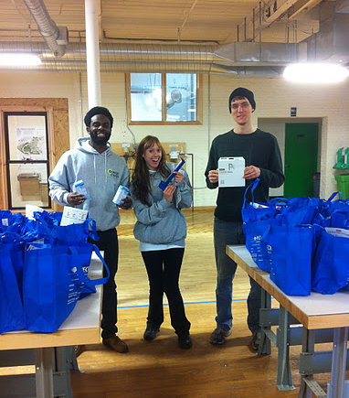
Last Words
Measure results when and where you can, not just activities, products or audience
What’s reasonable to measure in a project’s life span? Keep it simple
There are resources at your disposal

Slide 19
Thanks! Al Kurki (akurki@ncat.org) 406-449-0104
(Photos Courtesy of Energy Corps members and Ron Daines)

